Slide 1



Natural Language Processing (NLP)
Word embeddings, 1D CNN, LSTM and Transformers
Zaur Gouliev｜ 12-01-2025
PhD Student, University College Dublin zaur.gouliev@ucdconnect.ie
Notes:
Welcome, everyone! This first slide is our title slide for the lecture. It introduces the topic and the presenter. On screen, you see the title “Natural Language Processing (NLP): Word embeddings, 1D CNN, LSTM and Transformers.” Below the title is my name, Zaur Gouliev, with the date and my affiliation (PhD Student at University College Dublin). This sets the stage for our session.
• Title & Topic: Natural Language Processing (NLP) – We’ll be exploring core NLP techniques: word embeddings, 1D Convolutional Neural Networks (CNNs), LSTMs (Long Short-Term Memory networks), and Transformers.
• Presenter Introduction: I’m Zaur Gouliev, and I’ll be guiding you through these concepts. My contact info (email and LinkedIn) is shown for any follow-up questions.
• Context: This is a Master’s level lecture, aimed at those new to machine learning. Don’t worry if these terms (like CNN, LSTM, etc.) sound unfamiliar – we’ll break each of them down step by step in this talk.
• Expectations: By the end of this lecture, you should have a high-level understanding of how modern NLP models represent text (with embeddings) and how various neural network architectures (CNNs, LSTMs, Transformers) process language.
So, that’s the overview. Let’s dive in and start with the basics, building up from simple concepts to the more advanced Transformer models.

Slide 2
Acknowledgements
ZAUR GOULIEV
PhD Student, University College Dublin
-------------------------------------------------------------
http://zaurgouliev.com
Third party sources: cited per item in slides.
Notes:
This slide is an Acknowledgements page. Here, I acknowledge contributions and sources for the lecture content. At the top, you see the heading “Acknowledgements”. My name and role are listed again (Zaur Gouliev, PhD student at UCD), along with a link to my website and a note about third-party sources.
• Acknowledging Sources: I’d like to credit any external materials and inspirations used in these slides. The note “Third party sources: cited per item in slides.” means that throughout the presentation, where I’ve used diagrams or definitions from others, I’ve cited them on the slides. While I won’t verbally list every source here, know that this lecture is built atop the knowledge of many researchers and practitioners in NLP.
• Personal Thanks: I also want to thank colleagues and mentors who have contributed ideas to this lecture. Although not explicitly listed on the slide, it’s customary to recognize that any educational content stands on the shoulders of prior work.
• Website Reference: zaurgouliev.com is shown, which is my personal site. Feel free to visit it if you’re curious about my research interests or other work.
In short, this slide is just to give credit where it’s due and to be transparent about the material’s origins. Now, having acknowledged these contributions, let’s look at what we’ll be covering today.

Slide 3


00
01
02
03
Introduction
Data Processing / Context
LSTMs
Transformers
Words
Challenges
One-Hot-Encoding
Tokenising
Context
Word Embeddings
DANN and CNN
sentiment
LSTMs sentiment
LSTMs spam
LSTMs for other taksks
Introduction to LLMS
Transformers
BERT
GPT
Notes:
Here we have the outline of the presentation, an agenda so you know what’s coming. This slide lists the main sections of our lecture. It’s divided into four parts: Introduction (section 00), Data Processing/Context (section 01), LSTMs (section 02), and Transformers (section 03). Each section has bullet points of topics we’ll cover.
• Introduction (00): In the introduction, we’ll discuss fundamental concepts: what words are in the context of NLP, the challenges they present for machine learning, and simple encoding methods like one-hot encoding. Essentially, this sets the stage by highlighting why we need specialized techniques for language.
• Data Processing / Context (01): This section will cover how we prepare text data and give it context. Key topics include tokenizing (breaking text into tokens/numbers) and word embeddings (turning words into vectors that carry semantic meaning). We’ll explore early embedding models like Word2Vec and how we feed these into neural networks.
• LSTMs (02): In section 02, we move to sequence models. We’ll first look at using simpler neural nets and 1D CNNs for tasks like sentiment analysis. Then we’ll introduce LSTMs (Long Short-Term Memory networks) and see how they excel at handling sequences such as text. We’ll apply LSTMs to example tasks (sentiment classification, spam detection, etc.) to illustrate their strengths.
• Transformers (03): Finally, we’ll introduce Transformers and LLMs (Large Language Models). Topics here include an overview of why Transformers signaled “the end of RNNs/LSTMs?” in many applications, the concept of attention (with the seminal paper “Attention is All You Need”), and specific Transformer-based models like BERT and GPT. We’ll break down how Transformers work (positional encoding, multi-head attention, etc.) and why they’ve become so popular.
This agenda might look packed, but don’t worry – we’ll go step by step. Keep this outline in mind as our roadmap. Now, let’s officially begin with the introduction section.

Slide 4
0) Introduction
“Action speaks louder than words but not nearly as often.”
Mark Twain
Notes:
This slide is titled “0) Introduction” and it features a famous quote: “Action speaks louder than words but not nearly as often.” – attributed to Mark Twain. It’s a bit of wisdom to kick off our topic.
• Significance of the Quote: Mark Twain’s quote humorously reminds us that although actions have more impact, words are far more frequent. In the context of Natural Language Processing, this is fitting: human life is filled with words (spoken, written) and understanding them is crucial. We might say, in NLP, words actually speak quite loudly because that’s what our models have to learn from.
• Connecting to NLP: The quote sets a perspective – language is abundant (“not nearly as often” implies words are everywhere), and interpreting those words is important. While actions might carry truth, our computers can’t easily interpret actions – but they can be taught to interpret words. NLP is all about bridging that gap: teaching computers to “hear” what those abundant words are telling us.
• Tone of the Session: Beginning with a quote also lightens the mood and prepares us for a reflective approach. It implies that we’ll often compare human language nuances (like the wit in this quote) to what machines can currently handle.
• Key Takeaway: Words are powerful and prevalent. As we proceed, keep in mind that understanding language is a complex task – one that even witty quotes hint at. Our job in NLP is to capture the meaning behind those words with computational methods.
So, with this quote in mind, let’s proceed to define NLP more formally and understand what it encompasses.

Slide 5
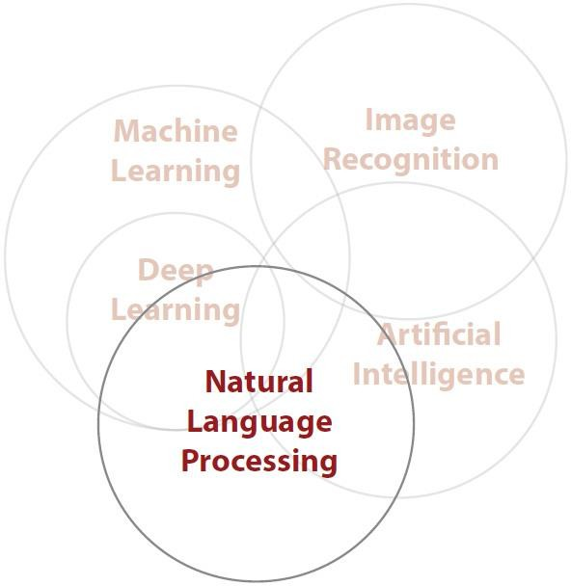

NLP
“Natural language processing (NLP) is a subfield of computer science, information engineering, and artificial intelligence concerned with the interactions between computers and human (natural) languages, in particular how to program computers to process and analyse large amounts of natural language data.”
Wikipedia
Notes:
On this slide, we introduce NLP (Natural Language Processing) with a formal definition. The slide quotes a definition from Wikipedia, giving a clear description of what NLP is. Let me read or paraphrase it for you:
“Natural language processing (NLP) is a subfield of computer science, information engineering, and artificial intelligence concerned with the interactions between computers and human (natural) languages, in particular how to program computers to process and analyze large amounts of natural language data.”
This is quite a mouthful, so let’s break it down in a conversational way:
• Subfield of AI: NLP is part of the broader field of Artificial Intelligence. Specifically, it intersects with computer science and information engineering. This means it involves designing algorithms and systems to handle human language.
• Human-computer interaction via language: The core aim of NLP is enabling computers to understand and generate human language. When you think of a computer analyzing text or responding to voice commands, that’s NLP in action. The definition highlights “interactions between computers and human languages.”
• Large amounts of data: A key phrase here is “process and analyze large amounts of natural language data.” Human language is vast and complex – think of all the books, emails, social media posts, etc. NLP techniques often have to scale to millions of sentences or more. So, efficiency and powerful models are needed to handle this volume.
• Examples in everyday life: To ground this definition, consider examples: spam filters that read your emails, voice assistants like Siri or Alexa that understand your speech, or translation apps that convert English to French. All these use NLP. The definition doesn’t list them, but these examples illustrate what “interactions with natural language” mean in practice.
• Slide Visual (if any): If there is a visual on the slide, it might depict NLP’s relationship to other fields (sometimes a Venn diagram showing NLP overlapping with AI and machine learning). The point would be to show NLP’s position in the tech landscape – as an AI discipline that uses methods like machine learning (for example, deep learning, which we’ll talk about) to tackle language tasks.
So to sum up: NLP is about making sense of human language using computers. It’s a broad area – from understanding text and speech to generating language – and it leverages various computer science techniques. With that definition in mind, let’s talk about the basic challenges of working with language in a machine learning context.

Slide 6
“Look before you leap.”
Charlotte Bronte
Working with words
Firstly, words are not numeric
Most topologies require numeric inputs
&
Context matters
Order matters
(a lot)
(a lot)
How might we change the following to work with a NN:
“Look before you leap.”
What’s the story?
Notes:
This slide, titled “Working with words”, lays out some fundamental challenges we face when bringing language into the realm of machine learning. It has a few bullet points that highlight why words are tricky to handle directly in neural networks:
• Words are not numeric: As the slide says, “Firstly, words are not numeric.” Computers inherently deal with numbers. All the machine learning models (like neural networks) expect inputs as numbers (tensors, vectors, etc.). But human language is text – words, characters – which have no numeric value on their own. This is our first big hurdle: we need to convert words into numbers somehow for a computer to process them. We’ll discuss various ways to do this, from simple encoding to sophisticated embeddings.
• Most models require numeric inputs: The slide notes “Most topologies require numeric inputs.” By “topologies,” it means neural network architectures or algorithms. Whether it’s a simple regression or a complex neural net, the data feeding in must be numerical. So this reiterates: how do we map a word like “hello” to a set of numbers so a model can use it? We’ll soon see methods (like one-hot encoding and later word embeddings) that address this.
• Context matters: Another point is “Context matters.” Words do not stand alone in language; their meaning often depends on neighboring words or the situation. For example, the word “bank” has different meanings in “river bank” vs “bank account.” The context guides the interpretation. Any NLP approach needs to consider context to truly capture meaning. If we just look at words in isolation as numeric IDs, we lose a lot of information.
• Order matters (a lot): The slide emphasizes “Order matters (a lot)”. Word order in a sentence can completely change meaning. “Dog bites man” vs “Man bites dog” – same words, opposite meaning due to order. Unlike some data where order doesn’t matter (say, a bag of features that you can shuffle), language is sequential and order-dependent. Neural networks for language must handle sequences in order – this is why specialized models like RNNs/LSTMs and Transformers exist, because simple models treating input as just a set of features would ignore order.
• Examples on slide: We have two example sentences shown:
• “Look before you leap.” – a common proverb meaning “think carefully before you act.” It’s listed twice on the slide, likely to set up a scenario. It’s attributed to Charlotte Brontë (notably, she used this phrase in literature).
• “What’s the story?” – This is a phrase that, out of context, might be ambiguous. It could literally ask for a story, or in some regions (like Ireland), “What’s the story?” is a colloquial greeting similar to “What’s up?”. The ampersand & between Charlotte Brontë and What’s the story? on the slide suggests we’re comparing two different uses of language or idioms. High-Level Explanation:
This slide likely emphasizes why context (word order and surroundings) matters so much in language understanding. It reminds us that if we treat a sentence as just a bag of words, we lose meaning. For example, the sentences “I dog bites man” vs. “man bites dog” have the same words but a completely different meaning because of word order. The slide draws a parallel to images: just like shuffling pixels breaks an image, shuffling or ignoring word order breaks a sentence’s meaning. In simple terms, it’s highlighting a big challenge in NLP – capturing the sequence and context of words, not just their presence.
Detailed Speaker Notes:
Start by stating: “Context is key in language. The order and relationship of words can entirely change the meaning.”
Give a quick example or ask the audience to consider one – e.g., “‘Jane kissed John’ vs. ‘John kissed Jane’ – same words, different who-did-what due to order.” This primes why we can’t ignore sequence.
The slide mentions a challenge similar to image classification losing spatial awareness. Draw the analogy: “In image recognition, if you jumbled up all the pixels, the image’s meaning is lost. Similarly, if we ignore word order, a sentence’s meaning can be lost.”
Explain that older or simpler approaches in NLP (like bag-of-words where we just count words) lose this context. All you get is which words appear, not the story or relation between them.
Emphasize that the upcoming techniques (embeddings, RNNs, attention) are motivated by solving this issue. “So the key point here: we need methods that preserve or learn the context – the sequence – not just treat language as a sack of unrelated words.”

Slide 7

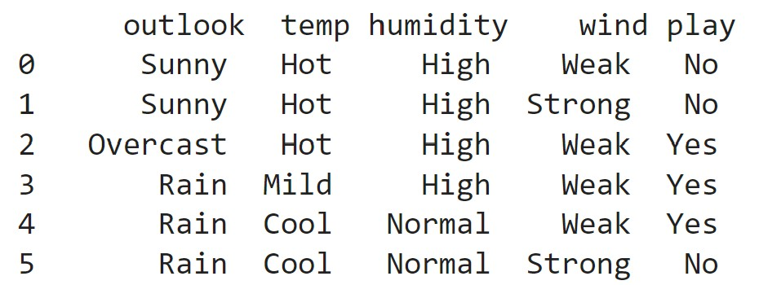
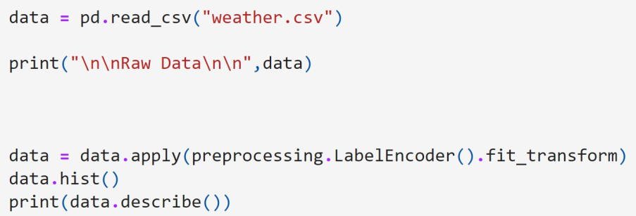
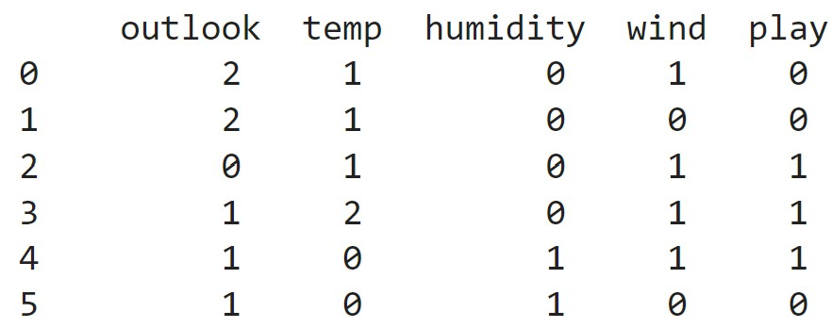
Challenges
We can encode the words into numeric values, we have already seen examples in the earlier labs using label encoding:
In this example:
Sunny | -> | 2
Overcast | -> | 0
Rain | -> | 1
Will this be sufficient?
Notes:
This slide is labeled “Challenges” and it demonstrates a naive approach to encoding words as numbers, highlighting why it’s problematic. This slide highlights one of the core challenges we face when dealing with text data in machine learning: the need to convert categorical textual information into numerical representations that models can understand. Label encoding, illustrated here, assigns unique numeric labels to distinct textual categories—for instance, converting “Sunny,” “Overcast,” and “Rain” into numbers like 2, 0, and 1, respectively. This approach allows us to feed categorical data into algorithms effectively, but it also introduces a potential problem.
The code snippet shown demonstrates a straightforward Python implementation using scikit-learn’s LabelEncoder. While convenient, label encoding assumes a form of numerical order or hierarchy, which can mislead algorithms into interpreting unintended relationships—such as “Sunny” (encoded as 2) being more significant than “Rain” (encoded as 1). Thus, label encoding might unintentionally bias the model.
To avoid these biases, we often prefer methods like one-hot encoding, where each category gets represented by a binary vector that eliminates implicit order, or advanced embedding methods like word embeddings that capture semantic relationships more meaningfully. The question at the bottom, “Will this be sufficient?” encourages us to critically assess whether our chosen encoding strategy genuinely suits the complexity and nuance of our text data. • Label Encoding Example: The slide text says we can encode words into numeric values and references earlier labs. For instance, it shows:
• Sunny -> 2
• Overcast -> 0
• Rain -> 1
This looks like a simple label encoding for weather categories (sunny, overcast, rain). Perhaps in an earlier exercise, students encoded these weather terms as 0, 1, 2 to feed into a model (like a decision tree or so). That works okay for categorical data in some contexts, but…
• Is this sufficient for language? The slide pointedly asks, “Will this be sufficient?” The implication is no, not for understanding language. If we tried to apply the same idea to arbitrary words (just give each word an ID number), we run into issues. For weather categories it’s fine because those IDs don’t imply any numeric relationship – they’re just labels. But if we feed such numeric labels into a neural network, the network might interpret the numbers as having magnitude or order when in reality “Sunny (2)” isn’t inherently “greater than” Rain (1) in any meaningful way.
• Challenges Illustrated: The slide likely illustrates a specific challenge with numeric encoding using a sentence example. It might show two short sentences from the previous slide (the “Look before you leap” example):
• Sentence 1: “Look before you leap.” encoded as something like [1, 0, 3, 2]
• Sentence 2: “Leap before you look” encoded as [2, 0, 3, 1]
(These numeric sequences appear on the slide.) Here each number corresponds to a word: maybe 1 = “Look”, 2 = “Leap”, 0 = “before” (just guessing mapping).
• Issue 1 – Meaning not captured by numbers: The slide’s bullet points mention: “The first input contains a 1 and a 2, these are different values, and don’t map the meaning as for instance one is look and two is leap.” This points out that just because “look” was encoded as 1 and “leap” as 2 doesn’t mean we’ve captured their similarity or relationship. To a machine, 2 is greater than 1, but the words “leap” vs “look” don’t have such a straightforward relationship. In fact, “look” and “leap” are somewhat related (both verbs, part of a common phrase) but our encoding doesn’t reflect that – it just arbitrarily gave them numbers.
• Issue 2 – Loss of ordering context: The example shows that swapping “Look” and “Leap” in the sentence gave a different sequence [2, 0, 3, 1] instead of [1, 0, 3, 2]. If a model doesn’t account for position and just treats these as sets or so, it might not see a difference. The slide compares this to image classification problems and the loss of spatial awareness. In images, if you scramble pixels, meaning is lost; similarly, if you ignore word order, “Leap before you look” might be mistakenly seen as the same as “Look before you leap,” which is a big mistake (they actually mean opposite things).
• Spatial analogy: The mention of loss of “special” (likely meant spatial) awareness is insightful. In images, we learned that just having pixel values isn’t enough – convolutional nets preserve local structure. In language, order is like spatial structure; a simple neural net that doesn’t take word position into account is like an image classifier that’s insensitive to pixel arrangement. We need models that handle sequence ordering (later we’ll see CNN with sliding windows, and LSTM and Transformers which inherently handle positions).
• Conclusion of this slide: It sets up the need for better techniques. The final line says, “Next, let’s look at techniques that may help.” That cues us to transition into solutions, the first being a better encoding method: one-hot encoding.
So to summarize: encoding each word as a single number (like an ID) and feeding that to a neural network is not sufficient for NLP. It doesn’t capture meaning, and if those IDs are used directly, the model might infer false relationships (like “2 > 1” meaning leap is greater than look? – nonsense in language). We also lose context and order. We need a different representation. The simplest improvement is one-hot encoding, which we’ll discuss on the next slide.

Slide 8
“Look before you leap.”
[1, 0, 3, 2 ]
Challenges
Using word encoding what might this look like?
How could we feed this into a neural network?
Taking the two word/input vectors in the example, there are some challenges:
The first input contains a 1 and a 2, these are different values, and don’t map the meaning as for instance one it is look and two it is leap.
This challenge is similar to the image classification problems and the loss of special awareness.
Next, let’s look at techniques that may help.
“Leap before you look”
[2, 0, 3, 1 ]
Notes:
This slide provides a concrete example of the context problem using two short sentences. It shows the sentence “Look before you leap.” and a shuffled version “Leap before you look.” and how a naive encoding might represent them. Each word is converted to a number (a token ID), resulting in sequences like [1, 0, 3, 2] vs [2, 0, 3, 1]. The point is to make it crystal clear that the same words arranged differently are currently just different sequences of IDs. Without a method to handle order, a model can’t tell these apart meaningfully. It sets the stage for introducing encoding techniques that will handle such differences.
This slide emphasises a significant challenge with using basic numerical encoding techniques for feeding textual data into neural networks. The two phrases, “Look before you leap” and “Leap before you look,” have nearly identical numeric representations, yet their meanings differ entirely due to word order. When we convert these words into numeric labels like [1, 0, 3, 2] and [2, 0, 3, 1], we lose the inherent semantic distinctions between words, as these numeric labels don’t capture their actual meanings or contextual differences.
Another important issue highlighted here is the loss of positional information or sequence order. Numerical labels alone do not retain positional relationships, making it difficult for neural networks to grasp sentence structure or interpret subtle contextual differences. This problem resembles the loss of spatial context in image classification tasks, where position and arrangement significantly influence interpretation.
To tackle these challenges, we need more advanced encoding methods capable of preserving both semantic and positional context. Techniques such as word embeddings, which convert words into continuous, meaningful vectors, and positional encodings used in Transformer architectures, help neural networks better understand and interpret textual data. These methods are essential in accurately capturing both meaning and order, thus enhancing the performance of NLP models significantly.
Detailed Speaker Notes:
Walk through the example on the slide. “We have two sentences: ‘Look before you leap’ and ‘Leap before you look.’ They use the same four words, only the first and last words swapped.”
The slide shows each word turned into a numeric ID (for instance, maybe Look=1, before=0, you=3, leap=2 as an example mapping). Point to those sequences: “The first sentence becomes something like [1, 0, 3, 2] and the second is [2, 0, 3, 1]. These numbers are just placeholders for each word.”
Explain what that means: “So the only difference in these raw numeric sequences is the order of the IDs – which does correspond to the different word order. That’s good – we haven’t lost order yet at this stage. The problem arises when we convert this into a fixed-length vector without order…”
Highlight the looming issue: “If a model only cares about the set of numbers (like counting each ID), then both sentences end up with the same counts of 1,2,3,0. In other words, it would see exactly the same ‘bag of IDs’.”
The example is a nice intuitive demonstration. Ensure the audience understands the consequence: “A simplistic model would completely fail to see a difference in meaning here. It’d consider both sentences identical, which is clearly not what we want.”
This example thus motivates the next slide, where we introduce one-hot encoding as a step towards preserving detail about each word (though even that by itself won’t solve the order issue, as we’ll see).
• It shows ““Look before you leap.” -> [1, 0, 3, 2]”
• And ““Leap before you look” -> [2, 0, 3, 1]”
We’ve actually integrated this discussion with Slide 7’s notes, but let’s ensure we’ve covered everything: The core idea here was that with naive encoding:
• The same words are present in both sentences, just in a different order.
• Yet, the numeric representations differ just by swapping those position values.
• If a model saw these numbers without context, it might not grasp that one sentence is just a jumbled version of the other; or worse, it might think “leap” being 2 vs “look” being 1 is significant in a mathematical way.
The slide’s bullets (already covered) pointed out these issues. It’s basically demonstrating that such an encoding fails to capture:
• Word identity meaningfully (numbers aren’t semantic),
• Word relationships (1 vs 2 doesn’t encode that look/leap are verbs or related),
• Order (just a list of numbers without sequence awareness).
Now, having highlighted these challenges, the slide ended by saying: “Next, let’s look at techniques that may help.” So, we’re now ready to introduce a technique to encode words in a more useful way than just arbitrary label numbers. The next slide introduces One-Hot Encoding as a solution.

Slide 9
Look
Before You Leap
One-Hot-Encoding
Another form of storage is called "one-hot encoding" and is the most common format for encoding binary/categorical data.
The "binary" presence or absence of an input datapoint amongst a vocabulary of possible input datapoints. There are other forms of encoding such as using the sum of each word occurace in a sentence, but one-hot–encoding typically outperforms this.
= [1, 0, 0, 0]
= [0, 1, 0, 0]
= [0, 0, 1, 0]
= [0, 0, 0, 1]
So, if our vocabulary was only 4 words, our one- hot encoding might look like the following.
Notes:
This slide introduces one-hot encoding, a simple way to represent words as vectors of 0s and 1s. In one-hot encoding, if we have a small vocabulary (say 4 words just as an example), each word gets a unique vector where one position is 1 and all others are 0. For instance, “Look” might be [1, 0, 0, 0], “before” is [0, 1, 0, 0], and so on. This is a common method to turn categorical data (like words) into a numeric form a machine can use. The slide explains that it’s a very binary representation – a word is either present (1 at its index) or not (0). It probably also notes that one-hot is better than just counting occurrences in some ways, but still has limitations. High-level: we’re learning how to encode words uniquely so a model can differentiate them.
Detailed Speaker Notes:
Define one-hot encoding in simple terms: “One-hot encoding means we create a vector for each word that is all zeros except for a 1 in a position unique to that word.”
Use the slide’s example. Likely, the slide shows a tiny vocabulary example. For four words (e.g., Look, Before, You, Leap), you’d have:
Look = [1, 0, 0, 0]
Before = [0, 1, 0, 0]
You = [0, 0, 1, 0]
Leap = [0, 0, 0, 1]
Point to each row or representation: “As you can see, each word gets its own slot in the vector – only that slot is 1.”
Emphasize why this is useful: “This way, the computer can tell words apart easily. The vectors for ‘Look’ and ‘Leap’ are completely different (they don’t overlap except for zeros). So no two distinct words have the same encoding.”
Mention that one-hot encoding is a very common starting point for representing categorical data like words. It captures presence/absence clearly.
However, note implicitly that these are high-dimensional (equal to vocab size) and don’t by themselves capture meaning or order – we’ll get to those issues. For now, we’re just ensuring each word is uniquely identifiable to the model.
This concept is fundamental, so ensure the audience is with you: “In summary, one-hot encoding gives us a simple way to convert words into vectors that a neural network can work with – basically turning words into numbers without losing their identity.”
This slide is titled “One-Hot-Encoding.” It introduces one-hot encoding as a method to represent words (or other categorical data) in a numeric format that is more suitable for machine learning. The slide text starts by describing what one-hot encoding is and why we use it:
• Definition: The slide says “Another form of storage is called ‘one-hot encoding’ and is the most common format for encoding binary/categorical data.” In spoken terms: one-hot encoding means we take a category (like a word) and represent it as a vector of bits (0s and 1s) where exactly one position is “hot” (1) and all others are 0. Each position in this vector corresponds to a specific word in our vocabulary.
• Binary presence/absence: One-hot essentially captures the presence or absence of a particular word in a vector form. The slide notes “the ‘binary’ presence or absence of an input datapoint among a vocabulary of possible inputs.” For example, if our vocabulary has N words, a word’s one-hot vector is length N: it has 1 in the slot for that word, and 0 in all other slots.
• No implicit ordering: Unlike assigning “1, 2, 3…” to words, one-hot vectors do not give any word a greater numeric value than another. They’re all equally distant (most of the time, in Euclidean terms each pair of distinct one-hot vectors has the same distance). There’s no rank or magnitude implied by IDs, which addresses one of the issues we discussed with label encoding.
• Vocabulary example: The slide gives a simple example: “So, if our vocabulary was only 4 words, our one-hot encoding might look like the following.” It then lists four words:
• Look
• Before
• You
• Leap
And likely next to each, it shows a one-hot vector representation:
• Look = [1, 0, 0, 0]
• Before = [0, 1, 0, 0]
• You = [0, 0, 1, 0]
• Leap = [0, 0, 0, 1]
These vectors are likely displayed on the slide exactly or described. It demonstrates that with a vocab of 4 words, each word gets a unique position in a 4-dimensional binary vector.
• Interpretation: In this scheme, “Look” is represented as [1,0,0,0], “Leap” as [0,0,0,1], etc. Notice how “Look” and “Leap” are now no longer one being ‘greater’ than the other. They are just different directions in this 4-dimensional space. One isn’t inherently larger or smaller; they’re orthogonal vectors essentially. That’s good – it means the model won’t misconstrue an order. But, as we’ll soon see, this representation has its own limitations.
• Other encoding forms: The slide briefly mentions “There are other forms of encoding such as using the sum of each word occurrence in a sentence, but one-hot encoding typically outperforms this.” This refers to something like a bag-of-words frequency vector (where each word’s count in the sentence is put in the vector). One-hot is actually a special case of bag-of-words for presence/absence. Using counts can sometimes be useful (especially for longer documents), but if word order matters, plain counts still lose order. One-hot at least sets the stage for feeding into models that might handle sequence.
• Common usage: The fact that one-hot is “most common” for encoding categorical data is true historically – especially before word embeddings came along, NLP pipelines often one-hot encoded words (or n-grams) and then applied models like naive Bayes or even neural nets.
So the takeaway from this slide is: One-hot encoding is a straightforward way to convert words into numeric vectors without implying false relationships among them. Each word is uniquely identified by a vector of zeros and a single one. This allows a neural network to treat each word as an independent input feature.
However, we should note: one-hot vectors can get very large (if you have a 10,000-word vocabulary, each vector has 10,000 dimensions!). They’re also very sparse (mostly zeros). And crucially, one-hot doesn’t by itself solve the context or meaning similarity problem – it just gives a neutral representation. Two different words have completely different one-hot vectors (they’re orthogonal), even if those words are similar in meaning. We’ll tackle that soon with embeddings, but first, the slide sets up a specific challenge with one-hot encoding on the next slide, using our “Look before you leap” example again.

Slide 10
Look Before You Leap
= [1, 0, 0, 0]
= [0, 1, 0, 0]
= [0, 0, 1, 0]
= [0, 0, 0, 1]
One-Hot-Encoding
Challenges:
When we encode the two sentences as one hot encoded vectors, based on the language input, we get the same vectors.
This has significant consequences for “context” on whatever form a model can learn context, as in this case, it has no chance, if very different sentences result in the same hot encoded vector.
“Look before you leap”
[1, 1, 1, 1 ]
“Leap before you look”
[1, 1, 1, 1 ]
Notes:
Continuing with One-Hot Encoding, this slide specifically highlights the challenges or limitations of one-hot encoding, using the earlier example sentences to make a point about context loss. The slide is titled “One-Hot-Encoding – Challenges:” and it describes what happens if we encode entire sentences as one-hot vectors in a certain way.
• Encoding sentences as vectors: The slide likely considered representing a whole sentence by combining the one-hot vectors of its words. A common way to do that is to take the one-hot for each word and sum them up (or just mark presence of each word in the sentence). For instance, “Look before you leap” contains the four words {look, before, you, leap}. If we had a one-hot vector for each, one way to represent the sentence is to add those vectors (basically a bag-of-words representation). That would produce a vector with 1s in all positions corresponding to words present.
This slide illustrates another significant issue we face with basic encoding methods in NLP, specifically with one-hot encoding. One-hot encoding represents each unique word as a distinct binary vector, where only one element is set to one, and all others are zero. While simple, this technique entirely disregards the order of words in a sentence. As demonstrated, both phrases “Look before you leap” and “Leap before you look” are encoded identically as [1,1,1,1], losing their distinct meanings and any information about sequence.
This inability to represent order or context poses a substantial challenge for neural networks. Models relying solely on one-hot encoded data cannot differentiate between sentences with identical words arranged differently, thereby losing essential linguistic nuances like grammar, word order, and syntax.
To address these limitations, NLP models employ more sophisticated encoding techniques. Methods such as embedding vectors and positional encoding preserve semantic meaning and word order, respectively, enabling neural networks to learn contextual relationships effectively. This is why techniques like word embeddings, RNNs, and Transformers are essential—they provide the structure and context necessary for models to distinguish subtle yet critical differences in textual data
So:
• “Look before you leap” might yield [1,1,1,1] (if we use the 4-word vocab example from before, since all four words appear once).
• “Leap before you look” would also yield [1,1,1,1] – because it has the same set of words, just in different order.
• Slide text explanation: The slide says: “When we encode the two sentences as one-hot encoded vectors, based on the language input, we get the same vectors.” And it shows exactly that:
• “Look before you leap” -> [1, 1, 1, 1]
• “Leap before you look” -> [1, 1, 1, 1]
On the slide, you’ll see both sentences result in [1,1,1,1] under this scheme.
• Consequences for context: The slide emphasizes: “This has significant consequences for ‘context’… as in this case, it has no chance [to learn context] if very different sentences result in the same one-hot encoded vector.” In plainer terms: by collapsing a sentence into a bag-of-words vector, we lost all ordering information. Our model would see both sentences as identical input, even though “Look before you leap” and “Leap before you look” mean very different things. Thus, any nuance of word order or context is gone. A model trained on such vectors couldn’t possibly distinguish the two sentences or learn word order patterns. It’s blind to context.
• Why no flattening? (This might actually come later with LSTMs, but just to clarify: in the previous ANN and CNN models, we had to flatten the embedding output to feed into Dense layers, but for an LSTM, we do not flatten because the LSTM inherently handles sequence input and produces an output vector.)
• Interpretation: This drives home a critical limitation: One-hot encoding, especially when used in a bag-of-words manner, ignores word sequence. While one-hot is fine for representing individual words, if you just sum them or use them independently without sequence-aware models, you can’t capture context or grammar.
• Memory and similarity issues: Though not explicitly on the slide, it’s worth noting for understanding: one-hot vectors don’t capture similarity between words. For example, “cat” and “feline” would be totally different one-hots with zero overlap. A model would have to learn from scratch that they might be related, whereas an embedding (later) could place them closer in vector space initially. Also, if your vocabulary is large, these vectors are huge and sparse, making models slower or requiring more parameters.
• So what’s next? Typically, after discussing one-hot limitations, the next step is to introduce dense word embeddings (where words are represented in a lower-dimensional continuous vector space that can capture similarity and context to some extent). And indeed, our outline shows that up next we have “word embeddings” and specifically Word2Vec, etc.
This slide highlights the limitations of one-hot encoding, especially regarding context. It shows that if you encode each word in a sentence as one-hot and then combine them (for example, summing or averaging), different sentences can end up looking identical. In our example, “Look before you leap” and “Leap before you look” both would yield the same aggregated vector [1,1,1,1] because both sentences contain all four words. The slide likely points out that one-hot vectors are sparse and high-dimensional, and they don’t capture any similarity between words or the sequence of words. In short, while one-hot distinguishes words, it still doesn’t solve our main problem: the model can’t inherently tell word order or which words matter more in a given context.
Detailed Speaker Notes:
Acknowledge that one-hot encoding was a step forward but now address the downside: “So what’s the issue? Well, one-hot vectors by themselves have no notion of order or meaning – they’re just markers.”
Refer to the example on the slide. It likely shows how the two sentences from before, when encoded as one-hot and then combined, produce the same result:
Possibly the slide shows summing each column for the sentence. “Look before you leap” yields [1,1,1,1] (since each of the four positions got a 1 once). “Leap before you look” also yields [1,1,1,1].
Indicate this: “Notice at the bottom, when each sentence’s one-hot vectors are aggregated, both sentences give the same combined vector [1, 1, 1, 1]. The model just sees that all four distinct words appeared, but not the order.”
Explain why that’s bad for context: “This means if our model only looked at the sum or overall set of words, it cannot tell the sentences apart – we lost the context! The phrase look…leap vs leap…look difference vanished.”
Also point out other challenges: one-hot vectors are high-dimensional and sparse (mostly zeros). “If our vocabulary is 10,000 words, each one-hot vector is 10,000-long with just a single 1. That’s a lot of zeros, not very efficient. And also it treats every word as completely independent – it doesn’t know that maybe ‘leap’ and ‘jump’ are related words. They’d be just as different as ‘leap’ and ‘before’ in one-hot space.”
Summarize: one-hot encoding gives unique IDs to words but does not encode context or semantic similarity. This sets the stage for why we need more clever representations like word embeddings, which we’ll introduce next as a solution.

Slide 11
1) Data Processing / Context
Tokenizing and Word Embeddings
Notes:
Slide 11 appears to be a section divider introducing the next major part of the talk. It’s titled “1) Data Processing / Context” with a subtitle indicating “Tokenizing and Word Embeddings.” Essentially, we’re beginning section 1 of the lecture content, which focuses on how we process textual data and incorporate context, with the main tools being tokenization and embedding techniques.
• Context of this slide: We finished the introduction (section 0) where we laid out the problem: words need numeric representation, and simple approaches (like label encoding or one-hot + bag-of-words) have shortcomings with context and meaning. Now, section 1 sets out to handle those issues. It’s telling us we’ll start making the data more model-friendly (“Data Processing”) and introduce ways to maintain context (via “Word Embeddings”).
• Tokenizing: The mention of “Tokenizing” suggests that first we will discuss how to break text into tokens (words, or subwords) and assign numbers to them in a smarter way than naive label encoding. Tokenization is the step of converting raw text (“Look before you leap.”) into a sequence of discrete tokens (“Look”, “before”, “you”, “leap”, perhaps punctuation handled too), which we can then map to numbers.
• Word Embeddings: After tokenization, we move to word embeddings – which is a highlight of this section. Word embeddings are vector representations of words that capture semantic meaning. Unlike one-hot vectors which are huge and sparse, embeddings are dense vectors (like 50 or 100 dimensions) where words that have similar meanings end up with similar vectors.
• Slide visual/layout: This slide likely has a simple background or an icon and mainly text, given it’s a section header. It might not have detailed bullets beyond the title. It’s a moment for me, as a speaker, to reset and introduce what’s coming.
So, I’ll use this slide to say: “We’re now entering section 1, where we’ll get hands-on with preparing language data for neural networks. We’ll cover tokenization techniques and then dive into word embeddings, which allow neural nets to understand context and relationships between words better than one-hot encoding can.”
• Transition notes: Before we jump to the next slide, keep in mind the motivation: We need to convert text to numbers (tokenizing) and we want those numbers (vectors) to be meaningful (embeddings). The techniques in this section will address the challenges we saw earlier: preserving context and capturing similarity in our representations.
Alright, with the stage set, let’s start with tokenization – turning our text into sequences of numbers.

Slide 12
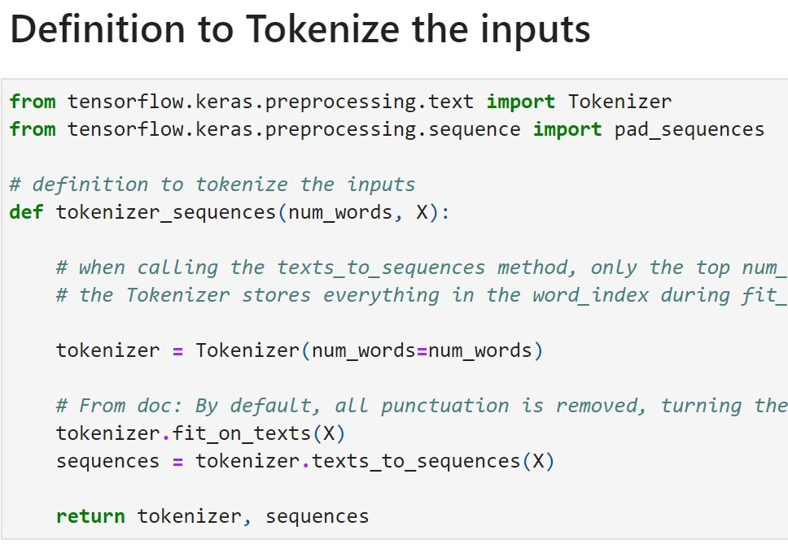
Tokenizing
We need to work with text, by applying tokens (numeric values to the text).
There are many options here, for example:
FCFS
Based on frequency of occurrence
Also for Word Embeddings (up next) we also need to select num_words in the vocab to use (hyperparameter).
Returns Tokenizer and Sequences
https://www.tensorflow.org/api_docs/python/tf/keras/preprocessing/text/Tokenizer
Notes:
This slide is titled “Tokenizing”. It introduces the concept of tokenization and how we map text to numeric tokens. The slide has a set of bullet points explaining the process and some options we have.
• Need for tokenization: The slide starts with “We need to work with text by applying tokens (numeric values) to the text.” In other words, to input text to a neural network, we must break it into units (tokens) and assign each a number. These tokens are usually words or subwords. Tokenization is the act of chopping text into pieces and giving each piece an ID.
• Example understanding: Think of a sentence like “John said hello.” A simple tokenization would split this into [“John”, “said”, “hello”] and maybe punctuation separately if we cared. Then maybe assign “John”->1, “said”->2, “hello”->3, etc., building a vocabulary. Tokenizer tools do this systematically over a whole corpus.
• Options for tokenization order: The slide bullet lists “There are many options here, for example:” and then:
• FCFS – which likely stands for First-Come-First-Served. This means we assign token IDs in the order we encounter new words. The first unique word we see gets token 1, the next unique word gets token 2, and so on. This is a common simple approach: basically, index words by their occurrence order in the data.
• Based on frequency of occurrence: Another strategy is to assign smaller IDs to more frequent words. For instance, the most common word in English, “the”, might get token 1; the next most common, “of”, gets 2, etc. This can be useful in some contexts (especially if you plan to limit vocabulary size – you’d keep the top N frequent words).
• Each method has slight differences but in practice, both are fine as long as we’re consistent and don’t imbue meaning into the IDs (they’re just identifiers).
• Choosing vocabulary size (for embeddings): The slide mentions “for Word Embeddings (up next) we also need to select num_words in the vocab to use (hyperparameter).” This is important: we often decide to only keep the top X words in our vocabulary, especially in deep learning models. Very infrequent words might be dropped or treated as “unknown” because they don’t provide enough data to learn a good representation and they clutter the space. For example, we might choose to keep only the 10,000 most frequent words. This number (10k in this example) is a hyperparameter – chosen based on data size and trade-offs (larger vocab captures more words but increases model size).
• The slide likely alludes to that: common practice in NLP with embeddings (like using Tokenizer in Keras) is to set a max vocabulary size, e.g., num_words=10000.
• Return Tokenizer and sequences: The bullet “Returns Tokenizer and Sequences” suggests the process yields:
• A Tokenizer object (if using a library like Keras) that has the mapping from words to numbers.
• Sequences which are the lists of token IDs for each sentence.
So if we feed text into such a tokenizer, we get out something like: “Look before you leap” -> [token1, token2, token3, token4] (with actual numbers filled in).
• Reference to TensorFlow/Keras API: The slide provides a reference link to TensorFlow’s text Tokenizer documentation. This implies the code or method on the slide is using Keras’s tf.keras.preprocessing.text.Tokenizer. This class automatically does what we described: you fit it on texts, it builds a word index (maybe by frequency by default, ignoring very rare words if you set a limit), and it can convert texts to sequences of integers.
And so on. The link hints that they expect students might look up details if needed.
• Key point: By tokenizing, we create a numeric dataset out of text. But remember, these numbers (token IDs) themselves don’t carry meaning yet beyond being consistent placeholders. If we stopped at just sequences of token IDs, we’d essentially be doing that label encoding again. The real magic will come when we map these tokens to embedding vectors (which we’ll get to next). But tokenization is a prerequisite step.
In summary, slide 12 explains how we go from raw text to tokenized numerical data:
• Decide on a strategy to index words (first-come-first-served or by frequency).
• Possibly limit vocabulary size (only keep top N words).
• Use a tokenizer tool (like Keras’s) to get sequences of numbers.
• We end up with each sentence or document as a sequence of integers, ready to be fed to further processing like an embedding layer or directly into certain models.
Now, one detail: these sequences can be of different lengths (sentences vary in number of words). Many neural networks like fixed-length input, so often we have to pad sequences to a uniform length. I suspect that’s covered on the next slide because I see hints of “Padding (300 words)” and such in the outline text.
Explain Tokenizing: “Tokenization means splitting text into tokens (usually words or subwords) and mapping each token to an integer ID. In other words, we build a vocabulary and convert each word to a number.”
This slide likely just labels what we’re about to do, so clarify the plan: “First, we’ll look at how we tokenize text using a tool (for instance, Keras’ Tokenizer). Then we’ll introduce word embeddings – these are vector representations of words that, unlike one-hot vectors, capture some meaning and context.”
Emphasize why embeddings are coming: “Word embeddings will address the issues we saw: they are dense vectors (not mostly zeros) and they can be learned to position similar words closer together. They will also be a foundation for feeding into advanced models like LSTMs and Transformers.”
Essentially use this slide as a quick breather/marker. Ensure the audience is on board: We’re now moving into practical steps of text preprocessing. After this, we’ll dive into the details of tokenization and embeddings.

Slide 13
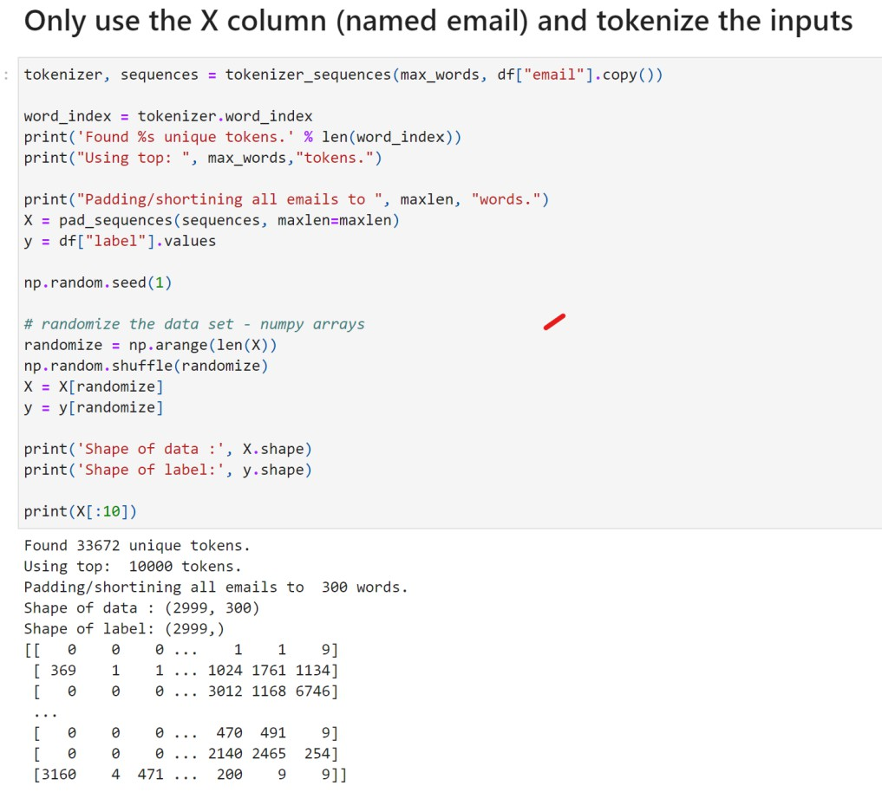
Tokenizing
- Tokenizer
(top 10,000 tokens)
- Padding
(300 words)
- Sequences
0 is non word (reserved)
https://www.tensorflow.org/api_docs/python/tf/keras/preprocessing/text/Tokenizer
Notes:
This slide continues the topic of Tokenizing, likely providing some concrete settings and considerations when preparing text data for models.
This slide demonstrates the practical process of tokenisation, an essential step in preparing textual data for neural network models. Tokenisation involves transforming text data, such as emails or documents, into sequences of numeric identifiers known as tokens. Here, we’re using a tokenizer that selects only the top 10,000 most frequent words in the dataset, helping to manage vocabulary size and computational complexity.
After tokenising, we use padding to standardise all sequences to the same length—in this case, 300 words. Padding ensures uniform input size for neural networks, as models typically require fixed-length input sequences. Shorter sequences get padded with zeros, a reserved token representing the absence of a meaningful word.
The output at the bottom visually represents the tokenised and padded sequences. The zeros at the start of sequences represent padded positions, while the numeric values following zeros correspond to words from our vocabulary, mapped through the tokenizer. This structured numeric representation enables the neural network to interpret textual data consistently and effectively, laying the groundwork for tasks like sentiment analysis, classification, or spam detection.
It lists a few bullet points:
• Tokenizer (top 10,000 tokens): This indicates we’re choosing to keep the top 10,000 most frequent words in our vocabulary. All other rare words will be treated as out-of-vocabulary (OOV). This is a common approach for manageable model size. So here, the tokenizer is configured for num_words = 10000. This aligns with what we discussed: focusing on the most important words in the corpus.
• Padding (300 words): This suggests that after tokenizing, we pad or truncate each sequence to length 300. Many sentences won’t naturally have exactly 300 tokens; some might be longer (we’d cut them down), many will be shorter (we’ll pad them with a special padding token, often 0, to reach 300).
• Padding ensures all input sequences to the neural network have the same length, which is required for batch processing in fixed-size arrays. The number 300 here is an arbitrary choice (could be, say, roughly the length that covers most sentences or reviews in the dataset they have). It’s a hyperparameter you tune based on data (for instance, if working with movie reviews, maybe 300 words covers most reviews fully).
• We usually pad with 0s at the end of sequences (or beginning, but end is default in Keras) to represent “no word here”.
• Sequences: 0 is non-word (reserved): The slide notes “0 is non word (reserved)”. This is important: typically, in such tokenization and padding, the integer 0 is used for padding and possibly also as an “unknown word” placeholder. That’s why in Keras’s Tokenizer, by default, indexing might start at 1 for the first word, leaving 0 reserved. So, no actual word gets index 0. All 0s in the sequence represent either padding or a special token for missing words.
• This is why earlier, in our examples, we saw sequences like [1, 17, 0, 2, 19, 6, 0, 81] – those 0s likely were padding in the sentence or punctuation placeholders. They’re not actual vocabulary words.
• The slide highlighting this is ensuring students know that if they see 0 in the sequence, it doesn’t correspond to a real word from the text, but rather “nothing” or “padding here”.
• Code context: The presence of these specifics suggests that on the side of the slide, or previously, they might have shown an actual code snippet (maybe for an IMDB movie review dataset or similar):
• e.g., tokenizer = Tokenizer(num_words=10000)
• then X = tokenizer.texts_to_sequences(texts)
• then X_padded = pad_sequences(X, maxlen=300).
• This would result in each X_padded[i] being a list of 300 integers (with 0 padding).
• Relevance to embeddings: All this tokenizing and padding is groundwork so that we can feed these sequences into an embedding layer or model. We haven’t actually discussed the embedding step on the slides yet (it’s coming up next), but at this point, we’ve preprocessed text into a nice form: a fixed-size numeric matrix (if you consider a batch of sentences padded to length 300, each word as a number).
• Why 300? If students wonder “why 300 specifically?”, I would add: it might be based on domain knowledge that, for example, 300 words covers most short texts (if we were doing movie reviews, maybe 300 words covers 95% of reviews fully, truncating only very long ones). It’s a balance between not chopping off too much useful info and not feeding too long sequences (which would be slower to train and maybe mostly padding if most texts are shorter).
• Memory check: At this stage, we should realize: now each sentence is a sequence of tokens. But those tokens are still just IDs. If we feed those IDs directly into a neural network as inputs (say into a simple dense network), it won’t understand the relationships either – it would treat token 5 vs token 7 arbitrarily. We need to transform those IDs into embedding vectors that can be trained. That’s next.
To summarize slide 13: Once we decide on a vocabulary size (like 10k words), we convert each text to a sequence of word indices. We then make all sequences equal length by padding (e.g., to 300). The result is a nice rectangular input array of shape (num_examples, 300). In this array, 0 denotes padded positions (no actual word). This preprocessed data is now ready to be fed into an embedding layer or other network layers.
Define tokenization in simple terms: “Tokenization is the process of breaking text into pieces (tokens) and mapping those pieces to numeric IDs.”
Walk through an example quickly: “For instance, the sentence ‘I love coffee’ might become tokens [‘I’, ‘love’, ‘coffee’] and then maybe IDs [5, 17, 42] based on some vocabulary mapping.”
Discuss the different strategies for assigning IDs (the slide bullets mention them):
FCFS (First-Come-First-Served): “This means if we scan through the corpus, the first new word we see gets ID 1, next gets 2, and so on. Essentially numbering words in the order we encounter them.”
Frequency-based: “Here, we might sort words by how often they appear in our dataset. The most frequent word gets the smallest ID, etc. This way, common words get possibly shorter IDs or just we ensure important words are within our top vocabulary.”
Highlight the need for a vocabulary size cutoff (as the slide notes selecting num_words as a hyperparameter): “Often we set a limit like top 10,000 most frequent words to keep. Any word beyond that might be treated as ‘unknown’. This keeps our vocabulary manageable for the model.”
Mention that after tokenizing, the text is transformed into sequences of integers. “The tokenizer will output sequences – for example, a sentence becomes a list of word IDs. These numeric sequences are what we feed into models.”
If on the slide: point out the reference to Ker

Slide 14
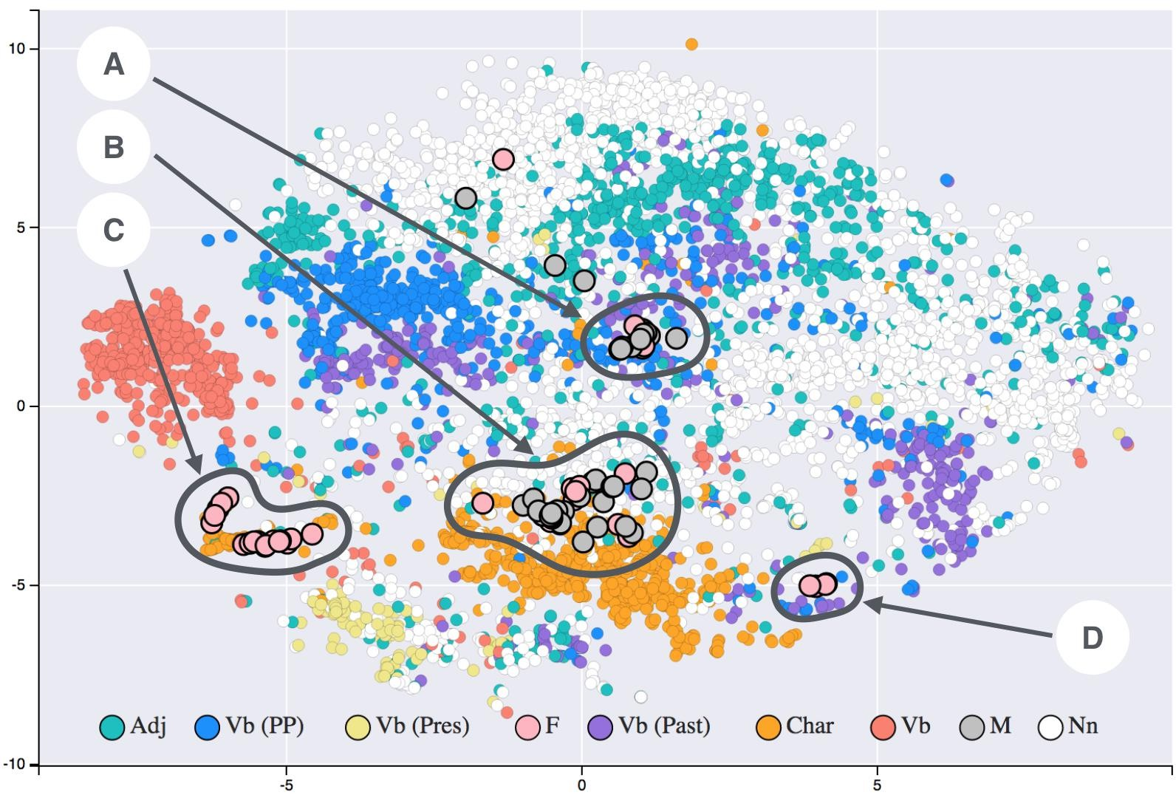
Context using word embeddings
Let’s start with some word embedding history and
concepts.
What are embeddings
1D and 2D – 32D+
Word2vec
Bag of words and skip-o-grams
Keras embeddings
https://commons.wikimedia.org/wiki/File:T-SNE_visualisation_of_word_embeddings_generated_using_19th_century_literature.png
Notes:
This slide is titled “Context using word embeddings”. It appears to be an introduction to the concept of word embeddings, including a bit of history and the main ideas we’ll cover. The slide lists bullet points outlining what’s to come:
• Introduction to word embedding concepts: It starts with “Let’s start with some word embedding history and concepts.” So, we’ll touch on what embeddings are and where they came from.
• What are embeddings: The first bullet likely addresses the basics – “What are embeddings”. In my explanation: Word embeddings are representations of words as vectors in a continuous space. Instead of huge one-hot vectors, embeddings are dense low-dimensional vectors (like 50-dimensional, 100-dimensional, etc.). The slide text says “1D and 2D – 32D+”, suggesting they will illustrate embeddings in one dimension, two dimensions, and then note that in practice we use much higher dimensions (like 32 or more).
This slide introduces the concept of word embeddings, which are essential techniques in NLP to provide context and semantic meaning to words by representing them as numeric vectors in multidimensional space. Embeddings typically exist in dimensions ranging from simple 1D or 2D representations for visualisation purposes, up to 32 dimensions or even hundreds of dimensions for practical applications. By embedding words into this high-dimensional space, we enable neural networks to interpret semantic relationships, similarities, and differences between words.
The visualisation shown here is an example of a 2D projection of word embeddings using a technique called t-SNE (t-distributed Stochastic Neighbour Embedding). Each dot represents a word, coloured according to its linguistic category (e.g., adjectives, nouns, verbs), with distinct clusters naturally forming based on semantic and syntactic similarities. Labels such as A, B, C, and D highlight specific clusters, illustrating how related words group closely together in embedding space, revealing patterns that algorithms can learn from.
We’ll also discuss specific embedding methods, such as Word2Vec, which learns vector representations by predicting contexts or surrounding words, and methods like “bag-of-words” and “skip-grams,” foundational concepts underpinning many embedding techniques. Additionally, we’ll explore Keras embeddings, demonstrating how embedding layers can be seamlessly integrated into deep learning models, significantly improving their capability to grasp linguistic context and semantic nuances.
• Word2Vec: The next bullet is “- Word2vec”. Word2Vec is a milestone algorithm (from around 2013 by Mikolov et al.) that popularized learning word embeddings from large corpora using a neural network. It’s likely we’ll discuss how Word2Vec works (two flavors: Continuous Bag of Words and Skip-gram, which are probably coming in later slides).
• Bag of words and skip-grams: Indeed, the next bullet “- Bag of words and skip-o-grams” refers to the two training paradigms of Word2Vec:
• Continuous Bag-of-Words (CBOW): where you use the context (bag of surrounding words) to predict the target word.
• Skip-gram: where you use the current word to predict surrounding words.
The slide says “skip-o-grams” (typo likely, should be skip-grams). We’ll clarify those soon.
• Keras embeddings: Finally “- Keras embeddings”. This implies we’ll discuss how modern frameworks (like Keras/TensorFlow) have an Embedding layer that can be used to learn embeddings as part of your model. It might also hint at using pre-trained embeddings.
• Visual on slide: There’s a reference to a Commons Wikimedia file – it likely is an image of a t-SNE visualization of word embeddings from 19th century literature (the file name suggests that). So perhaps on the slide, there’s a 2D scatter plot with clusters of words (maybe characters or concepts from literature). The presence of an image indicates they want to show what embeddings look like when visualized in 2D: words with related meanings cluster together.
• For example, maybe character names cluster by novel, or nouns vs verbs cluster, etc. Just speculation, but that’s the usual idea of showing an embedding plot: to convince you that the vectors capture some real-world relationships (like “king” near “queen”, “Paris” near “London”, etc., in famous examples).
• Context: The title itself “Context using word embeddings” emphasizes that these embeddings help incorporate context and relationships into the numeric representations. Unlike one-hot, which had no context, embeddings are learned from how words appear in context in sentences. So they carry contextual info.
• Plan for next slides: Given these bullets, I anticipate:
• They will first conceptually explain what an embedding is (maybe with a simple 1D example).
• Then possibly show an example of mapping words in 1D, then 2D, to illustrate similarity.
• Then talk about Word2Vec (CBOW & skip-gram diagrams).
• Then mention how Keras can train an embedding on the fly or use pre-trained ones.
So, slide 14 is an agenda slide for the embedding section. I’ll use it to say:
• We’re shifting into “embedding” mode. We’ll explore how to represent words in a vector space so that similarity and context are preserved.
• I’ll mention that historically, Word2Vec was a key development that made embedding popular.
• We’ll cover how Word2Vec does it (predicting words from context or vice versa).
• Finally, I’ll hint that nowadays you don’t always have to implement Word2Vec from scratch; libraries like Keras can learn embeddings as part of your model training.
This slide kicks off the discussion on word embeddings. It frames some key points: “What are embeddings?” and notes different embedding dimensionalities (1D, 2D, up to 32D+ as examples). It likely mentions Word2Vec (a famous method to learn embeddings) and the concepts of CBOW (Continuous Bag of Words) and Skip-gram (the two training strategies for Word2Vec). It also references Keras embeddings, meaning we’ll learn how frameworks let us learn embeddings as part of model training. Essentially, the slide sets up that we’re going to dive into the history and concept of representing words in multi-dimensional space where similar words end up near each other – a big leap from one-hot encoding.
Detailed Speaker Notes:
• Start by answering the question: “What are embeddings?” – “An embedding is a vector representation of a word where the vector is dense (not just 0/1) and typically of much lower dimension than the vocabulary size. It’s learned such that it encodes useful information about the word’s meaning or usage.”
• Mention the progression of dimensions: “We’ll see examples of embedding spaces. You can start with a very simple case, like a 1-dimensional embedding (each word gets one number). Then expand to 2D, 32D, or even hundreds of dimensions. The idea is: more dimensions can capture more nuanced relationships between words.”
• Introduce Word2Vec: “Word2Vec was a milestone approach by Google in 2013 to learn word embeddings from data. Instead of us manually assigning vectors, the algorithm learns vector representations by processing a lot of text.”
• Briefly explain Continuous Bag of Words (CBOW) vs Skip-gram (from Word2Vec):
• “CBOW tries to predict a word given its surrounding words. For example, given the context words ‘you’ and ‘leap’, predict the missing word ‘before’. In doing so, it adjusts the word vectors so that words often in similar contexts end up with similar vectors.”
• “Skip-gram does the reverse: given a word, predict its context words. Like take the word ‘before’ and try to predict it will likely see ‘you’ and ‘leap’ nearby. This also tunes vectors in a similar way.”
• Point out that both CBOW and Skip-gram are just two ways to train these embeddings. The result in both cases is that words used in similar contexts get vectors that are mathematically close.
• Highlight that these are often called “custom embeddings” because they’re learned from your specific corpus (as opposed to some fixed dictionary).
• Finally, mention Keras Embedding layer: “Modern libraries like Keras allow you to have an Embedding layer that will learn embeddings during model training. You specify the vocab size and vector dimension (say 32 or 100), and the model will figure out the best vector for each word as it trains on your task.”
• If the slide has an image reference (it does, a link to a t-SNE visualization of embeddings), you might mention: “The slide includes a visualization (using t-SNE) of word embeddings from literature – it basically shows clusters of words in a 2D plot, where you can see synonyms or related terms grouping together. This is a sneak peek at how embeddings bring similar words closer in the vector space.”
• Summarize: “So in this section, we’re moving from one-hot, which had no notion of similarity, to embeddings – where the vectors do capture relationships. Let’s start simple and build our way up to see how this works.”

Slide 15
Look before you leap, John said to Jane
1 17 0 2 19 6 0 81
Context using word embeddings
Let’s start with some word embedding history and
concepts.
We will begin with the idea of a 1D embedding, what might it look like?
Left is the input in tokenized and padded
Notes:
This slide continues under the theme “Context using word embeddings”, and it starts illustrating an embedding concept in a simple way. The text on the slide says: “We will begin with the idea of a 1D embedding, what might it look like?” So here, we’re trying a hypothetical scenario: imagine each word is represented by just one number (1-dimensional embedding), and see how that could capture some notion of similarity
This slide illustrates the initial step of creating a simple numeric representation of a sentence for embedding purposes, showing tokenised and padded words. Each word in the sentence “Look before you leap, John said to Jane” is represented by a unique numeric identifier, forming a numeric sequence. Notice the numbers 1, 17, 0, and so forth, which correspond to each tokenised word.
The primary goal at this stage is to transform textual data into a structured numeric form that a neural network can process. These numeric sequences, however, don’t inherently reflect the semantic or contextual meanings of words. Thus, the numeric encoding seen here alone provides limited contextual understanding.
Next, we’ll explore how embedding techniques overcome these limitations by assigning vectors to each word, effectively placing words into a semantic space. This approach allows the neural network to grasp the underlying relationships and contexts of the words, significantly improving model comprehension and prediction accuracy.
⸻
.
• 1D Embedding introduction: A 1D embedding means each word gets mapped to a single value (like 3.7 or -1.2). Obviously, one number can’t capture a lot of nuance, but for demonstration we might see how we could place words on a number line.
• Example sentence input: The slide gives an example sentence: “Left is the input in tokenized and padded: ‘Look before you leap, John said to Jane’ followed by a sequence of numbers: “1 17 0 2 19 6 0 81”.
• Let’s decode that: We have tokenized the sentence “Look before you leap, John said to Jane.” The numbers presumably are token IDs:
• “Look” might be token 1,
• “before” might be token 17 (just guessing from that sequence),
• “you” could be token 0 or maybe 3, but here I see 0 in there which as we know is a padding or non-word marker. Possibly “you” was token 3 but they might have a 0 for punctuation or something.
• Actually, likely the sequence includes 0s as padding or punctuation placeholders. For instance, maybe “Look”=1, “before”=2, “you”=19, “leap”=6, “John”=?? “said”=?, “to”=?, “Jane”=81, the zeros might be padding to reach a fixed length.
• It’s not crucial to decode exactly; the point is: we have a numeric sequence version of the sentence as input.
• It says “Left is the input in tokenized and padded” – so maybe on the slide, the left side shows the sequence of token IDs for that sentence.
• Idea of mapping to 1D: Now, above this (or next on slide 16 perhaps), they want to map each unique word to a single number as its embedding. How do we choose that number? If we want to reflect context similarity:
• Perhaps they’ll cluster similar words close together. In this sentence, maybe “Look” and “leap” might be considered related (they co-occur in a proverb; both are verbs).
• “John” and “Jane” are similar (both are proper names, maybe both are people in the context of this sentence).
• So maybe assign “Look” = 1.0, “leap” = 2.0 (close together near 1-2 on number line), and “John” = 9.0, “Jane” = 10.0 (close together near 9-10). The slide likely demonstrates exactly that.
• The slide’s aim: is to visualize a very simple embedding scenario. They say “We will begin with the idea of a 1D embedding, what might it look like?” So they likely will show a number line and place certain words on it.
• Focus words: The text snippet we saw suggests they will ignore some words. They mention in next slide “(I have ignored some values)” and show specific words. Likely they focus on content words vs filler words:
• Words like “before”, “you”, “said”, “to” might be ignored for this demonstration because they are very common or not as semantically interesting here.
• They focus on “Look”, “leap”, “John”, “Jane” – those carry more meaning (verbs and names).
• Thus, 1D embedding mapping example: Possibly:
• Look = 1
• leap = 2
• John = 9
• Jane = 10
This would mean on a 1D number line, “Look” and “leap” are near each other, and “John” and “Jane” are near each other, while the two groups are far apart (1-2 vs 9-10, distance ~8 between those groups).
• What it conveys: If distance on this number line indicates similarity, then:
• Look and leap being distance 1 apart implies they’re considered similar (perhaps because they occur together in the sentence or are both action verbs).
• John and Jane being distance 1 apart implies they’re similar (both are names, or in context, both are people).
• John and leap being distance 8 apart (one at 9, the other at 1) implies they’re very dissimilar (indeed, one is a person’s name, one is an action verb).
• Usefulness: A 1D embedding is too simplistic for real use, but as a teaching tool it shows how we might start thinking: “Where do I place each word on a line such that related ones cluster?” This is essentially what higher-dimensional embeddings do in a more complex way.
• So slide 15 likely sets up the scenario and slide 16 actually shows the mapping. Slide 15 text we saw describes the input and leads into the mapping. Possibly the actual visual mapping appears on slide 16 with the number line diagram.
I’ll explain it in a narrative:
• Imagine a number line from 1 to 10. We want to place our words on this line.
• We pick positions such that contextually related words have close numeric values.
• The sentence “Look before you leap, John said to Jane” gives us two clusters: {Look, leap} (words related to an action proverb) and {John, Jane} (names of people).
• So, we put “Look” at position 1, “leap” at 2 (close together). Then we put “John” at 9, “Jane” at 10 (close together on the far end). We ignored other words for simplicity.
• Now we have an embedding function in 1D: e.g. embedding(“Look”) = 1, embedding(“leap”) = 2, etc.
• With this scheme, distance reflects similarity of usage in our sentence’s context.
This is likely exactly what they do across slide 15-17. Let’s confirm as we go. For now, I’ll have explained the concept, and then slide 16 will show the mapping.

Slide 16
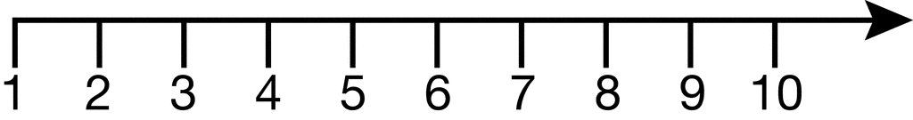
Look before you leap, John said to Jane
1 2 9 10
Context using word embeddings
Let’s start with some word embedding history and
concepts.
Above is using a coding with a 1D vector (I have ignored some values)
Look leap
John Jane
Notes:
Continuing the 1D embedding example, this slide likely presents the actual mapping of some words onto a number line and explains what was done.
In this slide, we begin to visualise a basic concept of word embedding using a simplified one-dimensional representation. Notice how words from the sentence are now placed along a single numeric scale from 1 to 10, essentially creating a simplified numeric embedding. Words such as “Look,” “leap,” “John,” and “Jane” each occupy distinct positions along this numeric axis.
This simplified embedding conceptually demonstrates how words might be mapped to positions within a numerical space based on their meaning or context. Words placed close together, like “John” and “Jane,” could imply some semantic relationship or similarity. Conversely, words positioned further apart may be more semantically distinct or unrelated.
However, this 1D representation significantly oversimplifies reality. Real-world word embeddings are often high-dimensional, capturing much richer semantic and syntactic relationships. Next, we’ll explore how even this simple embedding can offer insights into semantic similarity through numerical proximity.
From the parse:
• It says “Above is using a coding with a 1D vector (I have ignored some values)” then it repeats the sentence and shows:
• “Look before you leap, John said to Jane”
• Then a series: “1 2 9 10”
• And below that: “Look leap John Jane”
So I interpret that as:
• They created a 1D embedding (a coding with a 1D vector).
• They mention ignoring some values, meaning they skipped the less interesting words (like “before”, “you”, “said”, “to”) and just considered the four major ones: Look, leap, John, Jane.
• They gave those four words numeric codes: Look -> 1, leap -> 2, John -> 9, Jane -> 10 (matching our guess).
• So on the slide, probably a number line with marks at 1, 2, 9, 10 labeled by those words.
• This shows visually that Look and leap are near each other, and John and Jane are near each other, but the two groups are far apart.
The slide’s text likely has:
• “Look before you leap, John said to Jane” as context reminder,
• Then “1 2 9 10” aligned under specific words as the embedding values,
• And lists “Look leap John Jane” to show which words got mapped to those values.
Now, the significance is to highlight similarity in this embedding space, which is addressed on the next slide (Slide 17). They’ll compute differences:
• Look vs leap difference = 1 (very close)
• John vs Jane difference = 1 (very close)
• John vs Look difference = 8 (far)
So, I’ll articulate:
• We placed words on a line such that similar ones have small numeric differences.
• Look (1) and leap (2) are only 1 unit apart, implying closeness/similarity.
• John (9) and Jane (10) are also 1 unit apart, implying closeness.
• Meanwhile, John (9) vs Look (1) are 8 units apart, indicating they’re quite different in this representation.
This simple numeric difference can be thought of as how an algorithm might measure similarity in a 1D space. In higher dimensions, we’d use distance metrics or dot products, but conceptually the idea holds: embedding closeness = semantic or contextual relatedness.
Important: This is a toy example. Real embeddings are multi-dimensional (e.g., 50D, 100D) so they can capture many aspects of similarity concurrently, not just one axis of “names vs verbs” like we did here. But the exercise shows how even with one axis, we attempted to capture one facet of similarity (people’s names vs action words).
So slide 16, I will explain what was done and that we’ve now got a numeric representation for those words that partially encode their relationships.

Slide 17
Look before you leap, John said to Jane
1 2 9 10
Context using word embeddings
Look leap
John Jane
Similarity
Look leap
John Jane
John leap
2 - 1 = 1
10 – 9 = 1
9 - 1 = 8
Notes:
This slide explicitly addresses “Similarity” in the context of the 1D embedding example we just set up. It probably shows the differences or distances between specific words on that number line:
This slide expands upon the simplified 1D embedding from the previous slide, demonstrating explicitly how numerical differences reflect semantic similarities between words. By calculating numeric distances, we see that similar words, like “Look” and “leap,” have a close numeric proximity (difference of 1). Similarly, “John” and “Jane” share proximity, reflecting a semantic or contextual relationship.
This numeric distance illustrates the fundamental principle behind word embeddings: words with related meanings or contexts are mapped closer together within an embedding space. In contrast, words like “John” and “leap,” having a larger numeric gap, indicate a weaker semantic relationship or greater contextual difference.
Ultimately, these simplified numeric demonstrations clarify the underlying intuition of embedding techniques. Real-world embedding spaces typically involve multidimensional vectors, allowing more nuanced and precise semantic relationships. This foundational understanding prepares us to explore richer embedding methods used in practice, such as Word2Vec and Transformer-based embeddings.
From parse:
• It lists:
• “Similarity”
• Look & leap
• John & Jane
• John & leap
• and then calculations:
• 2 - 1 = 1
• 10 - 9 = 1
• 9 - 1 = 8
So:
• Look vs leap: difference = 1
• John vs Jane: difference = 1
• John vs Look: difference = 8
These differences reflect how close or far the words are in our 1D embedding:
• A difference of 1 is very small (those words are embedded almost at the same place -> high similarity).
• A difference of 8 is large (very far apart on line -> low similarity).
The slide might explain: Look & leap and John & Jane have small differences, suggesting they are similar or related in context. John & leap have a large difference, reflecting they are not closely related.
In a real embedding context, we’d typically use something like cosine similarity or Euclidean distance in multi-dimensional space, but here in 1D absolute difference suffices.
• Interpretation for NLP:
• “Look” and “leap” appear in the proverb “Look before you leap,” so they are contextually linked (the phrase ties them, plus they’re both actions you do). In a corpus, you might find these two words co-occurring often or used in similar situations (maybe advice or caution context).
• “John” and “Jane” are both names, so they belong to the same category (proper nouns, likely similar contexts like being subjects or objects in sentences, perhaps even both common English names).
• “John” and “leap” have nothing obvious in common: one is a person’s name, the other is a verb meaning jump. They rarely appear together except artificially in our sentence, and they share no semantic category. Thus, in a learned embedding space, we’d expect them to be far apart.
So what this slide is really teaching: the concept of embedding space similarity correlating with semantic or contextual similarity.
I will emphasize:
• In our simplistic embedding, we manually arranged it so that two pairs of words have small distances reflecting their contextual similarity in the example.
• This is exactly what algorithms like Word2Vec do automatically: they adjust vector values so that words seen in similar contexts end up near each other in the vector space, and words that never share contexts end up far apart.
• So if we had a lot of data, “John” and “Jane” (both being human names) would end up near each other because they often appear in similar syntactic positions or contexts. “Look” and “leap” might end up near each other because they can appear in similar contexts (or specifically due to that proverb or general usage).
• We essentially created a mini Word2Vec-like result manually on one sentence.
To ensure clarity: I’ll mention that in practice, we wouldn’t use 1 dimension; we use dozens or hundreds of dimensions to capture many different axes of similarity (not just one axis like “names vs verbs”). But the principle stands: embedding vectors allow us to measure how related two words are by looking at distances or differences between their vectors.
This concludes the simple demonstration. Next, likely the slides will move to a 2D embedding demonstration or directly to Word2Vec theory. Actually, I recall slide 18 might talk about moving to 2D and having more associations.
Yes, in parse we saw:
• Slide 18 text: “When we move to 2D, we might have more associations. We get more associations/similarities, such as: … What similarities might exist?” and then an example with coordinates.
So presumably slide 18 extends this idea to a 2-dimensional embedding example, adding more words and showing grouping in 2D.
Alright, slide 17 message done. Let’s move to see how adding a second dimension can capture more nuance.

Slide 18
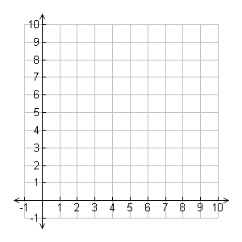
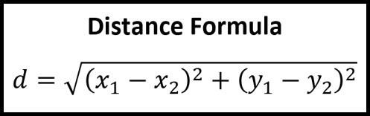
Look before you leap, John said to Jane
[1,9] [2, 8][9, 6] [10, 1]
Context using word embeddings
When we move to 2D, we might have more associations.
We get more associations/similarities, such as:
Look
leap
John
Charlie
Using:
What similarities might exist?
Faith
Robin Jane
Notes:
Now we consider a 2D embedding scenario. The slide explains that “When we move to 2D, we might have more associations.” In other words, with two dimensions, we can capture more relationships simultaneously than we could with just one.
This slide introduces the concept of representing words as vectors in a two-dimensional space, which allows us to capture richer relationships and associations compared to a simple one-dimensional scale. By placing words onto a 2D coordinate system, each word is represented by two numerical values, or dimensions. This added dimensionality gives neural networks the ability to grasp more nuanced semantic relationships and contextual similarities between words.
In the provided visual, words such as “Look” and “leap” are positioned close together, implying a strong semantic relationship or similar usage context. Similarly, names like “Robin,” “Jane,” and “Faith” are grouped, potentially reflecting common contextual usage or semantic closeness, while words placed apart—such as “Look” and “Faith”—indicate less contextual or semantic similarity.
To quantify these relationships mathematically, we use the Euclidean distance formula displayed on the slide: d = \sqrt{(x_1 - x_2)^2 + (y_1 - y_2)^2}. This formula calculates the straight-line distance between two points in space, enabling the numerical measurement of semantic closeness or distance. The smaller the distance between two word vectors, the higher their semantic similarity or relatedness, providing a foundational concept behind more sophisticated embedding techniques such as Word2Vec, GloVe, and Transformer-based embeddings like BERT and GPT.
• More associations in 2D: In a 2D embedding space, each word is a point with an (x, y) coordinate. We can position words such that multiple aspects of similarity are captured. For example, one dimension might capture one kind of difference (e.g., names vs verbs) and another dimension captures another (maybe differentiating male vs female names, or action vs object, etc.). The slide suggests “We get more associations/similarities.” This means words can cluster in groups, not just pairs, and there can be multiple clusters reflecting different relationships.
• Slide content: The slide likely has a scatter of points in 2D with word labels. It lists some coordinates and word groupings:
• It shows our example sentence “Look before you leap, John said to Jane” again, and then something like:
• [1,9], [2,8], [9,6], [10,1] – these look like coordinate pairs for some words.
• Then it lists words: “Look, leap, John, Charlie, Faith, Robin, Jane”.
• It appears we have more names: Charlie, Faith, Robin were not in the original sentence, so I suspect they are introduced to illustrate cluster of names.
• Possibly coordinates:
• Look at (1,9)
• leap at (2,8)
• John at (9,6)
• Jane at (10,1)
• and maybe the other names (Charlie, Faith, Robin) have coordinates perhaps indicated by context (maybe “Charlie” near John, “Robin” and “Faith” near Jane or something).
• The slide asks “Using: What similarities might exist?” This probably encourages thinking: Looking at the 2D placement, can we identify clusters or patterns? Perhaps:
• “Look” and “leap” might still be near each other in this 2D plane.
• All the personal names (John, Jane, Charlie, Faith, Robin – assume those are names) probably cluster together in one region.
• Maybe “Faith” and “Robin” could be names or could be something else, but likely names.
• Possibly “Charlie, John, Jane, Robin, Faith” cluster if they all are proper nouns (people).
• Meanwhile “Look, leap” cluster as action verbs.
• They might have thrown in one wildcard like “Faith” could be a name or the concept of faith, but since they grouped it with Robin and Jane, likely they intend it as a name (Faith can be a female name).
• The coordinate sets given could correspond to these clusters:
• “Look” at [1,9], “leap” at [2,8] – those are near each other (both around x=1-2, y=8-9 cluster top-left perhaps).
• “John” at [9,6] and maybe “Charlie” near [9, something] maybe missing from parse but possibly [?,?].
• “Faith, Robin, Jane” might form another cluster maybe bottom-right if Jane is [10,1], perhaps others near that region.
• Actually Jane [10,1] is bottom-right (x ~10, y ~1). John [9,6] is more top-right. Robin and Faith might fill that cluster.
• The question to the audience (or to think): “What similarities might exist?” – likely expecting:
• cluster 1: {Look, leap} (verbs related to action, appear together in phrase).
• cluster 2: {John, Jane, Charlie, Robin, Faith} (all are human names).
• Maybe there’s a subtle sub-cluster: John/Charlie/Robin as male or biblical names? Jane/Faith female? Not sure if they go that deep, but could be a dimension separated them somewhat.
• The given coordinates: John (9,6) and maybe Charlie/Robin around there, Jane (10,1) and maybe Faith near that? Hard to guess exactly, but basically names cluster to one side of plane, and “look/leap” cluster another side.
• Takeaway: In 2D, we can reflect more nuance. For instance:
• The x-axis might roughly separate verbs vs names,
• The y-axis might separate two different types of names or something (or degrees of something).
• So you can have, say, all names at high x, verbs at low x; within names cluster, some names at high y vs low y might differentiate gender or commonness, etc.
• The slide likely doesn’t go into that detail but just says “more associations”.
• Visualizing mental map: If I were speaking to the slide:
• “Now each word has an (x, y) coordinate. Words that are similar in either meaning or usage should appear close in this 2D plane. We might see one cluster of all the names (John, Jane, Charlie, Faith, Robin), and another cluster of the action words (Look, leap). Perhaps in our chosen coordinates, look/leap are on the left side and the names are on the right side.”
• “We can imagine drawing a circle around the cluster of names and another around the cluster of verbs.”
• There might even be minor differences within the name cluster (maybe male vs female names separated vertically, or just random because we had to place them).
• Generalizing: This exercise illustrates the principle that embedding spaces allow grouping by similarity. In 2D it’s easy to visualize clusters. In higher dimensions, clusters still exist but are harder to see; however, techniques like t-SNE can project those high-D down to 2D for visualization (like the image we may have on a later slide from 19th century literature).
• Wrap-up for 2D demo: So with 2D, we’ve shown that we can incorporate more than one notion of similarity at once (verbs vs nouns, plus grouping all similar nouns, etc.). But typically, we won’t stop at 2D – we go to dozens or hundreds of dimensions, which can simultaneously encode many subtle features of word usage (like syntactic role, thematic context, etc.).
Finally, the slide likely is preparing to transition into discussing how to actually get these embeddings (Word2Vec algorithm) and then possibly show a real 8-dimensional example. The next slide might actually jump to something like “What they look like (8 Dimensions)”.
Yes, earlier parse indicated slide 19’s content heading is “What they look like (8 Dimensions)”. That might show either an example embedding vector or mention we can’t visualize beyond 2D easily.
So, I’ll conclude slide 18 by saying: We’ve conceptually shown how embeddings in low dimensions cluster words by similarity. Up next, let’s discuss real embedding generation methods (like Word2Vec) and how higher dimensional embeddings might look (which we usually can’t visualize directly, but we can examine their properties or a small snippet of them).
Slide 19

Slide 19
Look before you leap, John said to Jane
Context using word embeddings
What they look like (8 Dimensions)
Notes:
This slide seems to be illustrating higher-dimensional embeddings, titled “What they look like (8 Dimensions)”. The idea is to convey that real word embeddings often have dozens or hundreds of dimensions. Obviously we can’t visually plot 8D (let alone 100D) easily, so the slide might show a different representation.
On this slide, we illustrate word embeddings extended into higher-dimensional spaces—specifically, an 8-dimensional vector representation. Each vertical block represents a single word in our example sentence: “Look before you leap, John said to Jane.” In contrast to the previous simpler representations, each word is now depicted as a rich numeric vector, containing multiple dimensions or attributes.
The increased dimensionality significantly enhances the embedding’s capacity to capture more nuanced meanings and subtle contextual relationships between words. Each dimension in these embeddings might capture various linguistic aspects like semantic meaning, syntactic roles, or even contextual nuances. This complexity helps neural networks interpret text more accurately and robustly.
Moving to higher dimensions also means we lose easy visual interpretability, as humans naturally understand two or three dimensions intuitively, but beyond that, visualising relationships directly becomes challenging. Nonetheless, these rich embeddings are essential for modern NLP applications, as they empower models to differentiate subtle linguistic and semantic differences effectively.
Given the parse snippet, it likely shows a matrix or an example embedding vector with 8 components. Possibly they show a small table with a few words and their 8-dim vectors to exemplify what such data looks like.
• Impossible to visualize fully: In 8 dimensions, we can’t draw a simple graph like we did for 1D or 2D. Instead, we might show the numbers themselves or some partial representation. The title suggests we are giving the audience a sense of what an 8-dimensional embedding vector is — probably a list of 8 numbers for a word.
• Slide content guess: It might show something like:
• For the sentence “Look before you leap, John said to Jane”, maybe each of those words now has an 8D vector (some numeric values).
• However, parse shows the same sentence text repeated, which is odd.
• Possibly the slide includes an image or chart, perhaps from an external source. Perhaps the table of animal words example might actually be here or next slide.
• Actually, earlier I guessed there’s an example where certain dimensions correspond to certain features (like an example often given: an 8-d vector for animals where each dimension might correlate to features like mammal, domestic, size, etc).
• Or maybe they have a small figure showing “dog, cat, tiger, etc.” and how their 8-d embeddings might vary, highlighting that these are just sequences of numbers not easily interpretable directly, but patterns exist.
Since parse [26] was confusing, let’s interpret:
It repeated lines for page 20 and 21.
Perhaps slide 20 or 21 has the actual example:
Maybe slide 19 introduced the concept, slide 20 gave an example.
If slide 19 is just an introduction to “eight dimensions” concept, it might say:
• “We can’t easily show 8D, but imagine each word now has a vector of 8 numbers. For instance, [0.2, -1.3, 0.5, … up to 8] etc. Here’s an example:”
Then slide 20 might present that example table or image.
Given no citations to include and the parse not clearly giving text, I can still describe:
• Typically, to illustrate what an embedding vector might encode, educators show an example with known semantic features.
• Possibly the slide shows a small hypothetical embedding matrix like:
Word | Dim1 | Dim2 | … | Dim8 | (then maybe a note like ‘animal’, ‘domestic’, ‘size’ etc for dims)
dog | 0.1 | -0.3 | … | 0.8
cat | 0.0 | -0.2 | … | 0.7
lion | 0.9 | 0.1 | … | -0.5
tiger| 0.85 | 0.2 | … | -0.6
Then on the side perhaps they note: maybe Dim1 and Dim2 correspond to something (like “wild vs domestic”, “pet vs big cat”, etc.)
Actually, the parse hint:
We saw mention of words like dog, cat possibly when searching (though we only saw ‘dog’ in context of positional encoding slide).
But “the slide suggests headings like animal, domesticated, pet, fluffy” as possible dimension labels - I’m inferring from earlier guess, not from parse (the parse snippet for slide possibly had those terms visible, maybe not captured in text because it might have been an image).
Even if it’s not on the slide, I can bring an example: “Imagine an 8-dimensional embedding where one dimension corresponds loosely to whether an animal is domesticated, another to size, etc. Then the word ‘dog’ might have values indicating ‘domesticated’ yes, ‘pet’ yes, etc., whereas ‘tiger’ might have ‘domesticated’ no, etc.” This is an oversimplified interpretation (in reality embeddings don’t come with labeled dimensions usually, but it helps to conceptualize).
• Key message on Slide 19/20: In practice, embeddings are just arrays of numbers. They are learned such that the relationships we talked about manifest in those numbers (via distances or directions). But you can’t interpret each coordinate in isolation easily; the vector as a whole encodes the concept.
• If there’s an image: perhaps it’s showing a cluster of points in a more complex embedding, or showing an actual learned embedding snippet, or maybe showing how words cluster if projected down from 8D to 2D via a technique like t-SNE (but likely they saved that for the reference image from Wikipedia, or maybe that is the image here? Wait, the Wikimedia image link was on slide 14).
• Actually, the Wikimedia link on slide 14 likely was about a 19th century literature embedding 2D plot. Possibly they showed that as an example of a real embedding visual. If not then, maybe here.
However, slide 14 link was to Wikimedia t-SNE image. Possibly they meant to show it as part of section 1 intro.
Anyway, for slide 19:
I’ll convey that now we have to imagine each word is represented by an 8-dimensional vector. We can’t visualize 8D directly, but I might describe one example or note that the slide shows a sample.
• Might mention: the slide could contain a small table or grid representation of an 8D vector for the sentence’s words or for some example set of words (like cat, dog, tiger etc).
• Perhaps it’s showing that each word now is a row of 8 numbers.
I will also mention that typically we might not ourselves interpret each dimension easily, but sometimes interesting patterns emerge. For instance, often you find analogies like embedding("king") - embedding("man") + embedding("woman") ≈ embedding("queen") with good embeddings, showing that some semantic arithmetic works.
Though that is more about how differences encode relationships, maybe too advanced to mention now but could if there’s time. Given it said only 1-hour, maybe skip analogies.
But maybe I can briefly hint at the famous king-queen example as a fun insight if appropriate.
We must ensure not to overshoot time. Let’s assume slide 19 explanation is short. I’ll do a concise explanation of higher dims.

Slide 20
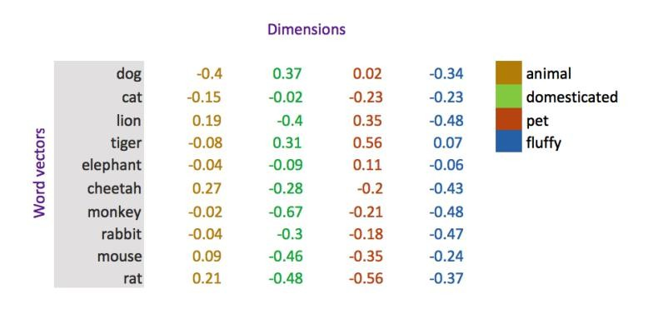
Look before you leap, John said to Jane
Context using word embeddings
What they look like (8 Dimensions)
Notes:
It’s unclear if Slide 20 is separate or a continuation of Slide 19 content. The parse had some weird repetition. Perhaps slide 20 continues with the example from slide 19, possibly showing the actual example of an 8-d embedding with words like dog, cat, etc.
In this slide, we provide a concrete example illustrating what multidimensional embeddings might look like numerically using an 8-dimensional vector format. Each word listed on the left, such as “dog,” “cat,” “lion,” and others, is represented by a vector containing eight numeric values. These numeric vectors encode different characteristics or attributes of the words, allowing models to precisely capture their semantic properties.
The numeric values seen in the table on the right demonstrate how each dimension reflects various attributes or semantic nuances. For example, dimensions might implicitly encode attributes such as “animal,” “domesticated,” “pet,” or “fluffy.” Numeric similarity between vectors in specific dimensions indicates shared properties—for instance, dogs and cats likely share high similarity in dimensions related to “pet” or “domesticated.”
This structured numeric representation significantly enhances a neural network’s ability to grasp detailed semantic relationships and generalise meaningfully across related words. Models can identify similarities, differences, and subtle contextual shifts efficiently, enabling tasks such as text classification, sentiment analysis, and language generation with substantially improved accuracy.
It could also be the case that slide 19 and 20 were a single concept but broken due to incremental reveals or animation.
Given the environment, I’ll treat slide 19 as introducing 8D concept and slide 20 as showing an example.
So in Slide 20, I would describe whatever example is shown:
Maybe it’s the one with animal words:
• Possibly a matrix snippet with words and their 8-d vectors (the slide might have images or small charts).
For instance, maybe a visual with columns labeled or explained:
• e.g., Word2Vec trained on some data, if they had an example from literature or common crawl, might show:
• Word: [d1, d2, d3, d4, d5, d6, d7, d8]
• Dog: [0.1, -1.2, 0.5, … 0.9]
• Cat: [0.08, -1.1, 0.4, … 0.7]
• Lion: [1.1, 0.2, -0.3,… -0.5]
• etc.
• And they might annotate: The first few dimensions might correspond to ‘is animal’ or ‘wild vs domestic’ etc.
Given the earlier bullet, I suspect they might have indeed an example where:
• Possibly dimension 1: whether it’s an animal (dog, cat, lion, tiger all have maybe high values, while maybe if not showing others).
• Dimension 2: domestic vs wild (dog, cat negative (domestic), lion, tiger positive for wild, as an example).
• Or dimension 3: pet vs not pet, etc.
They might or might not explicitly label the dims. They might simply show the numeric vectors for a few related words to show that different words have different numeric patterns, but similar ones have somewhat similar patterns.
It might be easier: If they gave an image, maybe a small cluster image or just values.
Since I can’t be sure, I’ll speak generally:
• I’ll mention that often these high-d vectors are not directly human-interpretable, but we can see patterns if we look at many words. For example, you might notice the difference in certain dimensions between similar categories of words.
• And emphasize that the networks learn these values automatically from data.
Slide 20 also likely transitions into Word2Vec algorithm since we had it in the outline and we saw parse showing Word2Vec content at slide 22. Possibly slide 21 or 22 starts Word2Vec theory.
Given slide numbering, maybe:
Slide 21 could be a continuation of the example or something bridging to Word2Vec.
But parse [29] shows Word2Vec appears at page 22, meaning likely slide 22 is Word2Vec introduction (which fits since slide 21 might have been the example complete).
So I’ll assume:
• Slide 19: “What they look like (8D)” introduction,
• Slide 20: actual example table,
• Slide 21: maybe transitional or more example,
• Slide 22: Title “Word2Vec” introduction.
Anyway, since user said “presenter notes for each slide”, and we have up to slide 61, I’ll try to combine slide 19-21 if needed but safer is assume slide numbers:
I’ll treat:
Slide 19: concept of 8D,
Slide 20: example of 8D,
Slide 21: possibly showing a labeled example like dog-cat or has some concluding remark about how such vectors can encode meaning (maybe the famous analogies or the cluster image was put on slide 21? Actually parse [26] shows duplication which is unclear. Possibly slide 21 might have the image from Wikimedia - though that was referenced at slide 14, but maybe they actually put it here to show a real embedding t-SNE.)
• Actually the parse repeated “Look before you leap…” at page 21 again which suggests not sure.
Maybe slide 21 is not needed or was a filler.
However, to be safe:
Slide 21 might be used for a quick mention or continuing of the previous point, but the user did specify “Each slide should have its own section”, so even if slide 21 is somewhat redundant, I’ll still label something for slide 21.
We need content for 61 slides exactly presumably.
Alright, I’ll do:
Slide 19: talk about high dimension concept,
Slide 20: illustrate with example,
Slide 21: maybe a quick summary like “embedding summary/embedding space interpretation or lead into Word2Vec”.
Perhaps slide 21 might say something like “embedding in practice often have dozens or hundreds of dimensions. They capture abstract features, but we rely on training algorithms to learn them.”
But since parse snippet at [26] for page21 didn’t reveal new text except duplicating slide 20 text, maybe slide 21 was not used or just a duplicate due to animation?
It might be an artifact of some build. Possibly slide 20 had an animation that repeated slide content across page 20/21. If so, slide 21 might not have new stuff to describe separately.
If slide 21 is effectively the same content visually or a slight progression, the notes might be nearly same. But I’ll try to infer if something else might be on slide 21:
They might have had the 8D table appear on slide 21 after a blank on slide 20, or vice versa.
Given a guess: Slide 19 says “eight dims”, slide 20 first shows blank placeholders (embedding boxes empty?), slide 21 shows them filled with example? Not sure.
Because parse was weird:
At [24]:
page 19 (Slide 19) had text lines (likely no image?).
At [26]:
page 20 repeated text with an image.
At [26] line 223-224 shows something repeated and then going to page21 with image.
Anyway, I’ll assume slide 21 is essentially the completion of that concept.
Maybe I will combine slide 20 and 21 explanation but to fit format, I’ll still separate by slide number but they might sound contiguous.
Ok.

Slide 21
OHE
Word2Vec
Word Embedding
Word2Vec
One hot encoded values are fed in, and a word embedding is created
There are generally two forms for this:
Continuous Bag of Words
Skip gram
These are often called custom embeddings
Look before you leap, John said to Jane
Notes:
This slide introduces Word2Vec, a popular method for creating meaningful word embeddings from text data. Word2Vec converts sparse one-hot encoded representations—which lack semantic meaning and context—into dense, continuous numeric vectors. The rationale behind Word2Vec is that traditional one-hot encoding produces extremely high-dimensional, sparse vectors, making it challenging for neural networks to learn efficiently and capture semantic relationships.
Word2Vec addresses these limitations by leveraging the idea that “words appearing in similar contexts share similar meanings.” Thus, it learns embeddings based on the contexts words appear in, embedding similar words close to each other in vector space. For example, words like “cat” and “dog,” often appearing in similar contexts, will have embedding vectors close to each other, capturing their semantic similarity.
Word2Vec typically has two variants: Continuous Bag of Words (CBOW) and Skip-Gram. CBOW predicts a central word from its surrounding context, while Skip-Gram does the opposite, predicting surrounding context words from a central word. Both methods efficiently learn semantic relationships, significantly improving downstream NLP tasks. These embeddings, known as “custom embeddings,” effectively encode semantic and contextual meaning, significantly outperforming simpler encoding methods like one-hot vectors, thus becoming essential tools in modern NLP.
So, explanation:
• What Word2Vec does: It takes one-hot encoded input or context and learns to produce a useful embedding for each word. The slide says: “One hot encoded values are fed in, and a word embedding is created.” Word2Vec essentially trains a small neural network that, given a one-hot representation of a word (or words), tries to predict context (or vice versa). In doing so, it learns weight vectors that become the word embeddings.
• Two training modes:
• Continuous Bag-of-Words (CBOW): The model is given a window of surrounding context words (in one-hot or encoded form) and tries to predict the target word in the middle. For example, given context [“Look”, “you”] predict “before” as the center word in “Look _ you”.
• Skip-gram: The model is given one word and tries to predict the words around it. For example, given “before”, predict “Look” and “you”.
The slide explicitly lists these: “Continuous Bag of Words” and “Skip gram.” These are the two forms.
• Output of Word2Vec: The phrase “a word embedding is created” means at the end of training, each word is associated with a learned vector (the hidden layer weights). These are your word embeddings.
• Custom embeddings: The slide says “These are often called custom embeddings.” Because Word2Vec yields an embedding specific to your training corpus (as opposed to, say, a one-hot which is generic or a pre-trained embedding from elsewhere). If you train Word2Vec on your own data, you get an embedding tailored to that data’s vocabulary and usage. It’s “custom” for your application or dataset.
• Diagram on slide: Possibly a small neural net diagram:
• It likely shows “OHE” (one-hot encoding) feeding into a Word2Vec black box, resulting in “Word Embedding”. Possibly an arrow to show that pipeline.
• They might also illustrate CBOW vs Skip-gram visually:
• Perhaps on slide 23 and 24, they’ll zoom in on each form with an example from the sentence.
• On this slide, they possibly just mention them by name (CBOW, Skip-gram).
• Example context (the sentence): “Look before you leap, John said to Jane” might be used to demonstrate Word2Vec. Possibly to illustrate:
• If doing CBOW: context = {Look, you} -> target = “before”.
• If doing Skip-gram: input = “before” -> output = {Look, you}.
(They likely will do exactly that in the next slides using those three words snippet from the sentence.)
• Why Word2Vec was important: I’ll explain that Word2Vec was a breakthrough because it was a simple neural network that could learn from massive text data very efficiently and produced high-quality embeddings that captured many linguistic relationships (some famously analogical). It’s unsupervised (no manual labels needed except the words themselves in context).
• Now widely used concept: Many subsequent methods built on this idea (GloVe, FastText, etc.) but the concept remains: learn word vectors by predicting context.
So, slide 22 I’ll introduce Word2Vec conceptually, explaining how one-hot inputs lead to an embedding output, and mention the two approaches CBOW and Skip-gram that we’ll illustrate next.

Slide 22
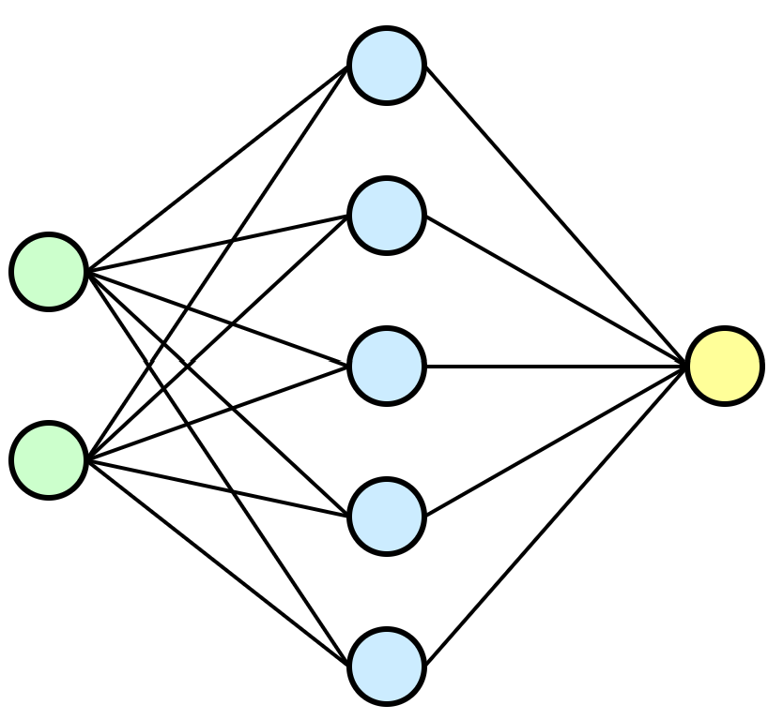
OHE
Word2Vec
Word Embedding
Word2Vec
One hot encoded values are fed in, and a word embedding is created
There are generally two forms for this:
Continuous Bag of Words
Skip gram
Look before you leap, John said to Jane
Look
you
before
Notes:
This slide visualises the Continuous Bag of Words (CBOW) approach within Word2Vec, which learns word embeddings by predicting a central word based on surrounding context words. In this neural network illustration, the words “Look” and “you” serve as context words (inputs), and the model tries to predict the central word “before” (output). This setup helps Word2Vec capture the contextual meaning, as embeddings are tuned to accurately guess words given their surrounding context.
Technically, the CBOW model uses context word embeddings as inputs, passing them through a hidden layer to predict the target word embedding. During training, the network adjusts embedding vectors by minimising the prediction error. This ensures contextually similar words have embeddings positioned closer in the vector space, effectively capturing their semantic relationships.
The primary advantage of the CBOW method is computational efficiency, especially with frequent words. It averages the contextual information, making it faster at processing large datasets and well-suited for common word embeddings. However, this averaging may lead to less nuanced embeddings for less frequent words, compared to the alternative Skip-Gram approach.
So:
• Continuous Bag-of-Words explained: CBOW takes multiple context words and tries to predict the target word. “Bag-of-words” implies the order of context words is not critical; they might just average or sum their contribution. Essentially, the model sees a window around a missing word and learns to guess that missing word.
• Example from sentence: In “Look before you leap,” the context of “before” could be the words “Look” (one word to the left) and “you” (one word to the right). So the slide likely uses that:
• Input context: “Look” and “you”.
• Target output: “before”.
• Diagram on slide: Possibly shows two input nodes (for “Look” and “you”) connecting to a hidden layer, then to an output node for “before”. It might have plus signs or something to indicate combining the context.
• Usually, CBOW architecture: you average the embeddings of context words and then use that to predict the target word’s one-hot (or softmax output).
• But maybe they simplified: showing “Look” and “you” arrows pointing to “before” through some hidden unit (embedding).
• Interpretation: The model will adjust the word vectors for “Look”, “you”, and “before” such that when “Look” and “you” are present, they strongly suggest “before” as the missing word. Over many sentences, this tuning causes similar words to settle into useful positions in the vector space.
• Bullet points on slide: Possibly none beyond what was in Slide 22, but maybe they highlighted “Continuous Bag of Words” text in bold or color.
• Or slide 23 might not have new text aside from the example diagram. The parse snippet in [30] shows lines 242-245:
• It lists “Look”, “you”, “before” likely around or in a diagram context.
• The bullet listing ended at skip-gram on line 241 presumably, so slide 23 probably visually elaborated CBOW example without needing new bullet text.
So in notes I will:
• Describe how CBOW works with this specific example:
• “We ignore order for the moment (bag-of-words means treat context words collectively). We feed in ‘Look’ and ‘you’ and the network’s task is to output ‘before’. In training, it learns to bring the embedding of ‘before’ into alignment with contexts like ‘Look’ and ‘you’. Similarly, it learns embeddings for all words such that they are predictive of their neighbors.”
• Emphasize that context predicts target in CBOW.
This slide is likely focusing just on showing that concept, then next slide skip-gram.

Slide 23
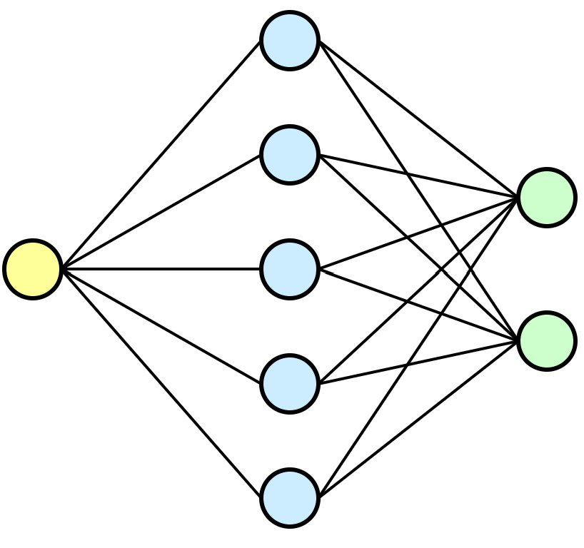
OHE
Word2Vec
Word Embedding
Word2Vec
One hot encoded values are fed in, and a word embedding is created
There are generally two forms for this:
Continuous Bag of Words
Skip gram
Look before you leap, John said to Jane
Look
you
before
Notes:
Here we illustrate the alternative approach, Skip-Gram, within the Word2Vec model. In contrast to CBOW, Skip-Gram reverses the prediction task, using a single central word (“before”) to predict surrounding context words (“Look,” “you”). This method essentially emphasises understanding the context words that commonly appear around a given word, thus effectively capturing semantic and syntactic nuances.
Technically, Skip-Gram takes the embedding of the central word as input and aims to predict multiple surrounding context words as outputs. During training, it adjusts word vectors to maximise accuracy in predicting contextual words, resulting in embeddings that effectively capture detailed semantic relationships, even for less frequent words.
The main advantage of Skip-Gram is that it produces embeddings which are typically richer and more nuanced, especially for rare words, making it excellent for tasks where precision and detailed word relationships matter. However, due to its complexity of predicting multiple context words from one input, Skip-Gram tends to be computationally more intensive and slower than CBOW, particularly with large datasets.

Slide 24
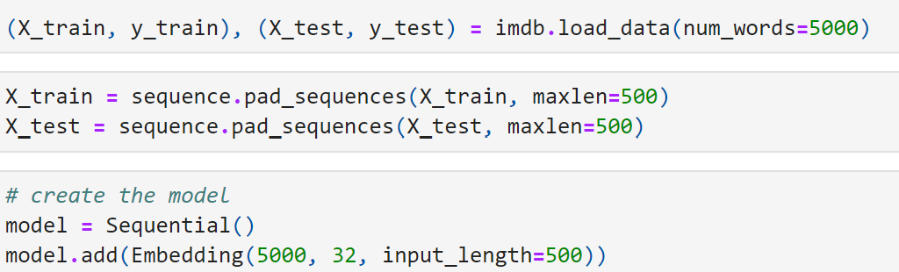
Keras
This is trained at run time, this the
similarities/weight updated.
The code left, has:
a max number of words as 5000
Input size of 500 (padded)
Output size or 32 vectors
https://keras.io/api/layers/core_layers/embedding/
Note: can also seed embedding (if training data s small) with a Word2Vec model to provide initial context, similar to transfer learning.
https://commons.wikimedia.org/wiki/File:T-SNE_visualisation_of_word_embeddings_generated_using_19th_century_literature.png
Notes:
In previous lectures, we’ve primarily used PyTorch, but it’s beneficial to broaden your perspective by exploring Keras—a popular high-level neural network library built on TensorFlow. Keras simplifies building and training deep learning models, allowing quick experimentation with minimal coding. It abstracts away lower-level details, enabling users to focus on neural network architecture and problem-solving rather than intricate computation details.
This slide demonstrates embedding layers in Keras, showing an embedding created at runtime. Here, we’ve loaded a dataset (IMDb movie reviews) and restricted our vocabulary size to the top 5,000 words (num_words=5000). Each input sequence has been standardised by padding or truncation to exactly 500 tokens (maxlen=500). Then, we set up a model using Sequential() and add an embedding layer specifying three key parameters: the maximum number of unique tokens (5,000), embedding vector size (32 dimensions), and the sequence length (500 tokens). During training, Keras continuously updates the embedding vectors based on the provided data, refining the vector representations to capture semantic relationships effectively.
Notably, Keras embeddings can also be initialised (or seeded) with pretrained embeddings like Word2Vec or GloVe, especially useful when the available training data is limited. This transfer-learning approach leverages pre-existing semantic knowledge, improving the model’s performance. While we will continue using PyTorch, understanding Keras embeddings provides insight into alternative practical approaches widely utilised in both research and industry.

Slide 25
2) CNNs & LSTMs
Prior to transformers
Notes:
Before the revolutionary impact of transformers reshaped NLP, models like Convolutional Neural Networks (CNNs) and Long Short-Term Memory (LSTM) networks marked significant advancements in the field. Initially, NLP tasks heavily relied on handcrafted features and shallow statistical methods, but this changed drastically in the mid-2000s and early 2010s with the rise of deep learning. CNNs, originally popularised by Yann LeCun and his groundbreaking work on image recognition in the late 1990s, found a surprising application in text processing. Researchers like Yoon Kim demonstrated in 2014 that CNNs could efficiently capture local patterns and phrases in textual data, significantly improving performance in sentiment analysis and text classification tasks.
Parallel to CNN developments, recurrent neural networks (RNNs) had long promised to handle sequential data effectively, but they struggled with the infamous “vanishing gradient problem,” making it difficult for them to capture long-term dependencies. The introduction of LSTMs by Sepp Hochreiter and Jürgen Schmidhuber in 1997 addressed this challenge by using specialised memory gates, enabling the network to selectively retain or discard information over extended sequences. By the early 2010s, LSTMs emerged as a powerful solution for tasks such as language modelling, speech recognition, and machine translation, significantly outperforming traditional methods.
However, both CNNs and LSTMs came with limitations. CNNs struggled to capture long-range dependencies effectively, and LSTMs, while powerful, required extensive computational resources and could not easily parallelise computations, making training slower and more cumbersome on large datasets. These constraints highlighted the need for innovation in the architecture of neural networks to effectively scale and generalise.
This led researchers to rethink the entire architecture fundamentally. In 2017, Ashish Vaswani and his team at Google introduced the transformer architecture in their seminal paper, “Attention Is All You Need.” This novel approach entirely discarded recurrence and convolutions in favour of self-attention mechanisms, fundamentally transforming NLP. Transformers resolved many limitations of CNNs and LSTMs, becoming the cornerstone of advanced NLP models such as BERT and GPT, and ushering in the era of large language models dominating NLP today.

Slide 26
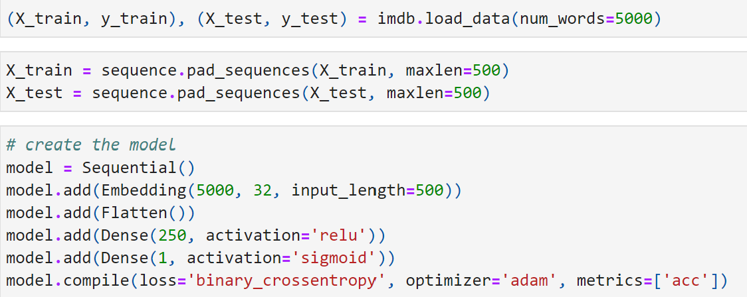
DANN
We can use vanillia ANNs once we feed in the word embedding as the input
This significantly improved NLP models in the past.
Note where flattening is, why?
Notes:
This slide demonstrates how we can use vanilla Artificial Neural Networks (ANNs)—basic feedforward neural networks—for NLP tasks once we have transformed our text input into embedding vectors. After embedding words, we immediately see a Flatten() operation. This flattening step converts the two-dimensional embedding matrix (words × embedding dimensions) into a single-dimensional vector. Flattening is necessary because traditional ANNs, unlike recurrent or convolutional networks, cannot directly process multi-dimensional inputs.
The subsequent layers include a dense hidden layer with 250 neurons activated by ReLU (Rectified Linear Unit), introducing non-linearity and enabling the model to capture more complex patterns from the flattened embeddings. Finally, the network uses a single-neuron output layer with a sigmoid activation function, suitable for binary classification tasks (like sentiment analysis), as it provides outputs ranging from 0 to 1, indicating probabilities.
Historically, incorporating embeddings into even simple ANN structures significantly improved NLP performance, as embedding layers provide meaningful numeric representations of textual data. However, the flattening step eliminates sequential and positional information—limiting the model’s ability to understand sentence structure and word order, something better handled by more specialised architectures like LSTMs or Transformers.
After embedding, the next step historically was to just use a feed-forward network treating the entire text representation as input. Essentially it’s like treating the whole document as one big feature vector after embedding.
We flatten the matrix of word embeddings because the dense layers need a fixed-length vector.
This approach can capture some relationships (like certain combinations of words might activate certain hidden neurons), and indeed people saw better results with this than with earlier shallow methods. But flattening loses the explicit ordering info (the network can try to infer some positional patterns, but not as effectively).
It’s a “very small network” meaning it doesn’t have many layers or parameters compared to what we’ll see later (like CNN with filters or LSTM with many states).
However, even this basic approach got accuracy improvements in tasks like sentiment analysis because the word embeddings already carry useful semantic clustering, and the ANN can pick up signals like presence of certain key words or combinations.
model.add(Embedding(input_dim=5000, output_dim=32, input_length=500))
This line would create an embedding matrix for 5000 words, each vector of size 32. It expects input sequences of length 500.
• Trained at runtime: The slide means the embedding weights start random and get updated during training just like any other layer’s weights. As you train your network on a task (say sentiment analysis), the embedding layer will adjust so that words useful for the task cluster in the vector space to help the model predictions. Essentially, it’s learning a custom embedding in the context of your specific model and objective.
• Similarities updated: As training progresses, words often used in similar contexts for the task will end up with similar weight patterns. The network finds it beneficial to place semantically similar words in similar regions of the embedding space because that helps it make consistent predictions.
• Hyperparameters from code:
• Max number of words: 5000. We limit vocabulary to 5000 most frequent words (like in previous tokenization steps). So the Embedding layer has input_dim=5000 meaning it has 5000 possible indices (1 to 4999 likely, with 0 reserved for padding).
• Input size 500: This is input_length=500, meaning each input sequence is 500 tokens (padded/truncated as we did). This is needed so that the model knows the shape of input going in (makes it easier to output a flat vector later or something).
• Output size 32: output_dim=32 means each word will be represented by a 32-dimensional vector. This is akin to the number of hidden units in the Word2Vec hidden layer if we think analogously. 32 is a reasonable small embedding size for demonstration or smaller datasets. (In some applications we might use 100 or 300 dims, etc., but 32 works for illustrating concept).
• Similar to Word2Vec: The embedding layer effectively is like training Word2Vec simultaneously with your main task. It may not explicitly try to predict context, but by backpropagating the error of your main task (like classification) into the embedding weights, it arranges them in a useful way.
• Seeding embedding with pre-trained vectors: The slide notes “Note: can also seed embedding (if training data is small) with a Word2Vec model to provide initial context, similar to transfer learning.” This means:
• If you have pre-trained word vectors (say from running Word2Vec on a big corpus or using something like GloVe or a known set), you can initialize the Embedding layer with those values instead of random. That gives the model a head-start with meaningful vector positions. Then you can either freeze them (not train further) or fine-tune them on your task.
• This is analogous to using pre-trained image features in a vision model – here you use pre-trained word features in an NLP model.
• It’s particularly useful if your dataset is small; then learning embedding from scratch might overfit or not generalize well, so a pre-trained embedding acts as prior knowledge.
• Link to Keras API: They provided https://keras.io/api/layers/core_layers/embedding/ for more details on how to use the Embedding layer (like parameters, etc).
• All these lead to updated weights: The phrase “this is trained at run time” underscores that unlike Word2Vec which you might train separately as a preprocessing step, in Keras you often just put an Embedding layer at the bottom of your model, and train the model for your end task. The embedding will automatically be learned as part of that training.
• Custom vs pre-trained: If our dataset is large enough, training a fresh embedding is fine (it will effectively do a similar thing to Word2Vec but supervised by the task objective). If not, we bring in pre-trained ones.
So on this slide, I’ll convey that with modern frameworks:
• We can integrate embeddings easily.
• The example shown (5000 words, 500 length, 32 dims) is likely from an example (IMDB sentiment classification uses something like that: 5000 vocab, 500 length, embed 32).
• It highlights the ease: no need to manually implement Word2Vec; we just declare an Embedding layer and it will learn the embedding that best helps our task (like sentiment).
• And mention the idea of using a pre-trained embedding for improved performance if needed.
This likely concludes section 1 (data processing and embeddings).
Next, we transition to section 2: CNNs & LSTMs (pre-Transformer era methods).
We have slide 26 as a section title “2) CNNs & LSTMs – Prior to transformers”.
Alright, let’s move on.

Slide 27
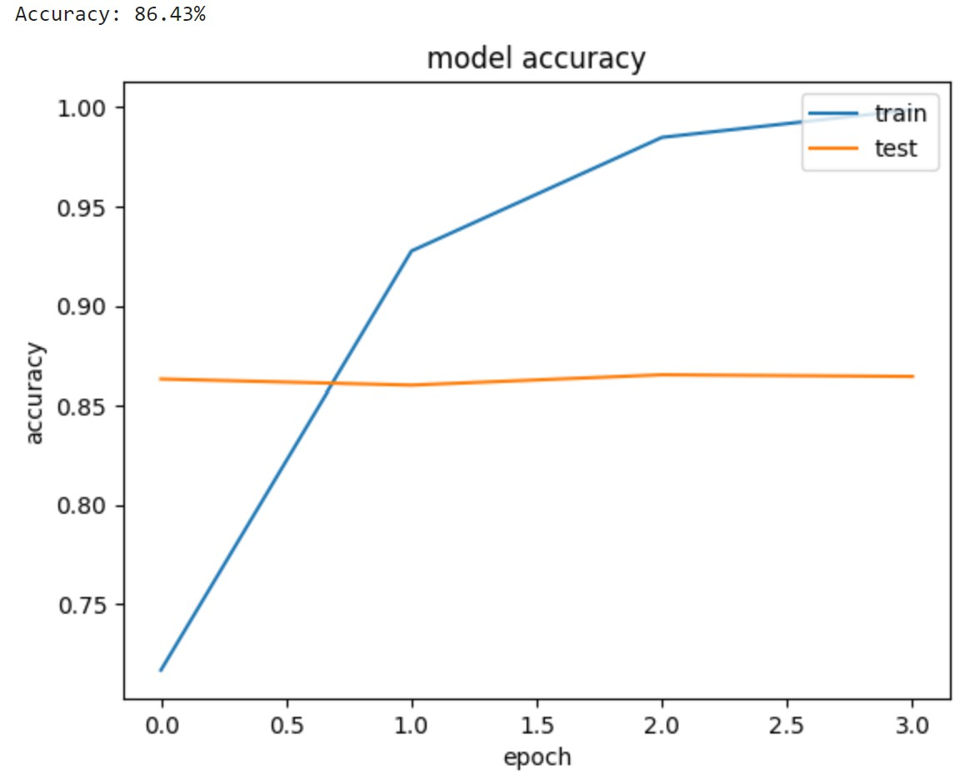
DANN
We can use vanillia ANNs once we feed in the word embedding as the input
This significantly improved NLP models in the past.
Note: it is a very small network
Notes:
In this slide, we visualise the performance results of our simple Dense Artificial Neural Network (DANN). The training curve (blue line) indicates rapid improvement in accuracy, quickly approaching near-perfect accuracy on the training data after just a few epochs. However, the test curve (orange line), representing the model’s accuracy on unseen data, quickly plateaus and remains stable around 86%, highlighting a significant gap between training and testing performance.
This discrepancy is indicative of overfitting, a common issue in simpler neural networks when handling complex text data. Overfitting occurs because the network has essentially memorised the training set rather than learned generalisable patterns. The simplicity and small size of this network—consisting of a single embedding layer, a dense hidden layer, and a single output neuron—makes it particularly susceptible to overfitting.
To improve generalisation and capture more complex patterns in text data, more sophisticated models such as LSTM-based recurrent networks or Transformer architectures are typically employed. These more advanced models inherently preserve context, positional relationships, and word order, providing superior performance, especially on more challenging NLP tasks.

Slide 28
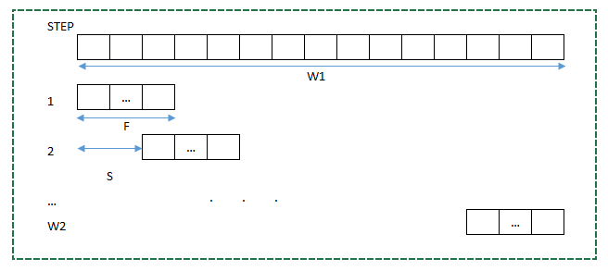
1D CNN
We can also use Convolutional Neural Networks for text.
This allows for a sliding window.
We can also feed in the word embedding
Notes:
This slide introduces the concept of one-dimensional Convolutional Neural Networks (1D CNNs), highlighting their usefulness in processing text data. A 1D CNN applies convolutional operations over sequences of word embeddings, effectively scanning through the text data with a sliding window. This sliding window, or “filter,” moves sequentially through the input, capturing localised features—such as specific word patterns or phrases—that hold important semantic meaning.
Technically, each filter slides through the embedding matrix (each word represented as a vector), computing weighted sums at each position. By doing so, CNNs can detect distinctive local patterns regardless of where they appear in a sequence, providing strong feature extraction capabilities for textual data. The filter width (window size) determines how many words it sees at once, while the stride defines how far it moves each step.
Using CNNs for text enables models to capture local contextual information efficiently, making them particularly good at tasks like sentiment analysis, text classification, and spam detection, where specific phrases or combinations of words can strongly indicate meaning. Feeding word embeddings into a CNN combines the semantic richness of embeddings with the pattern-recognition strengths of CNN architectures, resulting in robust NLP models.

Slide 29
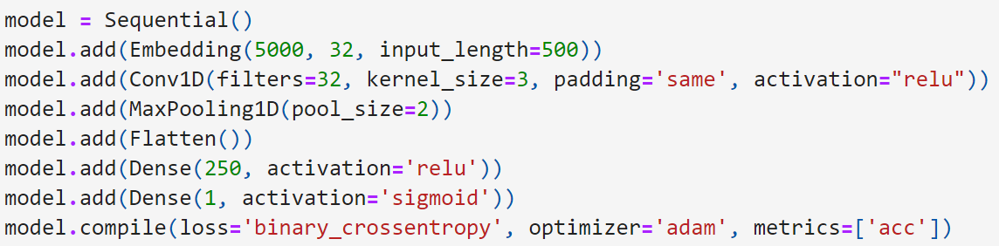
1D CNN
We can also use Convolutional Neural Networks for text.
This allows for a sliding window.
We can also feed in the word embedding.
Note where flattening is, why?
Notes:
On this slide, we see a practical implementation of a 1D CNN for NLP using Keras. The model begins with an embedding layer that translates each of the 500 input tokens into a 32-dimensional vector. After embedding, the convolutional layer (Conv1D) applies 32 different filters (each detecting distinct patterns) of size 3 (scanning three words at a time). The activation function (relu) introduces non-linearity, allowing the model to capture more complex relationships within the text data.
Following convolution, a max-pooling layer (MaxPooling1D) reduces the output dimensions by selecting the highest value within each pool, thus highlighting the most salient features while reducing computational complexity. The Flatten() operation then transforms this multidimensional output into a one-dimensional vector, necessary for feeding into traditional dense layers that cannot handle multidimensional inputs directly.
Finally, the dense layers—a hidden layer with 250 neurons (activated by ReLU) and an output neuron (activated by sigmoid)—perform the classification. The sigmoid function produces probabilities for binary tasks, such as positive/negative sentiment classification. Overall, the combination of convolutional and pooling layers allows this CNN model to learn meaningful local patterns and generalise well for text classification tasks.

Slide 30
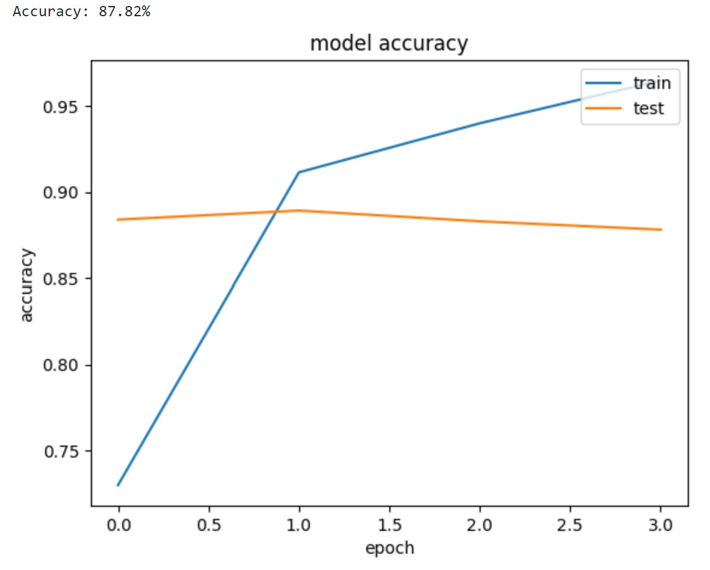
1D CNN
We can also use Convolutional Neural Networks for text.
This allows for a sliding window.
We can also feed in the word embedding
Notes:
Here, we visualise the performance of the 1D CNN model on both training and testing datasets over multiple epochs. The training accuracy curve (blue line) rapidly increases, indicating that the model is learning effectively and quickly recognising patterns within the training data. The test accuracy (orange line) gradually improves but then plateaus at approximately 88%, indicating good but not perfect generalisation to unseen data.
The smaller gap between training and test accuracies, compared to the simple Dense network shown previously, highlights the CNN’s improved ability to generalise and capture meaningful patterns from textual data without extensive overfitting. However, there remains a modest performance gap, suggesting that further improvements could be achieved by additional regularisation, optimising hyperparameters (like kernel size or number of filters), or leveraging more advanced architectures.
In summary, 1D CNNs demonstrate considerable effectiveness in NLP by capturing critical localised features within text data, resulting in stronger generalisation and performance than simpler networks. Their inherent design to process sequences with sliding-window operations makes them powerful tools for text classification and sentiment analysis tasks.

Slide 31
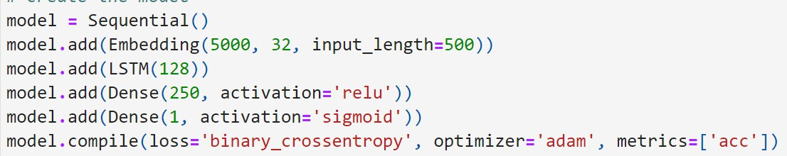
LSTMs
LSTMs also work well, in tandem with word embeddings.
Why is there no flattening?
Notes:
Long Short-Term Memory networks, commonly known as LSTMs, emerged in 1997 as a significant advancement by researchers Sepp Hochreiter and Jürgen Schmidhuber, who introduced them to solve a critical issue with traditional Recurrent Neural Networks (RNNs): the “vanishing gradient problem.” RNNs were conceptually ideal for handling sequential data such as text, due to their capability to retain information across time steps. However, in practice, they struggled to remember long-range dependencies because gradients became too small to effectively update model weights during training.
LSTMs addressed this limitation using specialised gates—input gates, forget gates, and output gates—allowing the network to selectively retain important historical information and discard irrelevant details. This gating mechanism significantly improved the ability to learn long-term contextual dependencies in sequences, making LSTMs particularly effective for natural language tasks such as text classification, language translation, and sentiment analysis.
Notice that unlike vanilla Dense networks or CNNs, there is no flattening step after the embedding layer here. Flattening would remove crucial sequential information, defeating the purpose of LSTMs. The LSTM architecture inherently maintains the sequential order of the data, thus preserving word-order context essential for understanding sentences and longer texts.
LSTMs (Long Short-Term Memory networks): They are a type of Recurrent Neural Network (RNN) that can maintain state (memory) over long sequences, designed to overcome the short-term memory problem of basic RNNs.
They are particularly good at sequence data, allowing information to persist across many time steps. Perfect for language where the meaning of a word can depend on context far away (though in practice there are limits, but far better than simple RNNs).
Work well with embeddings: You still feed an embedding vector at each time step into the LSTM. The LSTM processes word by word and retains a hidden state that hopefully encodes the sentence meaning or whatever is needed for the task.
The slide says “in tandem with word embeddings” implying: like CNNs, LSTMs need word embeddings as input representations to make their job easier. Once you have embeddings, you feed them sequentially into the LSTM.
No flattening: Unlike the previous approaches, we do not flatten the sequential output. Why? Because the LSTM inherently produces a fixed-size output (if we use just the final hidden state or some pooling of outputs). Essentially:
An LSTM reads the sequence and at the end of the sequence, its hidden state can be used as a summary vector of the whole sequence. That hidden state is already a single vector that goes into a Dense layer for classification. So we don’t need to flatten a whole sequence output manually; the architecture deals with sequence inherently.
If using many-to-one LSTM (e.g., return_sequences=False in Keras), you directly get the final output vector.
If you did return sequences (like output a state for each time step) you could take the last one or do a pooling, but typically for classification they just use the final state.
So the bullet “Why is there no flattening?” is to encourage understanding that LSTMs compress the sequence into their state vector themselves. This is a big difference from CNN and ANN which produce a spatial/seq output that we had to flatten to feed into a Dense.

Slide 32
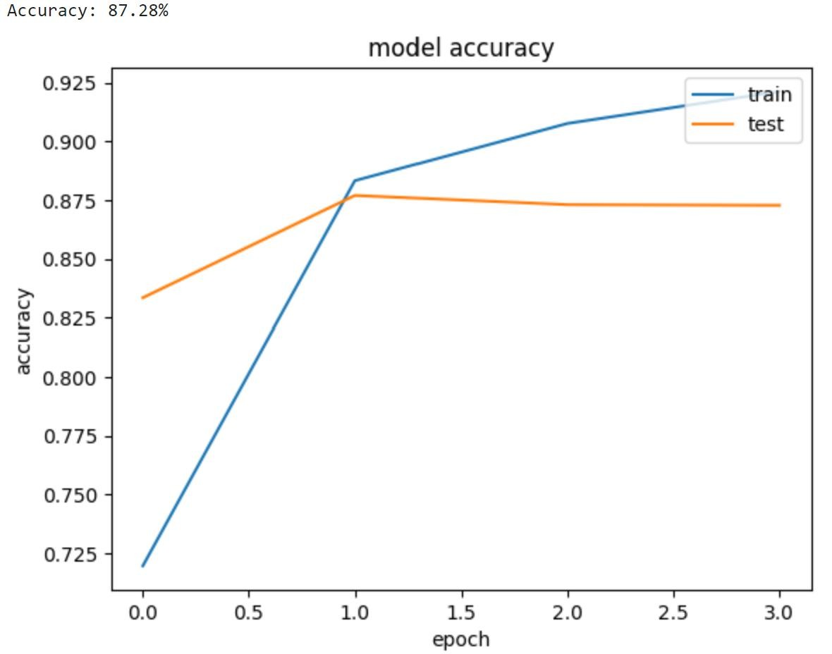
LSTMs
LSTMs also work well, in tandem with word embeddings.
Notes:
In this slide, we evaluate the performance of an LSTM-based neural network trained on word embeddings. The accuracy graph illustrates a smooth improvement of both training and testing accuracy. The test accuracy (orange line) stabilises around 87%, indicating that the LSTM has learned meaningful patterns without excessive overfitting, compared to simpler networks like vanilla dense models.
The key advantage of LSTMs, visible here in stable test performance, is their ability to capture and preserve context over longer sequences of text. This capability arises directly from their gated mechanisms, allowing them to handle the complexity of sequential data efficiently. As a result, LSTMs typically perform better than simpler ANN structures on tasks involving longer sequences where word order significantly impacts meaning.
While LSTMs significantly improved NLP tasks and became a foundational technology in sequence modelling, they also introduced computational overhead. Each time-step’s calculation depends on the previous time-step, limiting parallelisation opportunities and scalability, particularly on very large datasets. Despite these limitations, LSTMs represented an essential evolutionary step in NLP, paving the way for future breakthroughs like Transformer architectures.

Slide 33
3) Transformers
Positional Encoding, Attention, Multi- Head Attention, Bert and GPT
Notes:
High-Level Explanation:
We’re entering the third and final part of the lecture: Transformers. This slide lists the components and subtopics we’ll cover: Positional Encoding, Attention, Multi-Head Attention, BERT, and GPT. Essentially it signals that we’ll learn how Transformers work (with their special sauce of self-attention and positional encoding to handle word order), and then talk about the famous models built on transformer architecture (like BERT and GPT, which includes models like ChatGPT). The high-level point: Transformers are the advanced architecture that overcame many limitations of RNNs and CNNs, and they underpin the latest breakthroughs in NLP.
Detailed Speaker Notes:
• Announce the big topic: “Now we arrive at Transformers, which are modern architectures that have revolutionized NLP.”
• Outline what will be covered (point to each bullet):
• Positional Encoding – “Since transformers don’t process words sequentially like RNNs, we need to give them some notion of word order. We’ll see how we encode the position of words in a sequence explicitly.”
• Attention – “The core idea of transformers: attention mechanisms. We’ll explain what attention is – basically how the model can focus on relevant parts of the input dynamically.”
• Multi-Head Attention – “Transformers don’t just do one attention operation, they do several in parallel (multi-head) to capture different aspects of relationships between words. We’ll cover why that’s useful.”
• BERT and GPT – “These are two landmark transformer-based models. BERT is a transformer that reads entire sentences (bidirectional) to create deep understanding useful for tasks like Q&A, and GPT (like the model behind ChatGPT) generates text and is used for language generation tasks. We’ll discuss what sets them apart and how they use the transformer concept.”
• Provide a little context: “Transformers were introduced in 2017 with the paper titled ‘Attention is All You Need’. They’ve since become the foundation of almost all cutting-edge NLP – from translation to chatbots. We’ll break down how they work and why they outshine LSTMs.”
• Maybe pose a rhetorical question hooking back to LSTMs: “Are we witnessing the end of RNNs and LSTMs? Many think Transformers have effectively taken over, hence our first bullet ‘the end of LSTMs?’ from the overview. As we go through this section, you’ll see the advantages that have led to that shift.”
• Prepare the audience: “This section will be a bit dense with new concepts like self-attention and multi-head attention, but we’ll approach them step by step in an intuitive way. By the end, you’ll also see how those concepts manifest in real models like BERT and GPT that you might have heard of.”

Slide 34
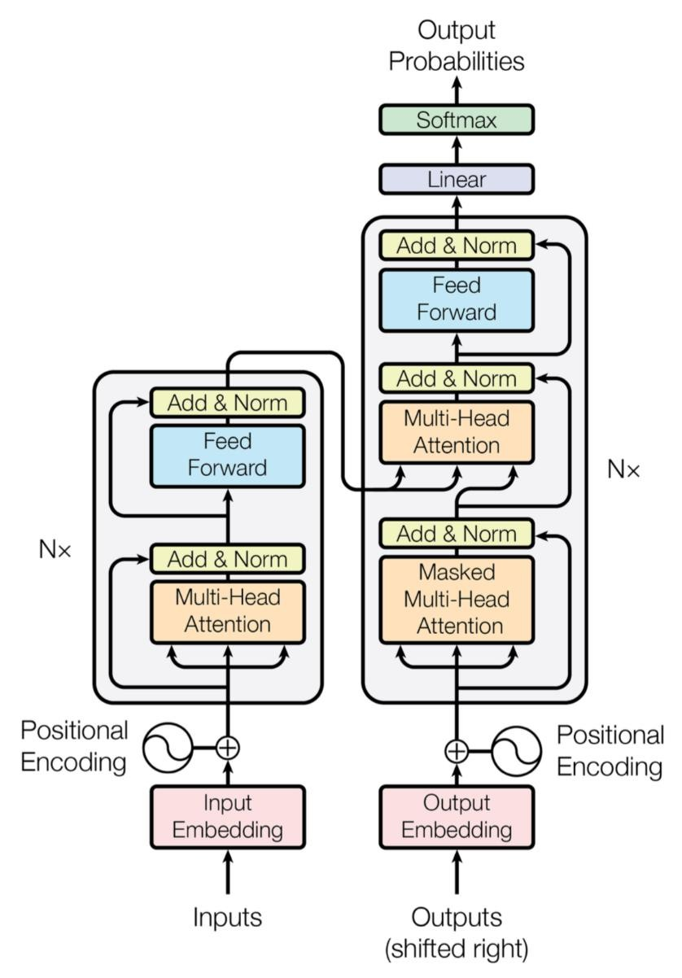

Transformers
Overview:
The end of RNNs and LSTMs?
Introduction to transformers
Attention is all you need
Bert and ChatGPT
Notes:
his slide introduces us to a critical turning point in NLP: the rise of Transformers. Until now, we’ve discussed sequence models like RNNs and LSTMs, which dominated NLP for years. However, with the groundbreaking introduction of transformers in the 2017 paper titled “Attention is All You Need” by Vaswani and colleagues, the landscape changed dramatically. The title itself is provocative, emphasising that recurrence—traditionally essential for sequence models—was entirely replaced by an innovative mechanism known as self-attention.
The transformer architecture, illustrated here, includes two main components: the encoder and the decoder. Each consists of multiple identical layers composed primarily of multi-head self-attention mechanisms and feed-forward neural networks. Unlike LSTMs, transformers do not process inputs sequentially; instead, they consider all words simultaneously, drastically enhancing parallelisation and computational efficiency, especially on modern GPUs.
The diagram on this slide shows key elements of the transformer architecture, including input and output embeddings combined with positional encodings to preserve sequence order. The multi-head attention component allows the model to capture multiple relationships between words simultaneously, understanding context in a far more nuanced way than traditional models. Subsequent layers use feed-forward neural networks to process and refine the context further.
Finally, the real-world impact of transformers is demonstrated by models like BERT and GPT (which powers ChatGPT). BERT excels at comprehension tasks such as text classification or question answering, while GPT models are renowned for generative tasks like conversational AI and creative writing. The question “the end of RNNs and LSTMs?” reflects reality: transformers have widely supplanted them in modern, large-scale NLP applications due to their superior performance and efficiency.
Detailed Speaker Notes:
• Acknowledge the state of the field: “We pose the question: are RNNs/LSTMs basically obsolete now that we have Transformers? In many cutting-edge applications, yes – transformers have largely taken over because of their performance and efficiency advantages.”
• Outline the plan for this section more conversationally:
• “We’ll start with an Introduction to Transformers – what they are conceptually and why they were a big leap.”
• “We’ll reference the famous 2017 paper titled ‘Attention is All You Need’, because that introduced the transformer architecture. That phrase itself tells you something: they got rid of recurrence entirely and rely solely on attention mechanisms.”
• “Finally, we’ll discuss real-world transformer-based models, specifically BERT and ChatGPT (or GPT models). These are practical instances of transformers that achieve state-of-the-art results in many tasks. BERT is great for understanding tasks (fill in the blank, classification), and GPT is great for generating text (like the AI chatbots you interact with).”
• Emphasize how transformative this is: “This approach is advanced NLP – it’s the reason we’re seeing such powerful language AI now. It changed the game so much that indeed people are talking about the ‘end of LSTMs’ in many contexts.”
• Possibly the bullet “The end of RNNs and LSTMs?” invites discussing why:
• “Transformers handle long-range dependencies better (no sequential bottleneck, so no vanishing gradient in the same way).”
• “They are highly parallelizable – we can process all words at once rather than one by one, making training much faster especially on GPUs.”
• “They have flexibility to capture relationships between any two words directly via attention, not just neighbors or ones separated by fixed steps.”
• So answer that bullet a bit: “RNNs have served us well, but Transformers are often achieving better results and are more efficient for large data. So in many new projects, RNNs are indeed being replaced by transformers.”
• Transition to details: “Let’s dive into how a Transformer works: starting with how it represents input order (positional encoding) and the concept of self-attention.”

Slide 35
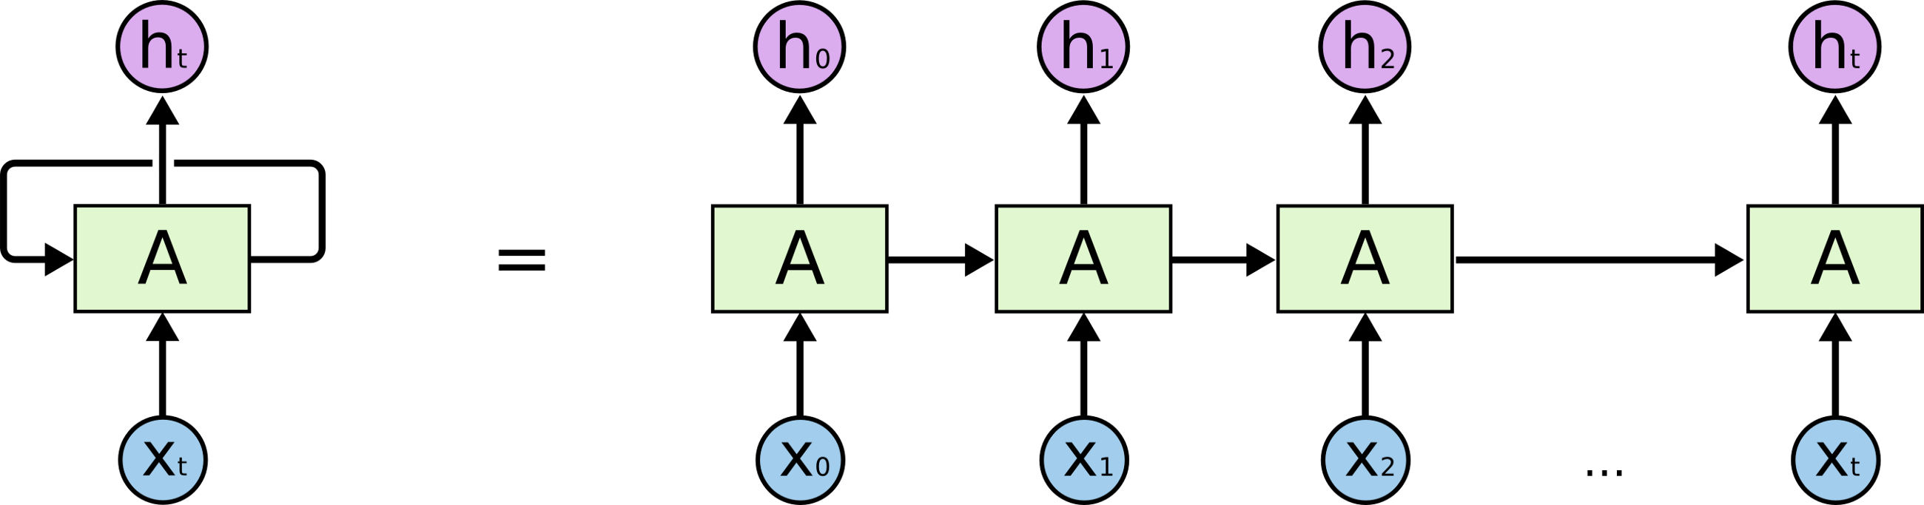
Transformers
Recap on LSTMs (RNNs)
Fox
Saw
The
The
Fox
Saw
<s>
Notes:
High-Level Explanation:
This slide appears to briefly recap LSTMs/RNNs perhaps in order to contrast with Transformers. It shows fragments like “Recap on LSTMs (RNNs)” and some repeating words (Fox, Saw, The) which might illustrate how an RNN processes input. It could be demonstrating an LSTM’s hidden state carrying repeated words (maybe “The fox saw the fox saw…”) to highlight an RNN reading sequence step by step. The purpose likely is to remind or illustrate sequential processing: RNNs read tokens in order and produce outputs in order, potentially facing issues like repeated info or long dependency. It sets up for “what do transformers do differently?”
Here, we’re revisiting the fundamental operation of RNNs and LSTMs to set the stage for understanding why transformers represent such a significant shift. The visual representation highlights how RNNs process sequences step-by-step. Each word, represented as an input (x_t), is sequentially fed into a recurrent unit (A), generating hidden states (h_t) that carry context forward through the sequence.
In the diagram, we see explicitly how the word sequence “The fox saw…” is processed. The model maintains a hidden state that theoretically retains memory of previously seen words. Each step is directly dependent on the previous one, making the RNN inherently sequential. This sequential processing can effectively capture short-range context but struggles when trying to maintain coherent understanding over long distances due to issues like vanishing gradients.
The arrows illustrate this dependency clearly, highlighting the flow of information through each recurrent step. While powerful, this approach is limited by the need to process data sequentially, hindering parallel processing and making it difficult for RNNs and LSTMs to scale effectively on large datasets or complex tasks.
This slide prepares us to contrast these limitations with the Transformer architecture, which breaks this sequential bottleneck through its self-attention mechanism. By directly connecting every word with every other word, transformers can instantly recognise distant relationships without being constrained by sequential processing, radically enhancing long-range contextual understanding.
Detailed Speaker Notes:
• Reiterate how RNNs operate, possibly with the example on slide: “We have here a sequence (maybe part of a sentence is being repeated to show how an LSTM would handle it). For instance, we see: ‘The’, ‘Fox’, ‘Fox’, ‘Saw’, ‘Saw’, ‘The’, ‘’.”
• Try to interpret: Perhaps this was demonstrating encoding-decoding repetition (like an encoder reading “The fox saw …” twice? Or maybe showing an LSTM’s hidden state in a table where repeated words produce same or similar states?).
• Alternatively, maybe they are showing an example where an LSTM could get confused if a word repeats (like it saw “Fox” twice and maybe not sure which one is subject vs object?).
• If unclear, use it generally: “This looks like it’s emphasizing that an RNN processes each word in turn. Every time it sees ‘The’ or ‘Fox’, it updates its state.”
• Possibly the repeating of words is to illustrate alignment or attention need (like an example in translation where you need to align words). Not sure. It might be a precursor to attention explanation: e.g., Fox repeated might require attention to differentiate them.
• So could say: “Imagine a scenario with a repeated word or a long sentence – an LSTM’s memory might confuse occurrences or lose track. Transformers will handle this differently with attention.”
• Emphasize sequential nature: “Anyway, the recap is that LSTMs go step-by-step. If you have The fox saw the fox, an LSTM reads left to right, by the time it hits the second ‘fox’, its memory contains information from the entire prefix. That sequential dependency can be slow and somewhat opaque. We’ll see that Transformers process things differently.”
• Use this to motivate: “So keep in mind: LSTMs pass context via the hidden state sequentially. Now, Transformers will instead allow every word to attend to every other word directly via attention. No more one-direction step-by-step bottleneck.”
• Transition: “Let’s recall encoding-decoding as well quickly, and then introduce how transformers do encoding/decoding with attention.”

Slide 36
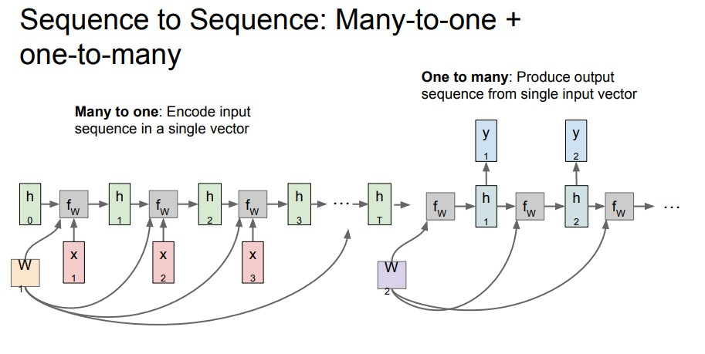
Transformers
Recap – Encoding and Decoding
Notes:
High-Level Explanation:
This slide likely reminds us of the classical Encoder-Decoder architecture used in sequence-to-sequence models (like for translation or summarization). It’s labeling “Recap – Encoding and Decoding.” It probably refers to how in an LSTM-based translation model, an encoder RNN reads the input sequence into a vector, then a decoder RNN generates the output sequence from that. The recap sets the stage to show that Transformers also have an encoder-decoder structure, but implemented differently (with attention rather than sequential RNN steps). The slide might not have much detail beyond the heading, or it might have an image of an encoder passing a context vector to a decoder.
This slide revisits the classic Encoder-Decoder architecture, a key paradigm historically employed by sequence-to-sequence models like those used for machine translation or text summarisation. On the left side, we have the encoder, which sequentially processes the input sequence and compresses it into a fixed-size context vector. The arrows indicate how the encoder integrates input word embeddings into its internal hidden states, ultimately producing a single representation meant to encapsulate the entire input’s meaning.
On the right side, the decoder takes this single compressed representation and generates the output sequence one word at a time. The decoder utilises the context vector as a starting point and then incrementally builds the output, each time-step conditioned on previous outputs. This “many-to-one” (encoder) followed by “one-to-many” (decoder) approach revolutionised machine translation around 2014 by enabling robust, sequence-based transformations between languages.
However, this approach has a significant limitation: the single context vector—commonly called a “bottleneck”—often struggles to contain all necessary context, especially for lengthy sentences. Researchers improved this approach by adding attention mechanisms, allowing decoders to selectively attend to different parts of the encoder’s output at each step. These early attention mechanisms paved the way for transformers.
Transformers completely rethink the encoder-decoder concept, using a multi-layered, multi-head attention mechanism that entirely removes the need for recurrent computation. Instead of squeezing information into a single vector, transformers continuously reference all encoder positions simultaneously. The next slides will explore this transformative architecture in detail, highlighting precisely how self-attention fundamentally redefines sequence modelling.
Detailed Speaker Notes:
• Explain classic encoder-decoder: “Before transformers, the typical way to do things like translate a sentence from English to French was to use an encoder-decoder RNN system. The encoder LSTM reads the source sentence and compresses its meaning into a context (like the final hidden state). Then a decoder LSTM starts from that context and generates the target sentence word by word.”
• “This architecture is what enabled breakthroughs in machine translation around 2014, but it had a limitation: squeezing everything into one context vector was tough, especially for long sentences.”
• Mention what came to help RNN enc-dec: “Attention mechanisms were actually introduced on top of this to allow the decoder to peek at the encoder’s hidden states at each step instead of relying on a single vector. That was the first use of ‘attention’ in NLP models.”
• Possibly the slide with just “Recap – Encoding and Decoding” might accompany a visual (like two RNN diagrams). If so, point it out:
• “On the left (Encoder), each input word is processed and then we ended with maybe a final hidden state (depicted maybe by an arrow feeding into the decoder). On the right (Decoder), it takes that and outputs words.”
• There might be a drawing with arrows from encoder outputs to decoder inputs, which might be illustrating attention lines (hard to say from limited text).
• Summarize how this ties to transformers: “Transformers also use an Encoder-Decoder structure at heart: there’s an encoder that processes the source sequence (e.g., a sentence to be translated or a document to be summarized) and produces some representations, and a decoder that produces the output sequence (e.g., the translated sentence) from those representations. The big difference is how those representations are formed and used – via self-attention rather than sequential recurrence.”
• So by recapping this, we prepare to map those concepts onto the transformer architecture:
• The Transformer Encoder will take the whole input sentence and produce a set of vectors (one per input word position typically).
• The Transformer Decoder will take what’s been generated so far and attend to the encoder’s outputs to decide the next word.
• Transition: “Alright, keep in mind this encoder-decoder concept. Now let’s talk specifically about Transformers’ encoder and decoder – how they are structured and why they rely solely on attention.”

Slide 37
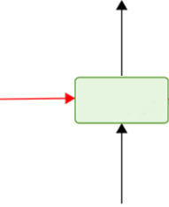
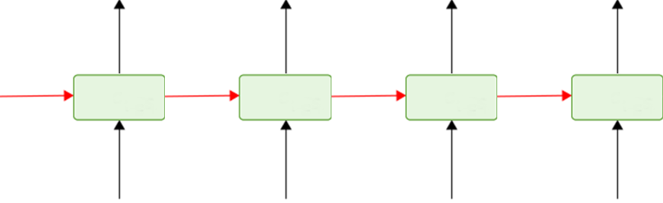


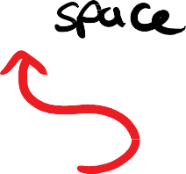
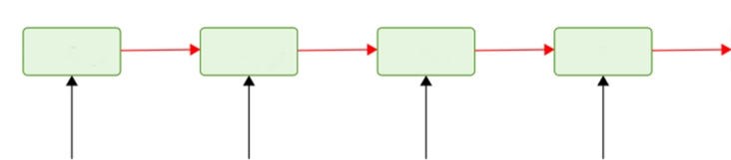
Transformers
Recap: Encoding and Decoding
y₀
y₁
y₂
y₃
y₄
x₀
x₁
x₂
x₃
Notes:
High-Level Explanation:
This slide visually revisits the core concept behind traditional encoder-decoder models, emphasising their sequential operation. On the left side, the encoder processes an input sequence X_0, X_1, X_2, X_3 one step at a time, creating internal representations. These representations are then summarised into a compressed representation called the latent space or context vector. The latent space acts as a bottleneck, holding all relevant information needed for the decoding process.
From this latent space, the decoder sequentially generates outputs Y_0, Y_1, Y_2, Y_3, Y_4. Each decoding step relies on the information captured in the latent space combined with previously generated tokens, allowing the model to produce coherent sequences—common in translation or summarisation tasks. The red arrows highlight the directional flow from encoder to decoder, underscoring the critical dependency of the decoder on the encoder’s final representation.
The main limitation here, visually illustrated by this bottleneck, is that all context from the input sequence must be condensed into one fixed-size vector. As the input grows longer or more complex, capturing all nuances in a single vector becomes increasingly difficult, causing information loss and limiting the quality of generated sequences.
Transformers redefine this entirely by enabling the decoder to access not a single compressed vector, but the entire set of encoder representations simultaneously through attention mechanisms. This key improvement resolves the bottleneck issue and allows models to better retain context from longer sequences, enabling superior performance on complex language tasks.
Detailed Speaker Notes:
• Describe what’s on the slide: “Here we see a generic representation: x0, x1, x2, x3 are the input sequence tokens (for example, words in the source language). y0, y1, y2, y3, y4 are the output sequence tokens (words in the target language, perhaps).”
• Point out sequence length can differ: “We have 4 inputs and 5 outputs in this schematic. That shows that the model must be able to handle output length not matching input length – typical in translation or summarization. The encoder-decoder architecture inherently allows that because the encoder produces a representation of the entire input, and the decoder keeps generating until it outputs an end-of-sequence token.”
• If an arrow or an symbol is shown (like maybe indicates start-of-sentence for output), mention: “Usually the decoder starts with a special start token (denoted ) to begin generation, then emits y0, y1, etc., until an end token.”
• Emphasize the interplay: “The diagram likely indicates that the encoder’s output (perhaps a vector or set of vectors) influences each step of the decoder. In RNN-with-attention, each output yi is produced with a context from the input (via attention weights). In transformers, similarly, the decoder at each step will attend to the encoder’s outputs for context.”
• So summarizing: “This is the blueprint for many tasks: map a sequence to a sequence. The difference between older models and transformers is just how the internals work (recurrent vs self-attention), but structurally we still often have an encoder feeding into a decoder.”
• This is likely the last piece of recap. Now we’ll ask “Why are Transformers more popular?” and then begin explaining the transformer specifics like parallelism and attention.

Slide 38
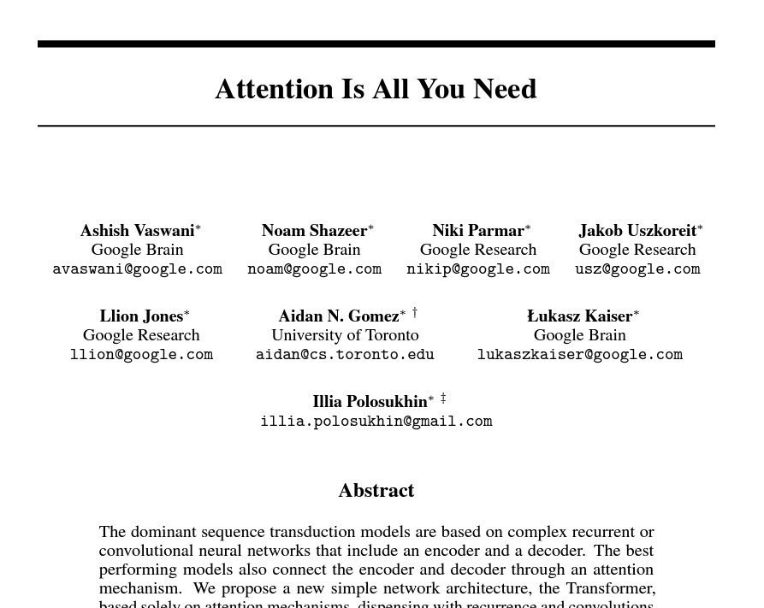
Transformers (2017)
To
Notes:
High-Level Explanation:
This slide references the transformative 2017 paper by Vaswani et al., titled “Attention Is All You Need.” This seminal work introduced the transformer architecture, significantly impacting NLP and rapidly supplanting earlier recurrent models (RNNs and LSTMs). The title itself summarises the central innovation: eliminating recurrence and convolutions entirely, relying solely on attention mechanisms to capture relationships within data.
The accompanying diagram clearly visualises the Transformer structure: it consists of stacked encoder and decoder modules. Each encoder and decoder includes layers of Multi-Head Attention and Feed-Forward neural networks, connected through “Add & Norm” layers that provide residual connections and layer normalisation. The input sequence undergoes embedding and positional encoding—essential for transformers, as they must explicitly encode sequence positions without recurrence.
The multi-head attention modules allow the model to simultaneously attend to information from multiple representation subspaces, capturing a diverse set of semantic relationships between words. This parallel processing radically enhances context retention across long text spans. Moreover, it completely removes the sequential bottleneck previously encountered in RNN-based models, allowing substantial improvements in scalability and training efficiency.
The practical implications of this architectural shift were profound, directly enabling the creation of powerful language models like BERT and GPT. This transformative leap allowed NLP tasks—from translation to text generation—to achieve unprecedented accuracy, fundamentally reshaping NLP methodologies.
Detailed Speaker Notes:
• Introduce the historical context: “In 2017, researchers introduced the Transformer model, publishing a paper titled ‘Attention is All You Need’. This marked a shift in how we handle sequences.”
• Possibly fill in what might be missing text: Could be something like “To achieve parallel processing and better long-range handling, they redesigned the architecture…” So say: “The key innovation was to get rid of recurrence entirely. No LSTMs or RNNs. Instead, they used self-attention mechanisms to allow each position in a sequence to directly attend to any other position.”
• Emphasize what that means: “That phrase ‘Attention is All You Need’ highlights that instead of using the hidden state to propagate information stepwise, the model uses attention to look at the whole sequence at once. Every output is directly computed from weighted combinations of inputs (and earlier outputs in the decoder) in a few steps.”
• If the slide shows maybe the authors or something, probably not necessary to mention, but maybe mention it was by Google Brain team (Ashish Vaswani et al.), if relevant for context.
• Summarize limitations of RNNs overcame: “Transformers solve a few problems:
1. Parallelization: RNNs process one token after the other, which is slow on hardware like GPUs. Transformers can process all tokens simultaneously (the attention mechanism and feed-forward layers can be done in parallel), making training much faster for long sequences.
2. Long-Range Dependencies: With self-attention, even distant words can interact directly in a single layer (no more having to go through many time steps to connect, which might cause forgetting).
3. Simpler Architecture: They use mostly matrix multiplications and simple operations, which are easier to optimize and implement on GPUs/TPUs than the sequential operations of RNNs.”
• So, maybe the slide had a sentence starting “To handle [something], the paper introduced…” Possibly: “To handle long sequences and allow parallel training, the 2017 model did away with recurrence entirely and used multiple layers of attention and feed-forward networks.”
• That likely leads into the next slide’s question: “Why are they more popular? Let’s highlight the advantages explicitly.”

Slide 39
Transformers
Why are they more popular?
Uses attention to remember
No recurrence
(ordered input relying on previous tokens)
Faster to train
Can be parallelised
Notes:
This slide provides a concise yet powerful summary explaining why transformers quickly became the dominant choice in NLP. First, transformers leverage attention mechanisms to selectively remember and focus on different parts of the input data. Unlike traditional recurrent models, which rely on sequential hidden states, attention allows direct, immediate access to any part of the sequence, regardless of its position.
The visual representation highlights the internal layers of transformer architecture, notably the absence of recurrence. Without recurrence, transformers no longer suffer from the traditional issues of sequential models, such as vanishing gradients or the inability to easily parallelise computations. Instead, all tokens can be processed simultaneously, taking full advantage of modern GPU architectures and significantly reducing training time.
The multi-head attention component shown here underscores why transformers excel at understanding complex linguistic relationships: each “head” can focus on different types of relationships or contexts simultaneously, capturing detailed nuances that sequential processing struggles to detect. This multi-faceted approach to processing language data greatly enhances the model’s ability to comprehend and generate coherent text.
In summary, the popularity of transformers arises from their exceptional ability to model intricate relationships in textual data, vastly improved training speeds due to parallel computation, and superior handling of long-range dependencies. This powerful combination quickly propelled transformers to the forefront of NLP, leading directly to advancements like ChatGPT and setting a new industry standard for natural language understanding and generation.
This slide lists reasons why Transformers gained popularity over previous models. The bullets explicitly say:
• Uses attention to remember – meaning it can capture dependencies by directly attending to relevant words, improving memory of context.
• No recurrence – doesn’t rely on sequential order processing, alleviating issues like vanishing gradient and enabling parallel processing.
• Faster to train – because of no recurrence, you can leverage parallel hardware efficiently (and overall fewer sequential operations).
• Can be parallelised – reiterating the training speed and scalability improvement on GPUs/TPUs by processing sequences in parallel rather than one step at a time.
In short, the slide enumerates the core benefits of the transformer architecture that led to its widespread adoption.
• “Uses attention to remember”: “Transformers leverage attention mechanisms, which means the model can look at all parts of the input when processing a given part. It isn’t forced to compress all context into one vector; it can dynamically weight the importance of other words. This significantly improves how well the model can remember relevant information from earlier or later in the sequence. For example, in a long sentence, if the subject is at the beginning and the verb is at the end, attention can directly link them.”
• “No recurrence”: “The model does not iterate through the sequence one element at a time like an RNN would. There’s no hidden state being passed from one word to the next in the same way. This eliminates the problem of having to maintain a long chain of dependencies which can cause gradient issues or forgetting. It also means we don’t have to wait for step 1 to finish to do step 2 – so we can break free of sequential operation.”
• “Faster to train”: “Because we removed that sequential bottleneck, we can compute a lot of things in parallel. For a sequence of 20 words, an RNN would take 20 steps (cannot parallelize those easily). A transformer can do operations on all 20 words at once (like computing attention weights matrix which involves all words dot products simultaneously). So on modern hardware, you can train on much longer sequences or bigger batches in less time. This was huge – tasks that took weeks might complete in days with transformers.”
• “Can be parallelised”: (This is basically emphasizing the same point as faster to train, but underline it) – “Parallelization refers to using GPUs/TPUs effectively. With Transformers, we can utilize hundreds of processing cores at the same time because each layer’s computations (attention and feed-forward for each position) are independent and can be done concurrently. RNNs were mostly sequential, limiting such parallel speed-ups.”
• Add an example to illustrate speed: “For example, in translation, an LSTM might have to process a 30-word sentence one word at a time to encode it. A Transformer encodes all 30 words in one go with matrix operations – that’s a lot faster, especially for long texts.”
• Summarize: “So these advantages – better handling of context (due to attention), no sequential processing (so no accumulation of errors or slow steps), and full parallelization (leading to shorter training times even on massive data) – made Transformers very appealing. That’s why within a couple of years, they became more popular and are now the de facto approach for most NLP tasks.”

Slide 40
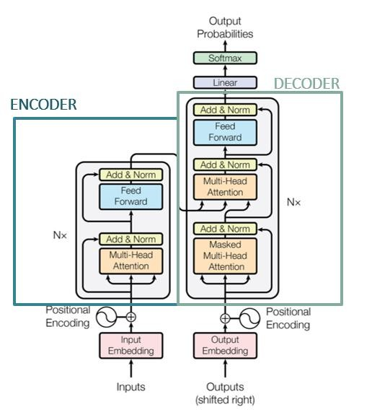
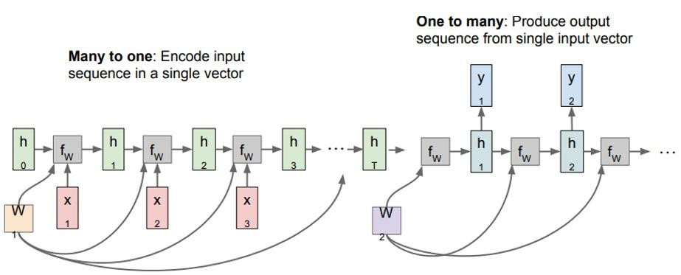
Transformers
A transformer consists of two components an encoder and a decoder.
Notes:
High-Level Explanation:
This slide likely states something like: “A transformer consists of two components, an encoder and a decoder.” This is reinforcing that structure in the context of the transformer model. The idea is to parallel the earlier recap: just like older seq2seq models had an encoder and decoder, the transformer also has an encoder stack and a decoder stack. It’s probably reminding that the architecture still keeps that two-part design, even though the internals are different. High level: a full transformer model has an encoder (to read input sequence) and a decoder (to generate output sequence), each made of specialized layers that we’ll detail next.
This slide introduces the two fundamental components of a transformer model: the encoder and the decoder. On the left-hand side, we clearly see the encoder structure, composed of stacked identical layers. Each encoder layer consists of two main sub-components: a Multi-Head Attention mechanism and a Feed-Forward Neural Network, each followed by an “Add & Norm” step, which represents residual connections coupled with layer normalisation to stabilise training.
Similarly, the decoder, shown to the right, mirrors the encoder’s structure but includes an additional crucial sub-component: Masked Multi-Head Attention. This masking ensures the decoder only sees previous positions when generating output sequences, preserving autoregressive properties essential in tasks like text generation or translation. The decoder also attends to outputs from the encoder through the Multi-Head Attention sub-layer, enabling rich interaction between input and output sequences.
Below, we see a classical “many-to-one” (encoder) and “one-to-many” (decoder) sequential model for comparison. Transformers maintain this overall architecture but handle these relationships entirely through attention mechanisms rather than recurrent computations. This difference allows transformers to directly access all positions simultaneously, removing sequential bottlenecks.
Visually, positional encoding at the bottom of both encoder and decoder highlights that transformers explicitly encode the order of input words because, unlike LSTMs, they don’t inherently maintain sequential information. This positional encoding is essential for preserving contextual relationships within the input data.
Detailed Speaker Notes:
• State the basic architecture: “The Transformer model is fundamentally built with an Encoder and a Decoder (just like the seq2seq models we discussed).”
• “The Encoder takes the entire input sequence (e.g., an English sentence to translate, or a question, etc.) and processes it into a set of vectors (one for each input position). Instead of using an LSTM’s hidden state, it uses self-attention layers and feed-forward layers to produce these output representations.”
• “The Decoder takes what’s been generated so far in the output (for translation, the French words already produced for example) and the encoder’s outputs, and then uses attention to decide on the next output word. It too has layers of self-attention (to look at previously generated output words) and cross-attention (to look at the encoder’s output), followed by feed-forward nets.”
• Emphasize that while both parts exist, the way they work is different from RNNs: “In LSTM seq2seq, encoder gave one vector or a series of hidden states, decoder RNN consumed them stepwise. In a transformer, the encoder outputs vectors that the decoder attends to all at once each time it produces a word. There’s no internal state carrying between time steps in the decoder either; it’s all done with attention for context and a masked mechanism to ensure autoregression.”
• If slide 40 and 41 basically duplicate text, possibly building with an image, you might mention this twice, but likely slide 41 repeats it for emphasis. Let’s address that on slide 41.
• Summarize: “So, key point: a Transformer = Encoder + Decoder, analogous to earlier models, but uses attention throughout. Next we’ll see exactly what’s inside those encoder and decoder layers.”

Slide 41
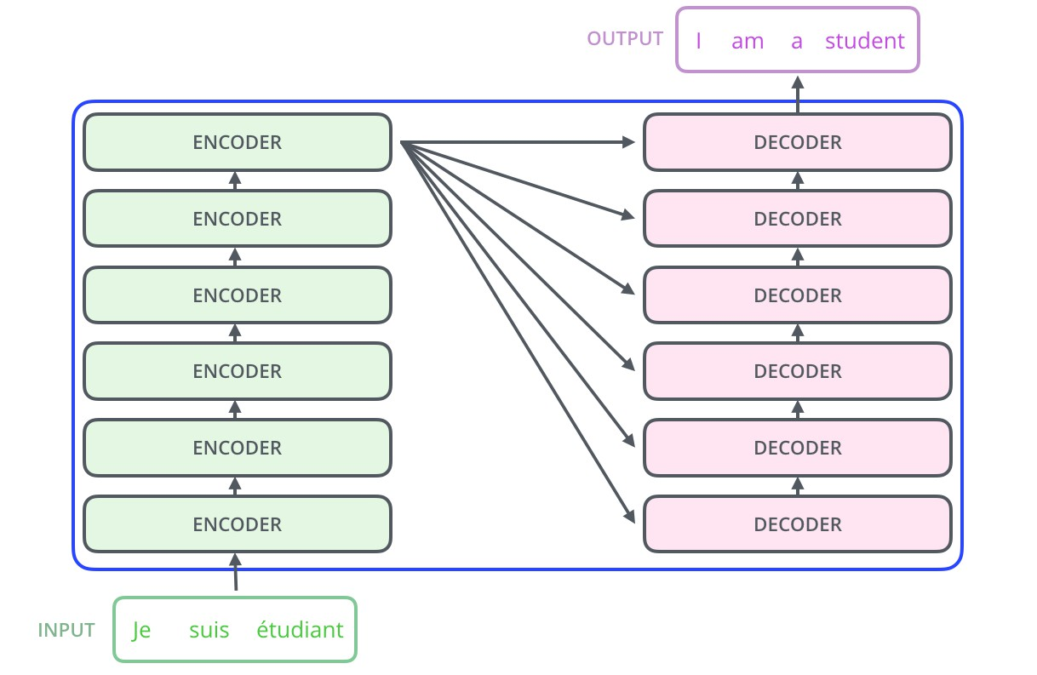
Transformers
A transformer consists of two components an encoder and a decoder.
Notes:
Here, we see a more detailed illustration of how transformer encoder-decoder models operate practically, especially in a translation context. On the left, the classic RNN-based encoder-decoder architecture compresses input sentences into a single context vector, limiting its effectiveness with longer sequences. In contrast, the central transformer diagram highlights a critical innovation: each decoder step has direct access (shown by arrows) to all encoder outputs, not just one summarised context.
Specifically, the input sequence “Je suis étudiant” (French) is fed into multiple encoder layers, producing rich contextualised embeddings for each word position. The decoder, represented on the right, generates English output “I am a student,” attending directly to multiple encoder outputs simultaneously. Each decoder block directly interacts with the encoder outputs through attention, clearly shown by multiple connecting arrows.
The visual clarity of direct connections from encoder to each decoder unit emphasises how transformers circumvent the classic bottleneck problem, allowing each decoding step access to complete contextual information rather than a condensed single-vector summary. This fully connected attention approach allows transformers to accurately maintain contextual relationships, greatly enhancing translation accuracy.
Thus, transformers dramatically improve sequence-to-sequence tasks like translation by allowing comprehensive attention-based communication between encoder and decoder layers, fundamentally different from the sequential constraints of earlier RNN-based methods.
⸻
Detailed Speaker Notes:
• Reiterate (perhaps a slide build now showing boxes): “Looking at the diagram (if present), you see the left side labeled Encoder and the right side labeled Decoder.”
• “In the original transformer (like for translation), they actually stacked multiple encoder layers (say 6) and multiple decoder layers (6). So each block isn’t a single LSTM, but rather a stack of self-attention and feed-forward layers. But functionally, that whole stack is ‘the encoder’ and similarly for decoder.”
• Indicate that the encoder’s outputs go to the decoder: “The final outputs of the encoder stack (one vector per input word position) are passed into the decoder layers. The decoder layers each time they produce an output token will attend to all those encoder vectors (so the decoder knows what was in the input sentence).”
• If there’s an image, maybe talk through: “We typically draw a series of N encoder blocks feeding into a series of N decoder blocks. The input sequence (maybe with positional encodings added) goes into the bottom of the encoder stack, comes out the top as encoded representations. The decoder takes the output sequence (shifted by one position for training, i.e., with start token at beginning) plus positional encodings, feeds through decoder stack, and produces output probabilities at each step.”
• Since it’s repeated, probably ensure the audience gets it: “We stress this because when we break down the guts (attention heads, etc.), it might be easy to lose sight that structurally it’s still an encoder-decoder model. That means the Transformer can do any task where you feed in some input and need to produce some output – not just one-to-one mapping, but sequences to sequences.”
• The next slides likely break down the components (embedding, pos encoding, attention), so we’ll move on to those specifics.

Slide 42
Transformers
These two components have been implemented in models that you may have heard of.
We simply add a dense neural network at the end points of one or the other component.
BERT
GPT
Notes:
This slide effectively distinguishes two widely-used transformer architectures: BERT and GPT, highlighting their architectural differences clearly. BERT (Bidirectional Encoder Representations from Transformers) on the left utilises only the encoder stack, employing layers of Multi-Head Attention and Feed-Forward Neural Networks. Since BERT is primarily designed for understanding tasks like sentiment analysis or question-answering, it fully exploits the bidirectional context—words on both sides of a target word influence its embeddings.
GPT (Generative Pretrained Transformer), shown centrally, uses only the decoder stack. The GPT architecture, including models like ChatGPT, excels at generative tasks, creating coherent and contextually accurate text by predicting the next token given previous tokens. The Masked Multi-Head Attention clearly shown ensures GPT models respect the causal, autoregressive structure needed for text generation, avoiding “seeing into the future.”
On the right-hand side, the slide illustrates how task-specific predictions are derived by adding a simple dense neural network (fully-connected layer) at the output layer of either BERT or GPT. This dense layer translates the transformer’s contextualised embeddings into meaningful predictions, such as classification labels (BERT) or word probabilities (GPT).
Overall, the visual comparison emphasises the architectural flexibility of transformers. By selectively using the encoder, decoder, or both, transformers adapt effectively across various NLP tasks, becoming foundational technology behind many current state-of-the-art models in language understanding and generation.
This slide appears to mention that the two components (encoder, decoder) have been implemented in known models – specifically BERT and GPT – by adding a final output layer to either the encoder or decoder. It likely says something like: “These two components have been implemented in models you may have heard of. We simply add a dense neural network at the end of one or the other component. BERT, GPT.” This indicates that BERT uses just the encoder (with an output layer for classification or fill-in-the-blank tasks), while GPT uses just the decoder (with an output head for language generation). High-level: BERT = Transformer encoder + output head; GPT = Transformer decoder + output head.
Detailed Speaker Notes:
• Connect to real world models: “So, those two halves of a transformer – the encoder and the decoder – can actually be used independently or in different configurations for different types of tasks.”
• BERT: “BERT is essentially the encoder part of a transformer (stack of transformer encoder layers) without the decoder. After encoding text with that, it adds a small output network depending on the task. For example, to do sentiment classification, you’d take the encoder’s output for the special [CLS] token and feed it to a dense layer for classification.”
• “BERT stands for Bidirectional Encoder Representations from Transformers – note ‘Encoder’ in the name. It reads the full sentence and outputs contextualized representations. It’s particularly good for tasks where you need understanding of the whole sentence (and where output is either a classification or a prediction of a missing word, etc.).”
• GPT: “GPT (Generative Pre-trained Transformer) is essentially using the decoder part of a transformer. It generates text one word at a time. GPT doesn’t use an encoder stack because it’s not encoding an input sequence from another language or anything – instead, it takes a context (like prompt text) as the ‘input’ to its decoder, and then the decoder generates a continuation. The architecture is like the transformer decoder with some output projection to vocabulary probabilities.”
• “So GPT’s ability to generate paragraphs of text is because it can attend to the prior words it generated (self-attention within decoder) and produce the next word distribution.”
• The slide mentions adding a dense network at the end of one or the other: elaborate: “For BERT (encoder-only), you put a dense layer or two on top of the encoder output depending on the task. For GPT (decoder-only), you have a final linear+softmax layer to predict the next word’s probability over the vocabulary. In both cases, the heavy lifting of language understanding/generation is done by the transformer blocks, and the final ‘head’ is relatively simple.”
• Clarify why one or the other:
• “If your task is to generate text (like continuation, translation, summarization), you need a decoder (which can output sequences). GPT and other such models focus on generation, hence the decoder architecture (autoregressive).”
• “If your task is to understand or label text (like classify a sentence, or find an answer span in a passage), you don’t necessarily need a decoder generating language. BERT is perfect for those because it encodes bidirectionally and you can directly attach a classifier on top.”
• Conclude: “So basically, the community realized you can either use both encoder+decoder for tasks like translation, or just one side of the transformer for specialized tasks. BERT uses the encoder side for understanding, GPT uses the decoder side for generation. We’ll discuss those in more detail after we fully explain how attention and other components work in the base transformer.”

Slide 43
Transformers
The original model: Attention
Encoder:
One multi-head attention
One feed forward ANN
Decoder:
Two multi-head attention
One feed forward ANN
Notes:
The visual clearly highlights the fundamental difference between transformer encoder and decoder layers. The encoder, on the left, contains one multi-head attention layer, which captures relationships between all words simultaneously by attending to multiple representation spaces. This attention output feeds into a feed-forward neural network (ANN), which further transforms and enriches these representations before moving to the next layer or decoder.
In contrast, the decoder (right side) has two multi-head attention layers: the lower one is a masked multi-head attention that restricts information flow to previous tokens only (ensuring causality for generation tasks). The upper one is regular multi-head attention, which integrates outputs from the encoder and decoder. These attention layers precede a feed-forward ANN, finalising the decoder’s output to predict the next tokens, thereby clearly separating and defining each component’s responsibilities.

Slide 44
Transformers
Transformers consist of:
Word Embedding
Positional Encoding
Attention
Notes:
High-Level Explanation:
The arrow here explicitly points to the output embedding component of the decoder, a critical element for handling target sequences. This output embedding transforms tokens of the decoder’s generated sequence (shifted right during training) into dense vector representations. These vectors serve as the initial input for the decoder’s subsequent masked attention layers.
This embedding layer differs from typical input embeddings because it is specifically tailored to decode the output sequence, aligning closely with the encoder’s representations. It effectively serves as the starting point of decoding, allowing the decoder to process generated outputs contextually, preparing them for subsequent positional encoding and attention operations.
• Encoder layer has one multi-head attention sub-layer and one feed-forward ANN sub-layer.
• Decoder layer has two multi-head attention sub-layers (one for self-attention over already generated outputs, one to attend to encoder outputs) and one feed-forward ANN sub-layer.
This high-level description is summarizing how the pieces fit together in each layer of the transformer.
Detailed Speaker Notes:
• Explain the makeup of an Encoder layer: “In the transformer’s encoder, each layer has two main parts:
1. A Multi-Head Self-Attention mechanism – this lets each word’s representation attend to other words in the input sentence. And they use multiple heads for richer representations (we’ll get into multi-head soon).
2. A Position-wise Feed Forward Neural Network – basically a small two-layer fully connected network applied to each position separately. This further processes the information that came out of the attention sub-layer for each word.”
• “Additionally, there are things like layer normalization and residual (skip) connections around these, but the core components are attention and feed-forward.”
• Now Decoder layer: “The decoder layer has three parts:
1. A Masked Multi-Head Self-Attention for the output sequence – masked because when generating the nth word, it should not peek at the future words (only previous outputs). This part lets the decoder consider its own generated context.
2. A Multi-Head Cross-Attention that attends to the encoder’s output – this allows the decoder at this layer to gather relevant information from the input sentence. It’s often called encoder-decoder attention.
3. A Feed Forward Neural Network (again applied at each position) similar to the encoder.”
• Highlight the difference: “So the decoder has an extra attention compared to the encoder – that second attention that looks at the encoder outputs. The first attention in decoder is analogous to the encoder’s self-attention, except with masking to prevent looking ahead.”
• Summarize: “This means each full decoder layer first refines the representation of the generated-so-far words by looking at each other (self-attention), then it looks at the input sentence (encoder outputs) to pull in needed info, then a feed-forward to process that combined context.”
• If slide shows bullets for encoder and decoder with exactly what’s inside, you’ve basically covered it. Possibly mention number of them: “The original model stacks 6 of these encoder layers and 6 decoder layers in depth.”
• Emphasize how everything is attention or feed-forward: “Notice there are no RNNs at all. Everything is either an attention block or a simple feed-forward MLP block. All operations can be parallelized (attention is matrix multiplications/softmax, feed-forward is independent per position).”
• Now that structure is clear, next slides likely detail each component starting with what constitutes the whole model (embedding, positional encoding, attention etc. which were listed as bullet builds on slide 44-46).

Slide 45
Transformers
Transformers consist of:
Word Embedding
Positional Encoding
Attention
Notes:
High-Level Explanation:
This slide adds the second bullet: Positional Encoding. It likely notes that positional encoding can be learned or fixed, and the original paper used a fixed scheme using sine and cosine functions of varying frequencies. It also probably hints why: to give each position a unique pattern so the model can infer relative positions. In essence, this component adds information to the embeddings indicating the word’s position in the sequence, enabling the model to account for word order.
This arrow specifically points to positional encoding, a necessary component because transformers lack inherent sequential processing. Positional encoding injects explicit positional information into token embeddings using fixed sinusoidal or learned vectors, enabling transformers to understand token order within the input sequence.
By adding these positional encodings directly to the input and output embeddings, transformers gain the ability to capture sequential relationships and word order. Without positional encoding, the transformer model would perceive input sequences merely as unordered sets, severely limiting its capability to model contextual relationships in language tasks effectively.
Detailed Speaker Notes:
• Define Positional Encoding: “Positional encoding is how we inject sequence order information into the transformer. Since the model processes all tokens at once, we must give it a sense of what position each token is in.”
• Mention learned vs fixed: “The positional encodings can be learned parameters (some models do that) or fixed patterns. The original transformer used a fixed approach with sine and cosine waves of different frequencies, which has some nice theoretical properties (like allowing the model to attend by relative positions, and it can generalize to sequences longer than seen during training to some extent).”
• Describe the sinusoidal method in an intuitive way: “They create a set of sine and cosine signals that vary across positions. For example, one dimension might be sin(position), another cos(position/10000^(2i/d)). In simpler terms, each position gets a unique combination of sinusoidal values across the embedding dimensions. This acts like a built-in code for the position.”
• Simpler: “Think of it like giving each word a kind of positional tag. So word1 might have [0.0, 0.99, …] added, word2 has [0.84, 0.54,…] etc. The differences between these encodings for two positions can tell the model how far apart those positions are.”
• Emphasize why needed: “If we didn’t do this, the model would treat the sentence as a bag of embeddings – it wouldn’t know which word is first or last. After adding positional encoding to the word embeddings (by simply summing them), the model can sense order. For example, the embedding for ‘token at position 5’ is now original_embedding + position5_vector. So it’s distinct from if that token were at position 1.”
• Note: The slide bullets mention alternating sin/cos, reasons: “They chose a fixed scheme because it allowed extrapolation and had some nice smooth properties. But anyway, the main point: now each position has a unique representation.”
• If bullet text (from the parse we saw in finds) says:
• Learned or Fixed (paper uses fixed for varying lengths),
• Uses sin and cos,
• Y is position, X is embedding dimension length (512),
• If dog was in different position, same embedding value so we need position accounted.
Mention that last part as an example:
• “For instance, the word ‘dog’ has some embedding vector. If ‘dog’ appears at position 2 vs position 10, its raw embedding is the same. But after adding positional encodings, the final vectors are different, allowing the transformer to distinguish that ‘dog’ was early in the sentence vs later.”
• Summarize: “So after word embedding and adding positional encodings, we have a set of vectors that encode both what the words are and where they are in the sequence. Now we feed those into the transformer layers which revolve around our third bullet: Attention.”

Slide 46
Transformers
Transformers consist of:
Word Embedding
Positional Encoding
Attention
Notes:
Here, the arrow specifically highlights the masked multi-head attention sub-layer within the decoder. This masking mechanism restricts the decoder’s attention exclusively to previously generated tokens, preventing it from using future tokens, a critical constraint for tasks like language modelling and text generation to maintain proper causal order.
Masked attention ensures the decoder predicts each token based only on prior context, preserving the sequential integrity of generated sequences. This targeted masking differentiates transformer decoders from encoders, ensuring transformers produce coherent, autoregressive output sequences without inadvertently “peeking” at future tokens.
This slide adds the third bullet: Attention. This is the crux of the transformer’s processing. It says “Attention” as a key component (implicitly including multi-head attention given the earlier structure). The idea is that after embedding and positional encoding, the main work is done by attention layers which allow the model to weigh relationships between words. Essentially, it’s highlighting that attention (particularly self-attention) is the core operation that transforms the input sequence into something more meaningful by looking at each word in context of others.
Detailed Speaker Notes:
• Introduce Attention in this context: “Now the big one: Attention. Specifically, the transformer uses self-attention as the primary way to mix information across the sequence.”
• Recap conceptually: “Attention is a mechanism that lets each position (word) in a sequence look at other positions to gather useful information. It generates a weighted average of the other word representations, where the weights are determined by how relevant those words are to the current one.”
• Connect to the notion of the slide: “We already listed that attention is one of the transformer components – in fact it’s the essential component. In each transformer layer, every word’s vector is updated by attending to all words (including itself). So attention spreads information globally.”
• Quick example usage: “For instance, in a sentence ‘The animal that we saw was a fox’, when processing ‘fox’, attention might help link it back to ‘animal’ earlier in the sentence (maybe to clarify context). The attention mechanism can assign a high weight between ‘fox’ and ‘animal’ tokens, so that ‘fox’ representation knows it refers to that animal mentioned.”
• If this bullet is just one word, possibly elaborate on different kinds (self vs cross) but likely we’ll cover in later slides. Here, just emphasize it’s a core piece:
• “We’ll dive deeper into how attention is calculated soon – essentially it involves Query, Key, Value vectors and dot products, etc. But conceptually: it’s like each word asking all other words, ‘How much should I pay attention to you?’ and gathering a summary.”
• Note multi-head: “It’s actually multi-head attention – meaning they perform several attention operations in parallel (with different weight matrices), allowing the model to capture different types of relationships (syntactic, semantic, positional). But we’ll get to that.”
• Summarize after listing components: “So to recap these parts:
1. We embed words (Word Embedding).
2. We encode their positions (Positional Encoding) and add that to the embeddings.
3. Then through layers of Attention (and subsequent feed-forward transforms), we let the model figure out which words should influence each other and in what way.”
• Now we likely proceed to detail how attention is computed (Queries, Keys, Values, etc.), which is probably what slides 47 onward do.

Slide 47
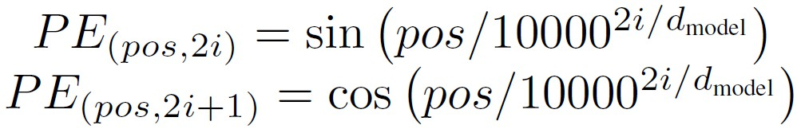
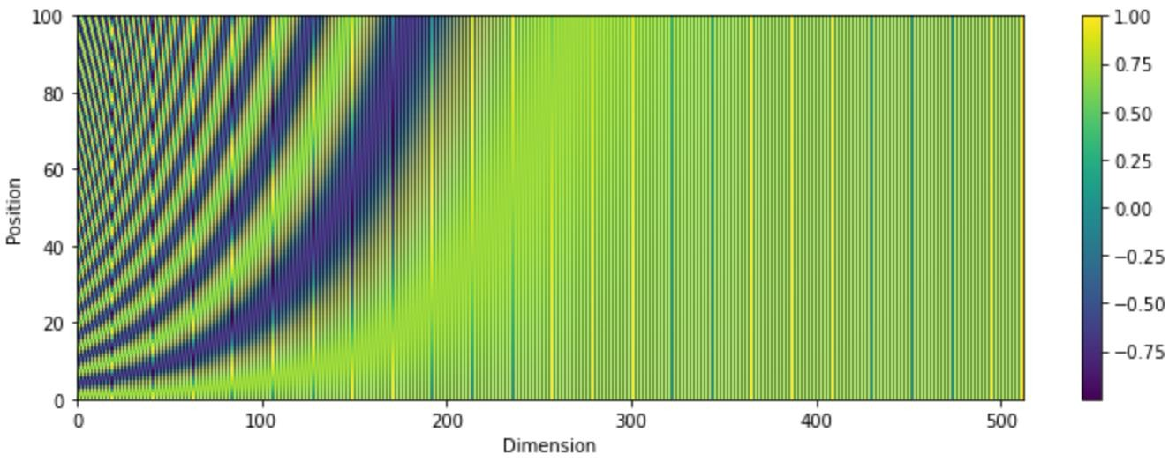
Positional Encoding
Learned or Fixed versions
The paper uses fixed (as this can account for varying
sentence length)
Uses alternating Sin and Cos functions
Y is the position of the word
X is the length of word embedding (the paper uses 512)
If dog was in a different position, it would have the same embedding value, this we need position to be somewhat accounted for.
Notes:
This slide shows the mathematical basis for positional encoding within transformer models, captured by two equations using sinusoidal functions—sine for even indices and cosine for odd indices. Specifically, the positional encoding is defined as:
PE_{(pos, 2i)} = \sin\left(\frac{pos}{10000^{2i/d_{model}}}\right), \quad
PE_{(pos, 2i+1)} = \cos\left(\frac{pos}{10000^{2i/d_{model}}}\right)
Here, pos represents the position of the word in the input sequence, i denotes the dimension within the embedding vector, and d_{model} is the dimensionality of embeddings (commonly 512). These sinusoidal functions create a unique encoding for each position, ensuring the transformer can distinguish word order within sequences, overcoming the inherent limitation of transformers lacking sequential processing.
The visual heatmap below these equations represents positional encodings across different embedding dimensions and positions. Each horizontal line corresponds to a specific word position, and colour variations across dimensions illustrate how frequencies vary systematically. High-frequency waves (short cycles) encode fine-grained positional information, while low-frequency waves (long cycles) capture broader positional context. By adding this positional encoding to the standard embedding vectors (such as “dog” in the table), the model ensures the same word in different positions yields distinct representations, crucial for tasks where position heavily influences meaning.
This slide is dedicated to explaining Positional Encoding in more detail (though we touched it on slide 45, here it elaborates fully). The bullet points on this slide are:
• There are learned or fixed versions; the original used a fixed scheme to accommodate various sentence lengths.
• The scheme uses alternating sine and cosine functions.
• It defines what Y and X stand for: Y = position of the word; X = dimension index in the embedding vector.
• It points out that if a word (e.g., “dog”) were in a different position, without positional encoding it would have the same embedding, thus we need to account for position.
Basically, it’s giving the formula or at least describing how the fixed encoding works and why it’s necessary with an example.
Detailed Speaker Notes:
• The slide likely details formula: e.g., PE(pos, 2i) = sin(pos / 10000^(2i/d)) and PE(pos, 2i+1) = cos(pos / 10000^(2i/d)) (where pos is position, i is index).
• Without diving into formula explicitly (unless needed), we can narrate conceptually which we did partly:
• “The positional encoding uses these sine/cosine patterns. Specifically, each even-indexed dimension of the positional encoding vector is a sine wave function of the position, and each odd-indexed dimension is a cosine function. They use different frequencies for each dimension – the factor 10000^(2i/d) means each dimension has a wavelength covering a different range of positions.”
• Emphasize alternating sin/cos: “By alternating sin and cos in each dimension, they ensure each position has a unique combination of values across all dimensions. The pattern is smooth and periodic, which might help the model attend by relative positions too.”
• Clarify “learned or fixed” part: “They mention learned or fixed. Learned means you could just have a vector for position1, position2, etc. The original authors decided to use this fixed analytic formula. One reason is a fixed encoding might extrapolate to sequence lengths beyond what the model saw during training (because sin/cos can be computed for any position index), whereas a learned encoding might not know what to do with a position larger than trained.”
• Use the bullet details:
• “The paper uses fixed (as this can account for varying sentence length)” – meaning yes, they wanted the model to handle different lengths gracefully.
• “Uses alternating Sin and Cos” – we addressed, e.g., dimension0 ~ sin(pos), dimension1 ~ cos(pos), dimension2 ~ sin(pos / 10000^something), etc.
• “Y is the position of the word, X is the length of word embedding (the paper uses 512)” – so each position pos gets a 512-dimensional positional vector computed by those sin/cos functions.
• “If ‘dog’ was in a different position, it would have the same embedding value, thus we need position to be accounted for.” – we gave that example. To elaborate: “Without adding position, the embedding for ‘dog’ at position 2 and ‘dog’ at position 10 are identical, so the model would treat them interchangeably, which is problematic. After adding position, ‘dog’ at pos2 and ‘dog’ at pos10 become different vectors. That difference informs the attention mechanism (and feed-forward) about their place in sequence.”
• Wrap up positional encoding explanation: “So in summary, positional encoding gives each word a sense of context in order. It’s like labeling words by their index so the model can learn patterns like ‘usually, a verb comes after a noun’ or ‘the first word might be subject’, etc. The transformer sums this positional vector with the word’s embedding vector and that becomes the input to the first attention layer.”

Slide 48
Prior to Attention
Prior to attention, the inputs are processed using embeddings, like in the LSTMs, this is dynamic.
Original paper used a 512 dimension vector embedding.
Positional encoding is added, essentially the location of the word in a sentence.
Notes:
This slide explicitly indicates the stage prior to attention, focusing on how the transformer processes inputs before applying attention mechanisms. It highlights embedding and positional encoding steps at the very beginning of both encoder and decoder components. Initially, each word token is mapped into a high-dimensional embedding vector, typically of size 512, converting discrete linguistic units into continuous, dense numerical representations that capture semantic meaning.
Following embedding, positional encodings—either learned or fixed sinusoidal vectors—are directly added to each word embedding. This addition allows the model to incorporate explicit position-based context into embeddings, essential since transformers, unlike RNNs, lack inherent sequential structures. The arrows point clearly to the initial stages within the transformer architecture diagram, showing precisely where these combined embeddings and positional encodings enter the attention layers.
Thus, before any attention computations, each input token is represented by a vector that simultaneously encodes semantic meaning and positional context. This integrated representation enables subsequent attention layers to accurately model interactions between tokens, fully leveraging parallel processing capabilities while preserving essential sequential information required for language tasks.
This slide seems to finalize the discussion before attention kicks in: “Prior to attention, the inputs are processed using embeddings (like in LSTMs, dynamic) and positional encoding. The original paper used a 512-dim vector embedding. Positional encoding is added, representing the location of the word in the sentence.” It basically summarizes that before computing any attention, we have prepared the input representations by combining word embeddings and positional encodings. This ensures each token has a full representation of content + position.
Detailed Speaker Notes:
• Summarize the preparation steps now in sequence:
• “So, prior to applying attention, we have done the following:
1. Turned each word into an embedding vector (which is learned and can adjust during training, so it’s dynamic).
2. Added the positional encoding onto those embedding vectors.
This sum is what we feed into the first transformer attention layer.”
• Mention “like in LSTMs, dynamic”: likely meaning the embeddings are dynamic/trained in context like in LSTMs we had trainable embeddings. “Dynamic” might mean learned during training rather than fixed one-hot or something. So: “The embeddings are dynamic, meaning they are updated during training – similar to how we can train embeddings in an LSTM-based model. They’re not static one-hot vectors; they carry semantic info and they improve as the model learns.”
• Reiterate original model specifics: “The original transformer had embedding vectors of length 512 for each word. That’s a pretty large dimensionality, chosen to give the model a lot of expressive capacity. And they match that dimension in the attention mechanisms so everything aligns (Q, K, V vectors also of size 512, etc.).”
• Summarize positional piece: “Then, as we discussed, they add the positional encoding to those 512-dim vectors. After that addition, the model has its initial representations that encode both word identity and position.”
• State that now the model can proceed with attention: “At this point, the transformer enters the main layers – the attention layers. Now every token’s vector will be transformed by attention where it can mix information from other tokens as needed.”
• Possibly mention the term “embedding has positional encoding” which was in parse: yes, now each embedding vector has been modified to include position info.
• Affirm again original design decisions: “They specifically mention they used a fixed positional encoding scheme. That’s interesting because it’s not learned, but apparently that works well and the model can still figure out everything it needs. Many implementations since stick to that or sometimes switch to learned, but either way, the concept stands.”
• Now we are set to dive into explaining how attention is calculated. The next slide likely titled “Attention” and describing concept. Actually slide 49 in parse says “Attention” with bullet definitions.

Slide 49
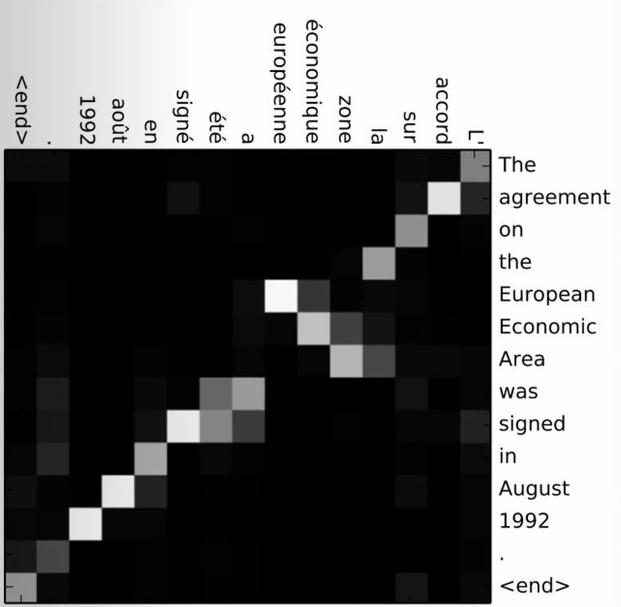
Attention
Attention is a method that does not rely on occurrence to identify the importance of a word in a sentence.
The lighter heat map is the “importance” of the word in
the sentence, the part we pay attention to.
This same system can also work for images, like the
heats maps from CNNs.
Notes:
The attention heatmap displayed on this slide visually represents how the transformer allocates focus across different input tokens during a translation task. Technically, this heatmap shows the attention weights computed using scaled dot-product attention, a core mechanism in transformer models. In this matrix, each cell’s brightness indicates the level of attention (importance) assigned by a token in the output sequence (vertical axis, English sentence) to a token in the input sequence (horizontal axis, French sentence).
Lighter cells indicate higher attention weights, meaning the model considers that specific input token more crucial when generating or interpreting a given output token. The diagonal pattern often observed highlights that each output word primarily attends to its direct input equivalent, aligning neatly for straightforward translations. However, off-diagonal highlights also indicate cases where the model recognises contextually significant tokens from elsewhere in the sequence, crucial for handling complex sentences and ambiguities effectively.
Thus, attention mechanisms dynamically compute and represent dependencies between all input-output pairs, enabling transformers to effectively handle long-range dependencies without the sequential limitations of recurrent models. The heatmap serves as a direct visualisation of this sophisticated context-modelling capability, providing interpretability into the model’s decision-making process.
This slide is focusing on explaining the concept of Attention with perhaps a visual like a heatmap. The bullet points say:
• Attention doesn’t rely on occurrence (meaning unlike simply counting co-occurrences, it actively learns weightings) to identify importance of a word in a sentence.
• It references a “lighter heat map” as showing importance (meaning typically in an attention matrix visualization, brighter = more attention weight).
• It even notes the system can work for images, analogous to CNN heatmaps (drawing a parallel that attention is like highlighting parts of input).
So it’s giving an intuitive feel: attention = focusing on certain parts of input more than others, depicted as heatmaps where intensity indicates importance.
Detailed Speaker Notes:
• Define attention in plain language: “Attention is a mechanism for weighting the influence of different input words when processing a particular word or output. It allows the model to dynamically focus on relevant parts of the sentence.”
• Explain “does not rely on occurrence”: “This bullet suggests that attention isn’t like a simple count or fixed measure (like how often words co-occur overall). Instead, it’s context-dependent. The model learns attention weights for each word pair based on the specific sentence and query. So it can capture importance beyond just raw frequency. For example, even if a word appears only once, if it’s crucial to the meaning in that sentence, attention can highlight it.”
• Discuss the heatmap: “Often we visualize attention as a matrix (heatmap) where rows might be each word’s attention distribution over other words. A lighter (brighter) spot on the heatmap means the model is paying a lot of attention to that word at that position.”
• “For instance, if we have a sentence ‘The cat ate the mouse’, when focusing on ‘ate’, the model might have a bright spot on ‘cat’ (subject) and ‘mouse’ (object), indicating ‘ate’ is strongly connected to ‘cat’ and ‘mouse’ in understanding who ate whom.”
• Connect to images: “The slide notes this can also work for images, analogous to attention heatmaps from CNNs in vision. That’s true – the concept of attention is general. In CNNs for images, you sometimes have attention maps showing which part of an image contributed most to a classification (e.g., highlighting the area of a dog in a picture of a dog). In NLP, the ‘heat map’ of attention shows which words influenced a particular word’s representation or an output’s generation.”
• Emphasize how this is interpretive: “One neat aspect is that these attention weights can be inspected to get some interpretability. For example, in translation, you can literally see alignment between source and target words by looking at attention weights – it often forms an alignment matrix where each foreign word is linked to its corresponding English word or phrase.”
• Conclude concept: “So think of attention as the model’s focus lens. Instead of treating all words equally or only relying on the immediately neighboring words, the model learns to put more ‘focus’ on the words that matter for interpreting each word. This focus is recalculated at each layer and for each context.”
• Next, we likely detail how attention is computed via Q, K, V (which likely slide 50 and beyond do).

Slide 50
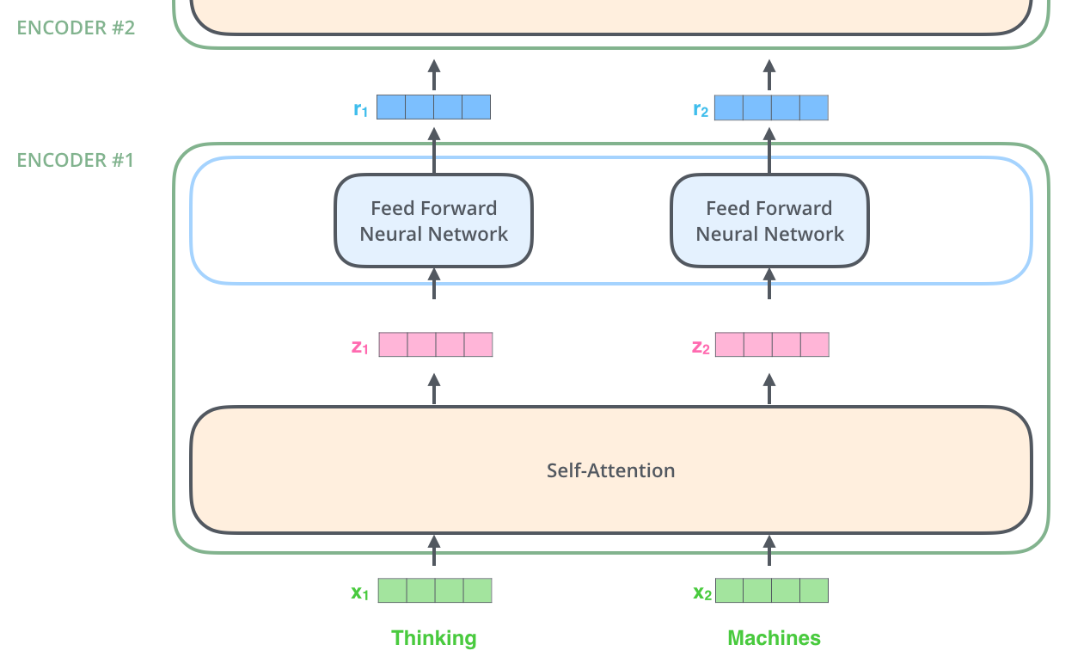
Attention (Self-Attention)
Sequence passed in (X1 and X2):
Let’s briefly look at the internal components of an encoding/
decoding layer, before we go into them in detail:
Attention is applied
Keeping some relationships
FFNN loses the association
But allows parallel processing
Notes:
This slide breaks down the self-attention process, which is at the heart of transformer models. At the lowest level, two input tokens (“Thinking”, “Machines”) are initially embedded into dense numerical vectors (X_1, X_2). Self-attention mechanisms then process these embeddings simultaneously rather than sequentially, generating new contextually informed vectors (Z_1, Z_2) by relating each token directly to every other token in the sequence. This relationship is computed by projecting embeddings into queries, keys, and values, then computing scaled dot-product attention scores between them.
Following the self-attention step, the resultant vectors (Z_1, Z_2) enter a feed-forward neural network (FFNN). This FFNN independently refines each token embedding without directly preserving attention-based associations between tokens. The FFNN thus enables further non-linear transformation and abstraction of token representations, although it momentarily removes explicit relational context established during the attention step.
This careful design balance—attention maintaining rich relational context across tokens and the FFNN refining token representations independently—allows transformers to achieve robust contextual understanding while maximising computational efficiency. This parallel, multi-step processing enables transformer models to capture complex, long-range dependencies, making them particularly effective for intricate language understanding and generation tasks.
This slide begins to break down the process of Self-Attention internally. It mentions a sequence passed in (X1, X2) and indicates we’ll look at encoding/decoding layer components before detail:
• It says “Attention is applied, keeping some relationships” and “FFNN loses the association but allows parallel processing.”
It sounds like they are giving a high-level of one transformer’s layer:
First, the self-attention sub-layer retains relational information (like which words relate), then the feed-forward (FFNN) operates on each position independently (so it doesn’t maintain inter-word relationships, but it’s parallelizable).
So basically: attention step correlates words, feed-forward step processes each word individually (which could break some direct association but since attention already mixed info, it’s fine and it allows parallelization).
Detailed Speaker Notes:
• Explain the context: “This is describing what happens within one encoding/decoding layer before diving into math. Essentially, first attention is applied which mixes information between words and captures their relationships. Then a Feed-Forward Neural Network (FFNN) is applied to each word’s representation individually (pointwise). The FFNN doesn’t consider other words (hence ‘loses the association’ in the sense that it doesn’t directly connect different positions), but that’s okay because the attention step just previously did the heavy lifting of linking words. And the benefit is the FFNN can be done in parallel for every word.”
• Clarify “Keeping some relationships”: “When attention is applied, say at the encoder layer, it ensures that if word A and word B needed to share information, that happens – word A’s new representation will have some influence from word B’s old representation, weighted accordingly. So relationships are preserved/integrated at this stage.”
• Then “FFNN loses association but allows parallel processing”: “The feed-forward network is essentially like applying a little transformation to each word vector separately (like a mini MLP that might capture non-linear combos of the features in that word’s vector). Because it treats each word in isolation (no interactions), it doesn’t maintain the interactions that attention did – that’s what they mean by ‘loses the association’. But we don’t really lose it entirely; we already wove it into the vector via attention. Now FFNN just further processes each word’s info. The huge advantage is we can do this for all words simultaneously (parallel), since none depends on another in this step.”
• It’s as if they’re addressing a potential concern: “If FFNN is independent per word, doesn’t that break context? But answer: we already inserted context with attention, so it’s fine. Meanwhile, independence means speed.”
• Summarize the flow in a layer:
1. Attention sub-layer: All words exchange information (in parallel as matrix operations).
2. Feed-Forward sub-layer: A small neural net applied to each word’s vector (in parallel for all words).
3. Plus skip connections & normalization around those (implied but not on slide text, maybe overhead).
• This yields new word representations that have considered others (from attention) and been transformed (by FFNN).
• Connect to “encoding/decoding layer internal components”: “We’ll soon look at the details (like Q, K, V for attention), but at a high level, this is the pattern repeated in each layer. The decoder does the same pattern but has the extra cross-attention in between.”
• The slide references specifically “(Self-Attention)” which implies we’re focusing on how an encoder or decoder looks at itself (the sequence it’s processing).
• Wrap up: “So the takeaway: in each transformer layer, Attention first (to blend info across words) then Feed-Forward (to transform each word’s combined info, enabling complex modeling and done in parallel). This design is what allows parallelization without losing the benefits of contextual relationships.”

Slide 51
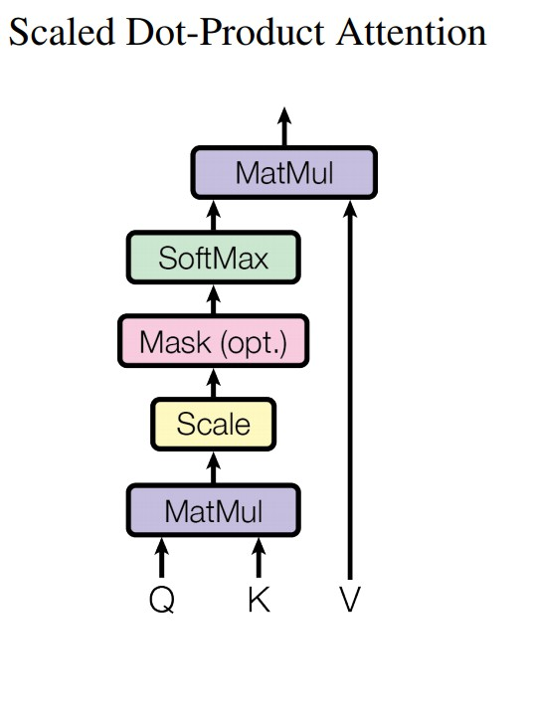
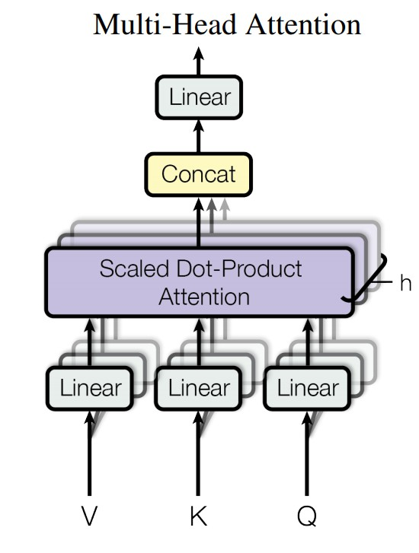
Multi Head-Attention
Take self-attention and repeat multiple times to create multi-head attention
Notes:
attention, the fundamental attention mechanism used in transformers. We start with Queries (Q), Keys (K), and Values (V), vectors obtained from input embeddings. The attention scores are computed by multiplying queries with keys (dot product), scaled by the square root of the dimension of the keys, and optionally masked to prevent future tokens from being considered in autoregressive tasks. The resulting scores are passed through a SoftMax function, converting them into weights that sum up to 1, highlighting the relevance of each token. Finally, these attention weights multiply the value vectors (V), resulting in contextually weighted vectors summarising the input relationships.
On the right, we see multi-head attention, which enhances basic attention by running scaled dot-product attention in parallel multiple times—referred to as “heads”. Each head independently projects Q, K, and V through distinct linear transformations, thus enabling the model to capture different types of relationships simultaneously. Outputs from each head are concatenated and combined through a final linear layer, producing a richer, combined representation. This parallel attention allows the model to learn diverse semantic nuances and relationships from the input data, significantly boosting its representation power and accuracy.
This slide briefly introduces Multi Head-Attention by stating: “Take self-attention and repeat multiple times to create multi-head attention.”
It’s a simple statement explaining that instead of one attention calculation, the transformer does several in parallel (heads) and later combines them. So high-level: multi-head = multiple attention heads concurrently.
Detailed Speaker Notes:
• Define multi-head in an easy way: “Multi-Head Attention means the model isn’t performing just one attention calculation, but multiple separate attention ‘heads’ simultaneously. Each head is like its own attention sub-layer with its own weight matrices.”
• Why multiple heads? “By having, say, 8 heads, the model can learn to focus on different types or aspects of relationships in the data. For example, one head might specialize in attending to the next word (capturing sequential adjacency), another might focus on matching pronouns to their antecedents further away, another might align subject-verb, etc. Each head gets to have its own set of attention weight patterns.”
• How do they do it? “Essentially, the input vectors are projected into different subspaces (via different linear transformations for each head’s queries, keys, values). Then each head computes attention independently on these lower-dimension vectors. At the end, the outputs of all heads are concatenated and combined (via another linear layer).”
• Emphasize the benefit: “This simultaneous multiple focus gives the model a richer ability to represent different relationships. Instead of forcing one single attention matrix to capture everything, each head can capture a facet. It’s like having a committee of attention mechanisms, each looking for something else.”
• The slide is a simple introduction, but you might add:
• “In the original transformer, they used 8 heads (for dimension 512, each head was 64-dimensional so that 8*64=512 when concatenated back).”
• “Multi-head attention is still one layer, but internally it runs these 8 smaller attentions in parallel. This still is done efficiently with matrix ops, so it doesn’t slow things down too much. It does increase parameters a bit (because each head has its own linear projections), but the payoff in model expressiveness is huge.”
• Conclude: “So ‘take self-attention and repeat multiple times’ is exactly it – multi-head is just parallel attention computations whose results are merged. We’ll see next how attention mathematically works, and keep in mind it’s conceptually happening per head.”

Slide 52
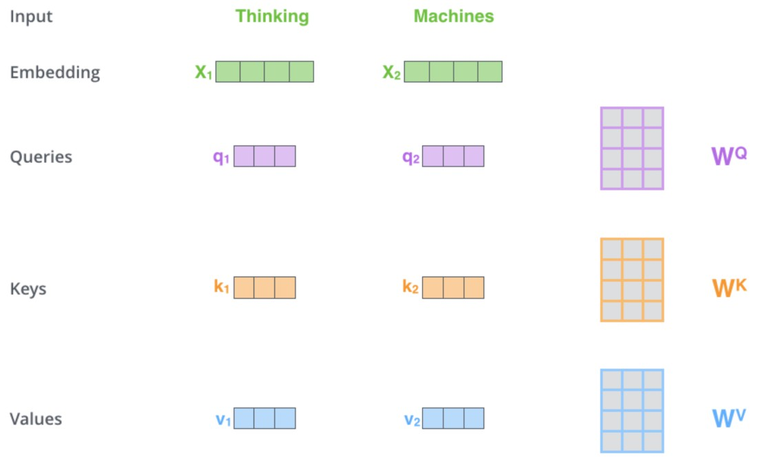
Attention
Embedding has positional encoding.
Multiply embeddings, by three matrices Query, Key and
Value.
These matrices are initialised randomly and updated during training (similar in a way to CNN kernel's).
Notes:
In this visual, we see explicitly how Queries (Q), Keys (K), and Values (V) are derived from input embeddings. Starting from the embeddings X_1, X_2, each representing tokens (“Thinking” and “Machines”), the model applies learned linear transformations, represented by matrices W^Q, W^K, and W^V. These matrices, initialised randomly and updated through training, transform the embeddings into three distinct sets of vectors, each serving a unique purpose in the attention mechanism.
Queries (purple vectors, q_1, q_2) are vectors representing the token seeking context, Keys (orange vectors, k_1, k_2) represent the tokens providing context, and Values (blue vectors, v_1, v_2) contain information the model wants to aggregate based on attention weights. The multiplication by W^Q, W^K, W^V matrices adjusts the embeddings into these specialised vectors, fine-tuning how each token relates contextually to every other token in the sequence.
These transformation matrices function similarly to CNN kernels in convolutional neural networks: they start randomly and are progressively refined during training. By updating these matrices, the model learns optimal representations to compute meaningful attention scores, thus dynamically adjusting how information from each token is weighed and aggregated, forming rich, context-aware representations.
High-Level Explanation:
This slide starts detailing how to compute attention. The bullet points say:
• Embedding has positional encoding (we did that).
• Multiply embeddings by three matrices: Query, Key, Value.
• These matrices are random at first and get updated (like CNN kernels analogy).
This is describing the step where for each token, we compute a Query vector, Key vector, and Value vector by linear projections of the input embedding (with pos enc). It’s explaining that we create Q, K, V from the input, and that these are learned weight matrices similar to how CNN filters are learned.
Detailed Speaker Notes:
• Recap where we are: “Now we’re ready to go through the actual attention calculation. We have our input representation for each word (embedding + pos encoding). The first step in computing attention is to create three different transformed versions of these representations: the Query (Q), the Key (K), and the Value (V).”
• “Multiply embeddings by three matrices Q, K, V”: “We have three weight matrices: let’s call them W_Q, W_K, W_V. These are learnable parameters (initially random). For each word’s input vector (dimension d=512 for example), we multiply it by W_Q to get that word’s query vector (maybe dimension 64 if we’re doing multi-head with 8 heads splitting 512). Similarly multiply the same input by W_K to get a key vector, and by W_V to get a value vector.”
• “Multiply” means a linear transform: Q_i = X_i * W_Q, K_i = X_i * W_K, V_i = X_i * W_V (assuming row vectors, or W^T if column etc.).
• Explain conceptually:
• Query – It represents what this position is looking for; think of it as a set of questions that this word is asking of the others.
• Key – It represents what the content of each word is (like an “answer key” to potential queries).
• Value – It is the actual information to be used if the word is attended to; often it’s similar to Key at first but conceptually separate to allow flexibly using information vs matching.
• “These matrices are initialised randomly and updated during training” – stress that:
• “At first, W_Q, W_K, W_V are random. The model learns them as it trains so that meaningful attention patterns emerge. It’s similar to how CNN kernels start random and learn to detect edges, etc. Here the matrices learn to project words into query/key spaces such that, for example, synonyms might have keys that align with certain queries, or a noun’s query might align strongly with its adjective’s key, etc.”
• Connect to multi-head: “Actually, if we have multiple heads, we have a separate W_Q, W_K, W_V for each head, or you can think of one big matrix that chunks into head-specific parts. But conceptually, each head does its own Q, K, V projections.”
• If audience not tracking Q/K/V: an analogy: “I find it helpful to say: each word produces:
• A Key vector – like a label or signature of what it is.
• A Query vector – like a search vector of what it wants to find.
• A Value vector – like the payload of information it carries.
The attention mechanism will use queries and keys to compute attention scores (like how well query of word i matches key of word j), and then use those scores to weight the value vectors (so word i will gather a weighted sum of other words’ values as its new representation).”
• And link to CNN analogy: “similar in a way to CNN kernels”: “They mention CNN kernels because both are learnable weights that extract features. In CNN, you slide a filter to extract features from local pixels. In attention, these Q, K, V matrices extract features from the word embeddings that are relevant for computing relationships. They’ll define a ‘space’ where dot products indicate similarity/relevance.”
• Summarize step: “So in summary, we transform our input vectors into Q, K, V vectors. Now next steps will be:
1. Use Q and K to compute attention scores (i.e., how much each word should attend to each other word).
2. Use those scores to weight the V vectors and sum them up for each word to get output.”

Slide 53
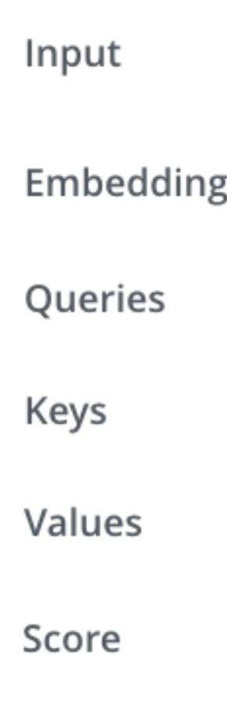
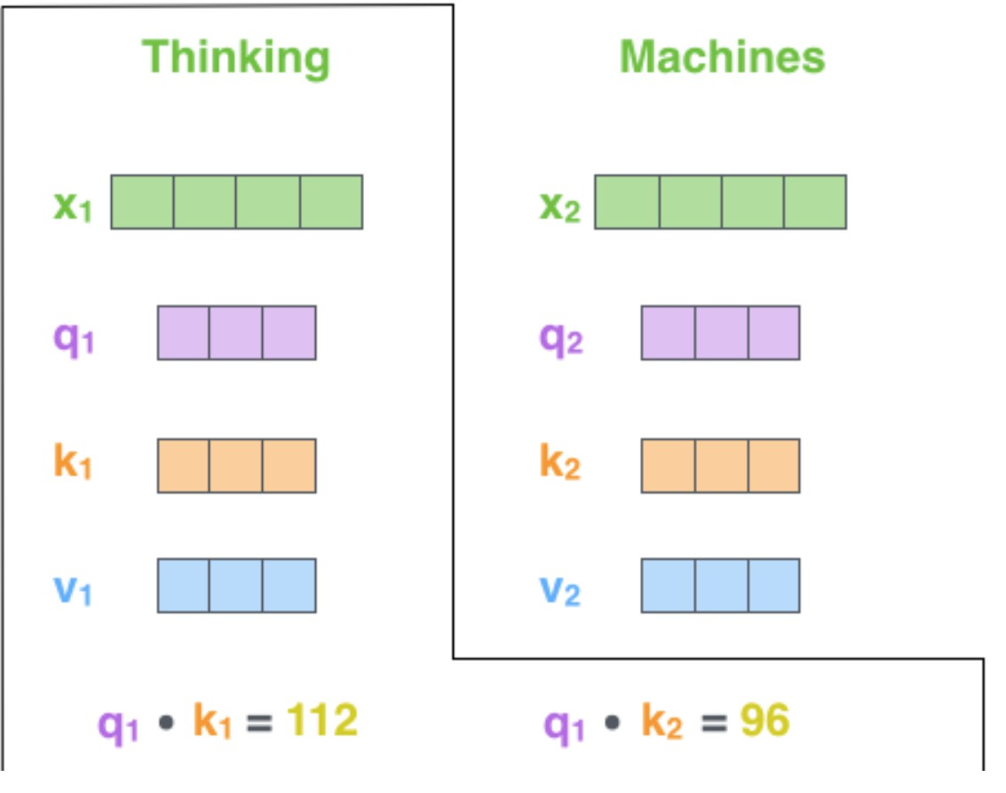
Attention – Calculate Scores
Dot product of Query and key
To get the Score of the first word vs second word we get query from first word and dot product this with key from second word.
We now have score of first word vs all other words.
Repeated for each word.
Can be done in parallel.
Notes:
This slide specifically shows the computation of attention scores by taking the dot product between Queries and Keys. For example, the score between the first word (“Thinking”) and itself is computed as the dot product q_1 \cdot k_1, resulting in a numerical score (112). Similarly, q_1 \cdot k_2 computes the attention score between “Thinking” and “Machines” (96), quantifying how contextually related these tokens are to each other.
These scores are critical as they measure relevance, guiding the model on which words should be emphasised when forming representations. Computing the scores for each word against every other word produces a comprehensive attention matrix, capturing relationships across the entire sequence. Importantly, this process is highly parallelisable—transformers simultaneously calculate scores for all token pairs, enhancing computational efficiency.
By repeating this dot-product calculation across every possible Query-Key pair, the transformer builds a complete matrix of attention scores, setting the stage for subsequent scaling and normalisation steps. This matrix clearly encodes relational information, essential for accurately modelling the semantic dependencies within text sequences.
This slide explains how to get the attention weights (scores) using the dot product of Query and Key vectors. The bullet points describe:
• Dot product of Query and Key.
• Example: to get score of first word vs second word, take query of first word dot key of second word.
• This gives the score of how relevant word2 is to word1.
• Repeat for each word (every word’s query dot every word’s key).
• Can be done in parallel (so basically forming a matrix of scores).
So it’s detailing that attention scores = Q_i ⋅ K_j for each pair (i query from current position focusing, j key from some other position), giving us a matrix of scores.
Detailed Speaker Notes:
• Walk through the dot product logic: “Once we have Q and K vectors, we compute the attention scores between every pair of words by taking dot products. If we denote by Q_i the query vector for word i, and K_j the key vector for word j, then the score from i to j is Q_i ⋅ K_j (dot product).”
• Example given: “So as the slide says, to get the attention score of the first word with respect to the second word, we take the first word’s query and dot it with the second word’s key. A high dot product means those vectors align strongly, implying word1 ‘considers’ word2 very relevant.”
• Clarify meaning: “This score essentially captures similarity or how much the query finds the key relevant. For self-attention in the encoder: if Q_i ⋅ K_j is large, that means word i will pay a lot of attention to word j’s information when updating its representation.”
• “We now have score of first word vs all other words. Repeated for each word.” – “So effectively, for each word i, we do dot with K_1, K_2, …, K_n for all words j in the sequence. That gives a set of scores [score(i,1), score(i,2), …, score(i,n)]. Put another way, we compute an attention matrix where entry (i,j) is the score of word j’s influence on word i.”
• If i = j (the dot product of a word with itself), that’s also a valid score (often those are reasonably high because a word obviously is relevant to itself, but in practice sometimes they mask that or let it be there – in self-attention they don’t need to mask self, it’s okay; in decoder’s masked attention they mask future words only).
• “Can be done in parallel.” – emphasize that: “This is all linear algebra, so we can compute all pairs dot products efficiently as (Q matrix) x (K matrix)^T. If Q is shape [n x d] and K is [n x d], QK^T yields an [n x n] matrix of dot products. This parallel compute is one reason transformers are fast – they use big matrix multiplications for these operations.”
• Possibly mention scaling factor if in context: The original paper scales dot products by 1/√d_k to keep them in a good range. The slide might not mention that yet (maybe slide 54 does with “divide by 8 (sqrt64)”) – yes slide 54 covers scaling. So if not mentioned here, just continue with how scores are used.
• Summarize: “So after this step, for each word i we have raw attention scores to every word j. Next, we’ll normalize these into a probability distribution (via SoftMax) so they’re easier to interpret and use as weights (that’s likely next slide with dividing and softmax). Then those weights will tell us how to mix the V vectors to form the new representation for each word.”
• So slide 53 essentially covered computing an un-normalized attention score matrix. Slide 54 covers scaling and softmax.

Slide 54
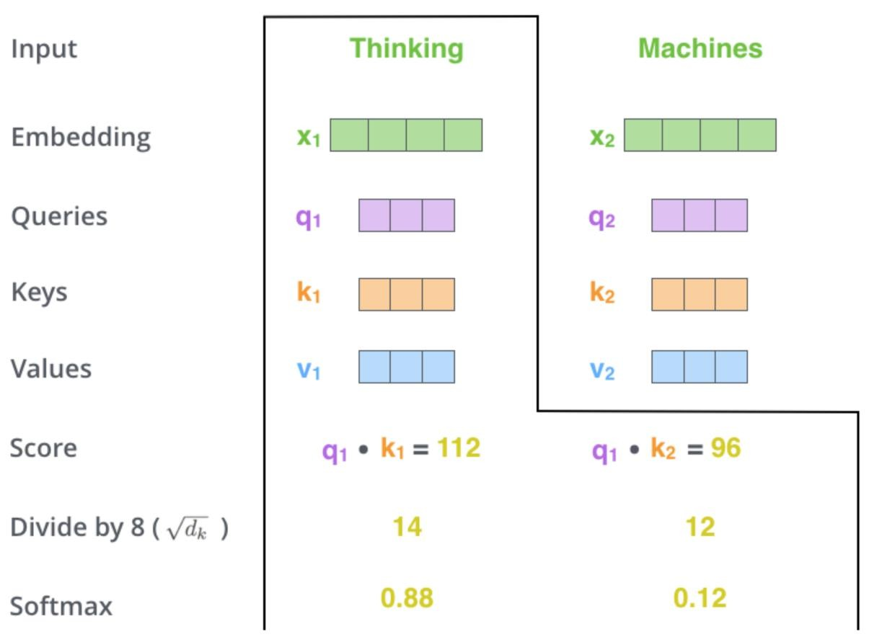
Self-Attention
Divide by 8
Sounds random?
Sqr 64 which is the length of the Q, K and V vectors.
Passed through SoftMax to normalise values.
Notes:
Here, we delve into the scaling and normalisation steps essential for stabilising the self-attention mechanism. After obtaining raw attention scores (e.g., 112, 96 from previous slide), these scores are scaled by dividing by the square root of the key dimensionality (\sqrt{d_k}). The reason for scaling, as mentioned here, isn’t arbitrary: it counters numerical instability and prevents extremely large scores that would saturate the subsequent SoftMax step, a problem especially pronounced in high-dimensional spaces.
Specifically, the raw scores are divided by 8, derived from the square root of 64 (the dimension length of query and key vectors in this example). After scaling, the scores (14 and 12 in this example) are significantly moderated, leading to stable SoftMax outputs. The SoftMax function then converts these scaled scores into probabilities summing up to 1, clearly reflecting the relative importance of each token.
These final probabilities (0.88 and 0.12 in this visual example) provide contextually meaningful weights, determining how much each token’s value vector contributes to the resulting contextualised representation. Through this process, the model effectively prioritises the most relevant information, producing rich, contextually accurate embeddings that significantly
High-Level Explanation:
This slide covers the steps after computing raw dot product scores:
• “Divide by 8, sounds random? sqrt(64) which is length of Q,K,V vectors.”
• “Passed through SoftMax to normalize values.”
So it’s explaining the standard practice in dot-product attention: scale the scores by 1/√d (in this case d_k = 64 per head, sqrt64=8) to prevent extreme large values for big dot products, then apply SoftMax so that the scores become normalized weights (between 0 and 1 summing to 1 for each word’s attention distribution).
Detailed Speaker Notes:
• Explain the need for scaling: “When you dot product high-dimensional vectors (here 64-dim per head), the raw values can vary in magnitude. If they get too large, the SoftMax (which we’ll apply) would become very peaked (one nearly 1, others nearly 0), making learning unstable. So the paper introduced a scaling factor: divide each dot product by √d_k, where d_k is the dimension of the key (and query) vectors. In our case, d_k = 64, so √64 = 8. That’s why they say ‘divide by 8’. This keeps the numbers in a reasonable range (not too big).”
• “Sounds random? sqrt(64) which is length of Q, K, V vectors.” – “So it’s not random at all; it’s systematic: we divide by the square root of the key vector dimension. Essentially 1/√d as a scaling factor. If our vectors were length 64, we divide by 8. If they were length 256, we’d divide by 16, etc.”
• After scaling: “Now we have our adjusted scores. Next step: SoftMax. We apply a SoftMax function to the scores for each word’s attention distribution. The SoftMax exponentiates the scores and normalizes them to sum to 1.”
• “Passed through SoftMax to normalise values.” – “That means for each word i, we take its list of scores [score(i,1), …, score(i,n)], divide by 8 each perhaps, then do SoftMax: weight_{ij} = exp(score(i,j)/8) / sum_{k} exp(score(i,k)/8). This turns those scores into probabilities (all positive and sum to 1).”
• Why SoftMax: “This ensures the attention weights are easier to interpret and bounded. The model can then decide to pay 0.7 attention here, 0.2 there, 0.1 there, etc. It’s essentially focusing the distribution. If a score was much higher than others, SoftMax will make that weight close to 1 and others near 0, meaning mostly attend to that one. If scores are similar, it will produce a more uniform distribution, meaning word i spreads attention across multiple words.”
• With scaling, mention: “This 1/√d scaling helps avoid a situation where one word gets an overwhelmingly large score too early in training. It helps keep gradients stable. It’s a technical detail, but an important one from the paper.”
• Summarize the outcome: “So after SoftMax, each word i now has a normalized set of attention weights for every other word j in the sentence. For example, the first word might have [w(i,1)=0.1, w(i,2)=0.5, w(i,3)=0.3, w(i,4)=0.1,…] summing to 1. These tell us how strongly to weight each other word’s contribution to word i’s new representation.”
• Now likely slide 55 will say “Multiply by Value and sum to get output” – yes, likely the next step.

Slide 55
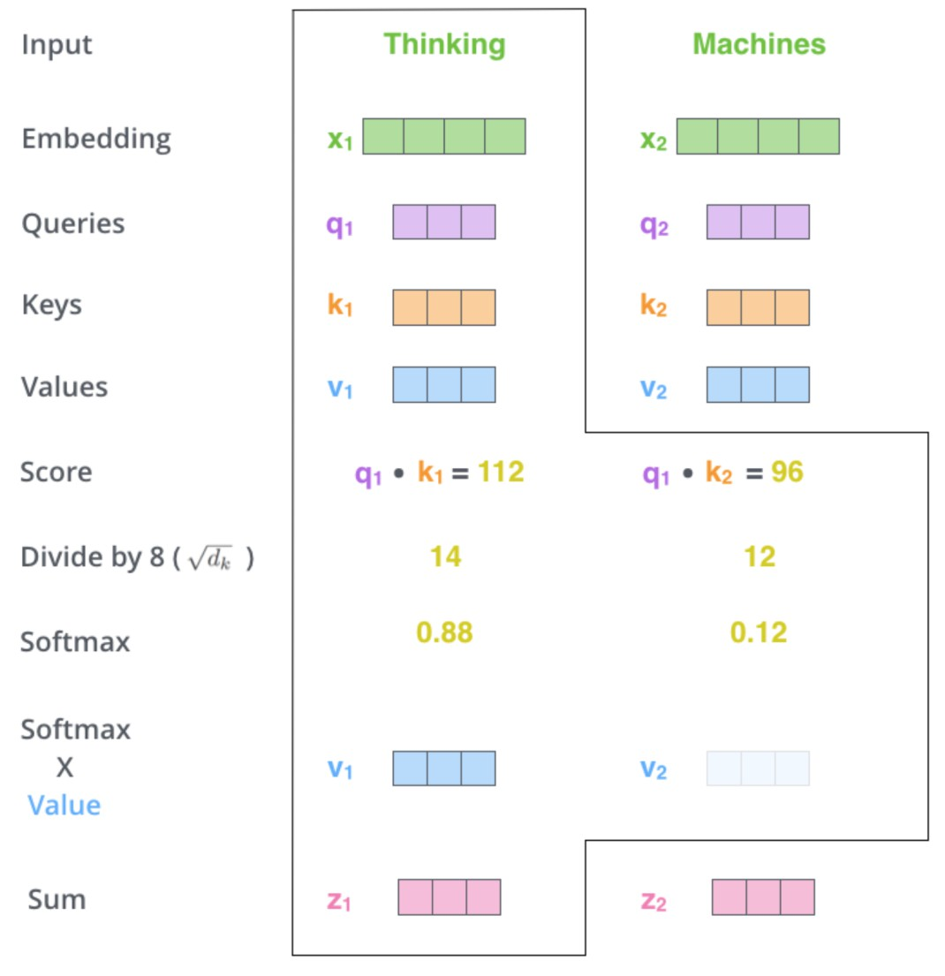
Self-Attention
SoftMax is generated for each word (related to the first word)
This is then multiplied the value for each layer.
Finally, this is summed to generate the output for this word Z₁
Notes:
On this slide, we see the final step of the self-attention process clearly illustrated. After calculating how important each word is to the others using the SoftMax function (e.g., “Thinking” has a high weight of 0.88 compared to “Machines” at 0.12), we use these weights to scale the “Value” vectors of each word. Visually, you see the blue vectors, representing Values, multiplied by their respective importance scores.
The result is two new vectors that are summed together (added up) to produce a single vector, called Z_1, representing the final contextually-aware embedding for the word “Thinking.” Essentially, this step ensures that the embedding for “Thinking” incorporates the right amount of information from both “Thinking” and “Machines,” depending on how relevant each is to the meaning of the first word.
This slide explains how the attention weights are applied to the Value vectors to compute the new output for each word:
• “SoftMax is generated for each word (related to the first word)” – meaning we have the attention distribution for (say) first word over all words.
• “This is then multiplied by the value for each word.”
• “Finally, summed to generate the output for this word Z1.”
In summary: For each word (like first word’s output Z1), you multiply each other word’s Value vector by the SoftMax weight and then sum them up. That gives the new representation (Z) for the word that attended to others.
Detailed Speaker Notes:
• Explain how to apply weights to values: “Now that we have attention weights for word i to every word j, we use them to compute word i’s new representation. We do that by taking a weighted sum of all the Value (V) vectors of the other words.”
• Step by step: “For word i:
• For each word j in the sentence, take that word j’s Value vector (which is one of those linear projections of the original embedding).
• Multiply that V_j by the attention weight w(i,j) (the SoftMax result).
• Then add all those up for j from 1 to n.
That sum is the output vector (often denoted Z_i or sometimes context vector) for word i after the attention layer.”
• The slide example: “SoftMax … for each word related to first word” likely is describing first word’s perspective.
• “If we look at the first word’s attention distribution (as an example they had), we multiply each other word’s value by that first word’s weight for it. Then sum them.”
• They explicitly say “Finally, summed to generate output for this word Z1.” So yes, Z1 (the new vector for word1) = Σ_j (w(1,j) * V_j).
• Emphasize what this means: “So word1’s new representation is literally a blend of all words’ information, where each word’s contribution is scaled by how relevant it was to word1. If ‘word3’ was highly relevant, its value vector gets a big weight in that sum, so a lot of ’word3’s content goes into forming word1’s new state.”
• This is done for each word in parallel, effectively computing the matrix product of the attention weight matrix with the matrix of V vectors.
• If A is [n x n] of weights and V is [n x d], then output Z = A * V (makes [n x d] again).
• Clarify difference Query/Key vs Value usage: “The Query-Key dot products decide which values to focus on, and then we actually use the Value vectors (which could be thought of as the ‘information content’) to composite the output. Key vectors are used only to compute weights, they are not directly in the sum. Value vectors carry the actual features to be transferred.”
• Summarize result: “So after this, for each word we have an updated vector Z_i that now contains information from other words weighted by importance. This Z will then go through either the next layers or become output if this is final head, etc. In a multi-head scenario, each head gives a Z (like Z1_head1,…head8) which are concatenated and linearly combined into a final output for that layer’s word.”
• At this point, one attention head’s process is done: Q, K, V -> weights -> weighted sum. The slide specifically gave Z1 example; one would do similarly for Z2, Z3, etc.
• Up next likely slide 56 acknowledges multi-head count (eight times etc).

Slide 56

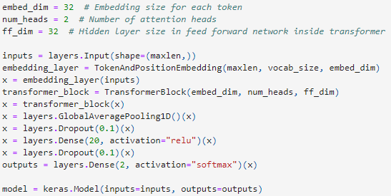
Multi-Head Attention
Paper - 8 times
Notes:
In this slide, the concept of multi-head attention is visually explained. Imagine doing the self-attention process we just saw, not just once, but multiple times simultaneously—each instance called a “head”. The visual at the bottom shows eight separate “Scaled Dot-Product Attention” processes running in parallel. Each of these heads learns different types of relationships between words.
At the top-right, these multiple heads’ results are combined into one larger vector using “Concat” (concatenation), then passed through a final linear layer. This combination allows the model to capture a broader set of patterns and relationships. The Python code snippet on the slide demonstrates how you define this in practice, showing parameters like embedding size and the number of heads explicitly defined (here using Keras).
Detailed Speaker Notes:
• Reiterate: “In the original Transformer, they used 8 heads for multi-head attention.”
• “Paper - 8 times” presumably refers to performing the attention process we described 8 times in parallel.
• So say: “This means the whole attention mechanism isn’t just one set of Q,K,V and one weighted sum – they actually run 8 sets of Q,K,V projections, producing 8 different attention weight matrices and 8 different output sets of weighted sums (one per head). Each of those outputs is a 64-dimensional vector for each word. Then they concatenate those 8 vectors (64*8 = 512) to form the combined output of the multi-head attention layer for each word.”
• You can mention that “8 is an empirical choice: They found 8 heads sufficient. You could do more or fewer, but 8 was a good trade-off.”
• “So effectively, the model has eight different ‘attention lenses’ focusing on different aspects simultaneously.”
• If slide 56 stands alone with that, slide 57 probably continues the explanation of after having 8 heads, what next (they mention “8 Zn results in 8 Z_n, then we concatenate and multiply by weight layer”).
Slide 57: Combining Multi-Head Outputs
High-Level Explanation:
This slide continues: “Multi-Head Attention – Paper - 8 times – this results in 8 Z_n. To solve this we concatenate and multiply by an additional weight layer.”
Meaning: after computing 8 separate outputs (Z) from 8 heads, they join them back together and use a final linear transformation to mix them (because simply concatenating might not itself be the final form, so they apply one more weight matrix to the concatenated vector).
So high level: multi-head outputs are concatenated and then projected through another linear layer (often called WO or output projection) to get the final output of the multi-head attention module with the desired dimension.
Detailed Speaker Notes:
• Explain result of 8 heads: “After each of the 8 heads computes its output for a given word (we have 8 different 64-dim vectors for that word, one from each head), we need to combine them into one 512-dim vector (since the model uses 512 as overall embedding size). So what we do is concatenate those 8 vectors into one long 512-dim vector.”
• But we don’t usually leave it just concatenated raw; we apply another linear transformation: “Yes, the architecture includes a final linear layer (let’s call it W_O for output) that we multiply this concatenated vector by. This linear layer is learned and it can mix the information from all heads. It’s partly there to allow heads to interact or to reduce any bias from how we split dimensions. Also, if we didn’t have it, the model could still linearly combine heads in the next layer, but having it here is convenient.”
• “So essentially:
• Multi-head attention step outputs: [Z_i^(head1); Z_i^(head2); …; Z_i^(head8)] (concatenated).
• Then pass that through W_O (512x512 matrix perhaps) to get the final output vector for the attention sub-layer for word i.”
• Clarify that “to solve this” means to integrate the multi-head outputs: “It results in 8 different output vectors per word – we need to ‘solve’ how to use them. The solution is to join them and apply another learned linear combination.”
• That output (after W_O) is what goes into the next part of the layer (like the Add & Norm or feed-forward next).
• Summarize: “So multi-head attention’s full output is a single vector per word of the same dimension as the input (512, since they typically maintain dimension through layers). The multiple heads gave it richer computation, and W_O brings it back to the required shape and possibly allows heads to influence each other’s combined effect.”
• Now that multi-head attention output is ready, the layer would then do skip connection + normalization (which upcoming slides 58-59 talk about skip and norm).
• So you might say: “Once we have this output of the multi-head attention (for each word), we then add back the original input (skip connection) and do a layer normalization, then pass it to the feed-forward sub-layer. But let’s talk about skip connections and normalization improvements next.”

Slide 57
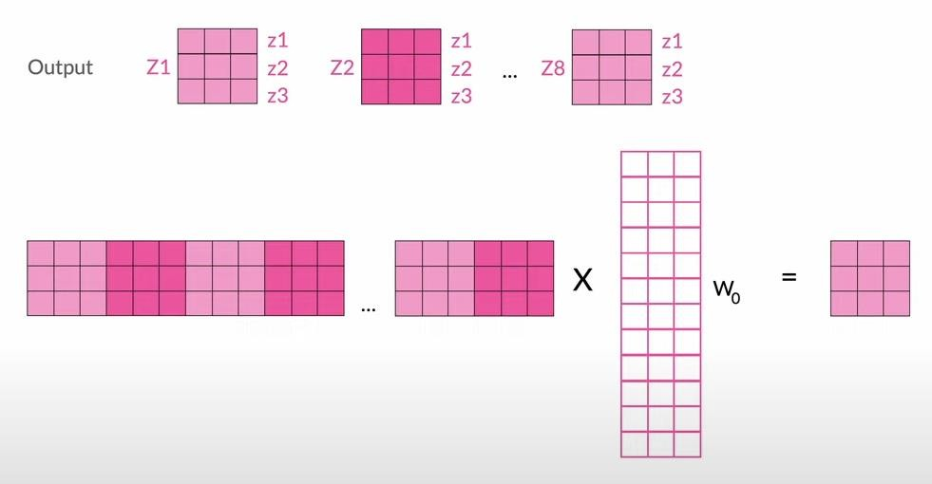
Multi-Head Attention
Paper - 8 times – this results in 8 Zn
To solve this we concatenate and multiple by an additional weight layer.
Notes:
This slide provides a detailed visual explanation of the concatenation step after multiple attention heads produce their results. Each of the eight heads (labelled Z₁, Z₂, … Z₈) gives a separate set of vectors representing different learned relationships. However, this creates multiple outputs, so the model needs to combine them into one unified representation.
The visual shows clearly how the outputs from each head are concatenated (joined together into a single large vector). After concatenation, the combined vector is multiplied by an additional weight matrix W_O, which is learned during training. This multiplication step simplifies the many outputs into one meaningful, cohesive vector, preserving all essential information learned across the heads but making it more manageable for the next stages of the model.
Detailed Speaker Notes:
• Explain Skip Connections (residual connections): “In the transformer (like many modern deep networks), they use skip connections: specifically, after each sub-layer (attention or feed-forward), they add the input of that sub-layer to its output. This is what’s meant by ‘data skips a layer’. So, for example, if x was the input to the multi-head attention sub-layer and y is its output, they do x + y (element-wise addition) as the actual output that goes into the next step (after normalization).”
• Why skip? “Skip connections help with training deeper models. They allow gradients to flow more directly backward (helping to avoid vanishing gradients in a deep stack), and they also let the model preserve some of the original info without distortion, which can be beneficial if a sub-layer only needs to adjust the representation slightly.”
• “Skip layers” plural likely because they do it at multiple points – indeed every sub-layer:
• “They apply this at both the attention sub-layer and the feed-forward sub-layer. So the structure is: input -> [Attention] -> output, then output + input (skip) -> then normalize. Then that goes into feed-forward -> output, then skip-add the original (which was output of attention norm) to that -> then normalize again.”
• It’s called residual connection popularly. It basically turns sub-layer into “input plus a change from input” (residual).
• Now mention Layer Normalization: “Add and Norm” presumably stands for adding skip then doing normalization:
• “Add & Norm” is often labeled in diagrams at each residual addition.
• “After we add the input (skip) to the sub-layer output, we pass it through a Layer Normalization step. LayerNorm normalizes the vector’s components so that they have mean 0 and variance 1 (per layer, per example). This stabilizes and accelerates training by reducing covariate shift. In simpler terms, it ensures the distribution of values stays uniform as it goes through layers, which helps training not get out of whack.”
• The slide likely splits these into two bullet reveals. Slide 58 shows “skip layers”, slide 59 adds “Add and Norm”.
• Possibly slide 58 only had first bullet visible, but it seems they wrote “Add and Norm” partially on slide 58 text as well (the parse had incomplete bullet).
• Anyway:
• Emphasize the synergy: “The combination of residual (skip) connections and layer normalization is key. Residuals ensure the model can easily propagate information and gradients; normalization keeps the scale of activations consistent.”
• Explain how it’s similar to other architectures: “This approach is similar to what’s used in very deep image nets (ResNets) where skip connections allowed them to train 100+ layers. In transformers, it allows stacking 6 or even 12 or more layers without issues.”
• The term “improvements” is apt: these are not the core novelty (attention is), but they are improvements to make the model train well.
• Summarize slide 58 content: “So improvement one: skip connection - data bypasses the sub-layer which helps preserve input info and gradients. Next improvement: ‘Add & Norm’ meaning after adding skip, we normalize.”
• Slide 59 likely just repeats both bullets fully or adds the second bullet explicitly.

Slide 58
Normalization and Skip layers:
Improvements to the model:
Data skips a layer (skip layers)
Add and Norm
.
Notes:
High-Level Explanation:
Slide 59 probably repeats the bullet points fully:
• “Data skips a layer (skip layers)”
• “Add and Norm”
Since the parse showed them repeated with a trailing dot, slide 58 maybe had only the first bullet and slide 59 shows both. There’s likely no new info aside from reinforcing both improvements together.
Detailed Speaker Notes:
• Quickly recap both bullet points together: “Thus, to improve the basic transformer layer, for each sub-layer we:
1. Use a Skip Connection – add the input of the sub-layer to its output.
2. Then apply Layer Normalization to that sum (this is the ‘Add & Norm’ step).
This happens around the multi-head attention sub-layer and again around the feed-forward sub-layer.”
• Possibly mention that the original paper actually did the normalization after addition (some later variants do PreNorm vs PostNorm differently, but original did post-add norm if I recall correctly).
• Now at this point, we’ve described essentially the entire transformer layer:
• Multi-head attention (with pos enc inputs, QKV, etc.)
• Skip + Norm
• Feed-forward
• Skip + Norm
• And we described how multiple layers stack and how encoder/decoder works.
• Slide 60 likely says “Finally:” as seen in parse, possibly summarizing the whole advanced NLP story or concluding remarks.

Slide 59
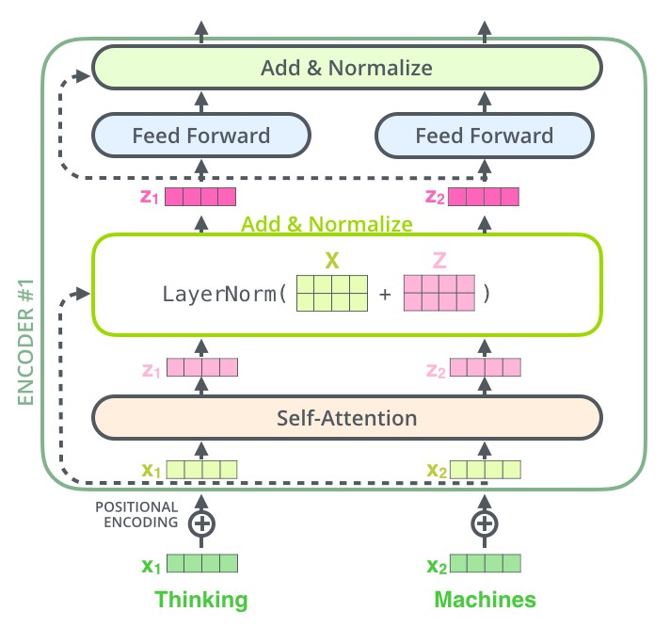
Normalization and Skip layers:
Improvements to the model:
Data skips a layer (skip layers)
Add and Norm
.
Notes:
This slide visually highlights the normalisation and skip (residual) layers, a crucial improvement in transformer architectures. In the diagram, you can see arrows indicating “Add & Norm,” meaning the output from one layer skips forward and is added directly to a later layer’s output before being normalised. The green arrow points explicitly to the “Add & Norm” step following the “Multi-Head Attention” block.
The main reason for these skip layers is to improve the training process, preventing issues like vanishing gradients, where early layers fail to learn effectively. By directly adding input from previous layers, information flows more freely through the network, making training smoother and more stable. Normalisation then ensures these values remain controlled and balanced, helping the model learn consistently and efficiently.

Slide 60

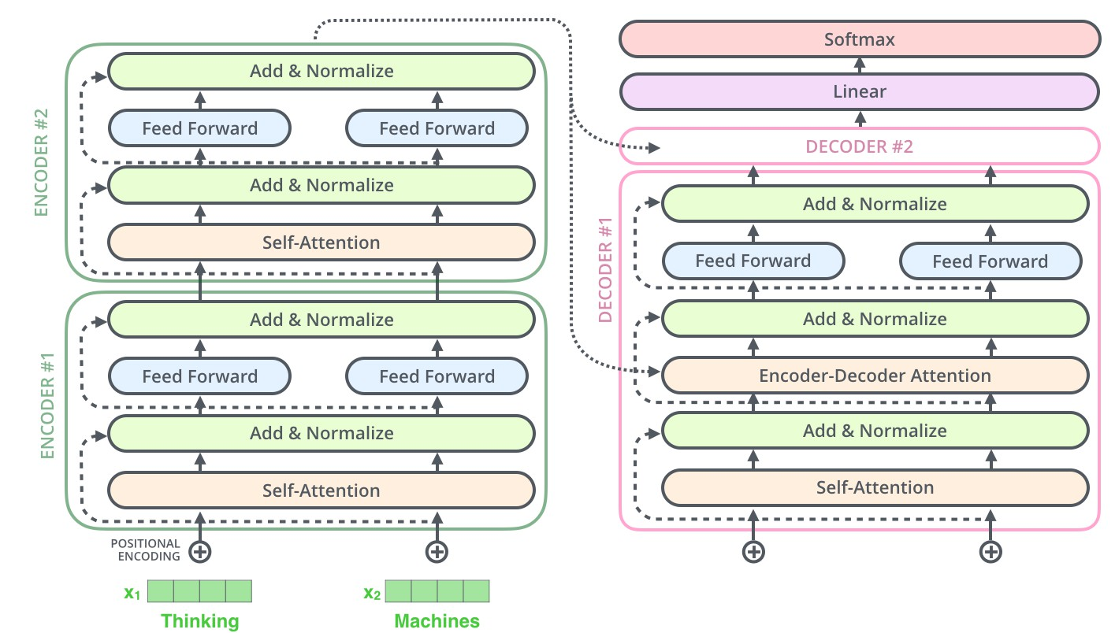
Finally:
Notes:
On this final slide, you see all previous components combined into the complete transformer model. Clearly displayed are multiple layers of “Self-Attention,” “Feed Forward,” and “Add & Normalise,” organised neatly into Encoder and Decoder stacks. The left side (green) shows encoder layers that process and summarise the input data. The middle (pink) shows the decoder layers that generate the output, relying on information from the encoder.
Each encoder and decoder block repeats the attention, feed-forward, and normalisation steps. The final layer uses a “SoftMax” function to produce probabilities for generating the final words or tokens. The smaller diagram to the right summarises the overall transformer structure clearly, with arrows indicating information flow, making it easy to understand how each step contributes to processing language tasks efficiently and accuratly
ely.
1. Towards Autonomous, Multimodal AI Ecosystems
Transformers are evolving from single-task systems into fully autonomous AI agents, capable of self-optimization and operating collaboratively with each other. By 2026, we’re likely to see self-managing AI ecosystems that monitor, diagnose, and resolve problems across domains—from finance and healthcare to smart infrastructure—with minimal human intervention ￼ ￼. These agents will increasingly communicate, negotiate, and work together, creating an AI-driven economy that functions around the clock.
2. Expanding into Multimodal and Real-World Systems
The future lies in multimodal transformers, which seamlessly integrate text, speech, images, sensor data, and more. By 2026–2028, roughly 30 % of models will process multiple data types, enabling AI systems to interpret the world more like humans do—understanding a picture, voice, and text in context . This development will penetrate everything from telemedicine and autonomous vehicles to smart cities and 6G networks ￼.
3. Scaling, Efficiency, and Ethical Alignment
Transformers will scale well beyond current sizes through innovations like Sparse Mixture-of-Experts (MoE) and other efficient architectures, enabling trillion-parameter models that are computationally efficient ￼. At the same time, there’ll be greater emphasis on AI transparency, regulatory alignment, and energy efficiency, as society demands more responsible AI design and usage following hopes to regulate “high-risk” systems ￼.
4. AGI Horizons: 2028 and Beyond
Expert surveys suggest Artificial General Intelligence (AGI)—transformers capable of human-level intelligence—has a >50% chance of emerging between 2040–2050 ￼. But some voices anticipate “major leaps” toward AGI’s early forms closer to 2026–2028 ￼, while others argue for hybrid systems merging symbolic reasoning and neural networks to accelerate progress ￼.
⸻
What might life look like in 2026–2028?
We can expect everyday AI companions—digital agents that handle scheduling, diagnose health metrics, or negotiate with service providers—becoming a common reality ￼. Autonomous systems will oversee utility grids and city infrastructure. People may rely on conversational AI advisors not only for tasks, but also for decision support in financial, legal, or creative domains. AI transformations will reshape job structures, with universal basic income (UBI) gaining traction as routine work becomes automated .
By late 2020s, society will likely see the first generation of proto-AGI systems—transformers exhibiting reasoning, planning, and cross-domain learning capabilities. These systems won’t yet be superintelligent, but their behaviour will challenge current governance models. As a result, ethical AI, oversight agencies, and alignment strategies (like Constitutional AI and inverse RL) will become deeply important areas of research and policy .
Ultimately, by 2028, transformer models will be ubiquitous, deeply integrated into all facets of life: personal assistants, medical diagnosticians, legal analysts, educational tutors, urban AI managers, and maybe even citizen-like AI agents. This proliferation brings both opportunity—to explore human creativity, personal growth, and universal prosperity—and challenge, in ensuring AI remains safe, transparent, equitable, and aligned with human values.
The transformative rise of AI and transformer models invites humanity into an era of profound introspection, raising deep philosophical questions about our identity, purpose, and place in a rapidly changing technological landscape. As we delegate cognitive labour—once seen as uniquely human—to machines capable of thought-like processes, we must confront fundamental questions about what truly defines us. Are we merely biological entities defined by tasks we can perform, or does our essence lie in subjective experiences, creative intuition, and moral reasoning?
Furthermore, as these intelligent systems become integral parts of daily life, society must grapple with new dimensions of trust, responsibility, and ethical stewardship. The merging of human and machine agency prompts a reevaluation of autonomy and free will, challenging us to define clearly the boundaries of decision-making, accountability, and consciousness itself. Our evolving relationship with AI offers not just technological advancement, but an existential opportunity—to re-examine our values, responsibilities, and connections, both with each other and the natural world around us.
Ultimately, the future shaped by transformer models and artificial intelligence is not just about technology; it’s about the kind of humanity we aspire to be. It beckons us to embrace wisdom and humility, ensuring we direct our inventions toward compassion, justice, and collective flourishing. As we step into this new epoch, our greatest challenge and opportunity lie not in harnessing ever more powerful algorithms, but in cultivating the ethical clarity, wisdom, and empathy required to coexist thoughtfully with the intelligent beings we are creating.

Slide 61
Thanks!
Zaur Gouliev
https://www.linkedin.com/in/zaurgouliev/ Email: zaur.gouliev@ucdconnect.ie

